Slide 1
Clinical Case
DEPARTMENT OF INTERNAL MEDICINE
December 7, 2016
PRESENTED BY:
Mark Tuttle, MD
Notes:
DEAL 2933460

Slide 2
History of Present Illness
29 F with a history of seizure disorder, hypertension presents to the ED for evaluation of headache and dyspnea.
Over the last several months, she has been experiencing frontal headaches every few days associated with nausea and palpitations. She has no visual symptoms or photophobia. The headaches generally respond to ibuprofen but have been worsening over the last week.
Today she developed some shortness of breath. She has had no fever, chills, cough, or sick contacts.
Notes:
Kervin (2755289)

Slide 3
Past Medical History
Seizure disorder
Hypertension
Medications
Levonorgestrel/ethinyl estradiol
Labetalol 100mg BID
Ibuprofen 600mg PRN headache
Social History
Smoker: 1 ppd
Occasional EtOH
Not sexually active
Family history
No familial disease

Slide 4
In the ED
VITALS: T 98.0, HR 116, BP 243/127, RR 20, SpO2 94% on RA
GENERAL: Mildly anxious, obese
HEENT: PERRLA
LUNGS: Appears dyspneic. Crackles at bases, diminished breath sounds bilaterally
CARDIAC: Tachycardic, no m/r/g
NEURO: Nonfocal
SKIN: No rashes
Notes:
Thyrotoxicosis
Sympathomimetic use
Secondary hypertension: Pheo, aldo, renovascular
PE
Pre-eclampsia

Slide 5
Hospital course
The patient subsequently develops worsening respiratory distress. Her oxygen saturation drops to 85% on 5L NC.
ABG shows pH 7.51/pCO2 30/pO2 65/HCO3 22
STAT X-ray is obtained
Notes:
Acute respiratory alkalosis: Drop of HCO3 by 2 for every 10 decrease in pCO2
Chronic respiratory alkalosis: Drop of HCO3 by 5 for every 10 decrease in pCO2

Slide 6
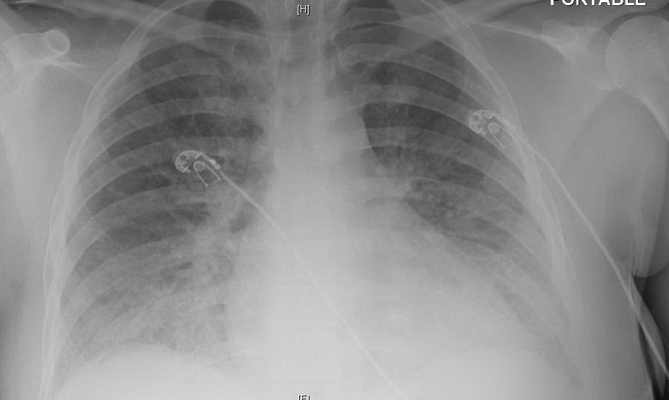
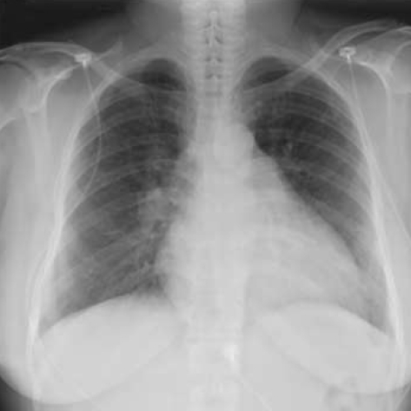
She is started on NIPPV and admitted to the CCU for hypertensive crisis.
Notes:
Moderate pulmonary edema

Slide 7
Initial Labs
9.6
136 | 97 | 20
3.3 | 29 | 1.4
11
86
109
27
LDH: 580
Haptoglobin: <5
Reticulocytes: 7.5%
INR: 1.0
Urine β-HCG: Negative
Toxicology: Negative
ALT: 13
AST: 22
T-bili: 0.8
Alk-Phos: 62
Notes:
8/7/2014

Slide 8
Pair up!
What are your top 3 differential diagnoses?
What would you like to do next to manage this patient?

Slide 9
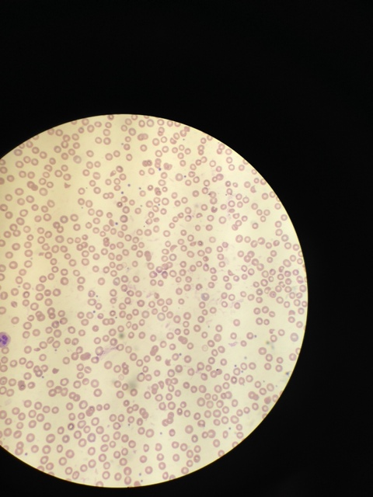
Notes:
Dr. Weinstock,
Could you take us through this blood smear?
Do you think this could be TTP?
RBCs: Normochromic, normocytic. No tear drops. There are 5-6 schistocytes per HPF.
WBCs: PMNs normal. Lymphocytes appear without dyspoeitic features. No blasts.
Platelets: Normal in size, decreased in number.

Slide 10
Thrombotic microangiopathy
(Encompasses TTP & HUS)
Diagnosis
Microangiopathic hemolytic anemia (MAHA)
Thrombocytopenia
Other causes excluded
FAT RN: The classic pentad
Fever
Anemia (microangiopathic hemolytic)
Thrombocytopenia
Renal failure
Neurologic dysfunction
35% of cases present without neurological findings. AKI not predominant in TTP.
Due to mechanical hemolysis
↑ LDH, T-bili
↓ haptoglobin
Schistocytes
Negative Coomb’s Test
Other symptoms
Fever
Neurological symptoms
Renal failure
Scully et al. British Journal of Haematology. 2012.
Notes:
Thrombocytopenia: 10-30k (median)
Scully M, Hunt BJ, Benjamin S, et al. Guidelines on the diagnosis and management of thrombotic thrombocytopenic purpura and other thrombotic microangiopathies. Br J Haematol. 2012;158(3):323-35.
Hemolytic anemia can be: Autoimmune, infectious, mechanical, inherited

Slide 11
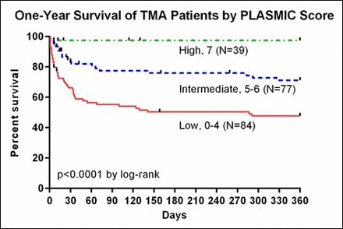
Is it TTP? The Plasmic score
Four individual laboratory parameters (platelet count <30,000/μL, MCV <90fL, creatinine <2.0mg/dL, and INR <1.5), a combined laboratory parameter (evidence for hemolysis based on either a reticulocyte count >2.5%, an indirect bilirubin >2.0 mg/dL, or absent haptoglobin), and two historical features (no active cancer, no history of bone marrow or solid organ transplantation)
One point for each:
Platelet count <30,000 μL
Creatinine < 2.0 mg/dL
MCV < 90 fL
INR < 1.5
Evidence of hemolysis (any)
  Reticulocyte count > 2.5%
  Indirect bilirubin > 2.0 mg/dL
  Absent haptoglobin
No active cancer or history of transplant (solid or BMT)
Proportion ADAMTS13 ≤10%
 |  | Validation
Risk (points) | Derivation (%) | Internal (%) | External (%)
Low (0-4) | 0/84 (0) | 0/22 (0) | 2/47 (4.3)
Intermediate (5-6) | 25/77 (32.4) | 3/15 (20) | 42/74 (56.8)
High (7) | 37/39 (94.9) | 3/3 (100) | 25/26 (96.2)
Bendapudi et al. Blood. 2014
Notes:
Bendapudi, P. K., Li, A., Hamdan, A., Fry, A. M., Uhl, L., Marques, M., Kaufman, R., Stowell, C. P., Dzik, W. S., & Makar, R. S. (2014). Derivation and Prospective Validation of a Predictive Score for the Rapid Diagnosis of Thrombotic Thrombocytopenic Purpura: The Plasmic Score.Blood, 124(21), 231. Accessed December 07, 2016. Retrieved from http://www.bloodjournal.org/content/124/21/231.

Slide 12
Differential of MAHA and thrombocytopenia
Thrombotic thrombocytopenic purpura (TTP)
Hemolytic-Uremic Syndrome (HUS)
Autoimmune hemolytic anemia/Evan’s syndrome
Disseminated intravascular coagulation
Malignant hypertension
Pregnancy: Pre-eclampsia, HELLP, eclampsia
Drugs
Infections: CMV, adenovirus, HSV, HIV
TMA
Not TMA
Notes:
Talk about how some labs can differentiate (ie. coagulation tests, Coomb’s test, etc)
Pre-eclampsia likely due to placental release of fms–like tyrosine kinase which causes diffuse endothelial dysfunction. Maynard SE, Karumanchi SA. Angiogenic factors and preeclampsia. Semin Nephrol. 2011;31(1):33-46.

Slide 13
Pathophysiology of thrombotic microangiopathy
Platelet aggregation
Hemolysis
Ischemia
Insult

Slide 14
Pathophysiology of TTP
Platelet aggregation
Hemolysis
Ischemia
vWF
TTP
↓ ADAMTS13
ADAMTS13
vWF
Notes:
a disintegrin and metalloproteinase with a thrombospondin type 1 motif, member 13
Idiopathic TTP: 94-97% have Anti-ADAMTS13 antibodies
Secondary TTP: hematopoietic stem cell transplantation (HSCT), pregnancy, drug association, other autoimmune diseases, HIV infection, and cancer
- Kremer hovinga JA, Lämmle B. Role of ADAMTS13 in the pathogenesis, diagnosis, and treatment of thrombotic thrombocytopenic purpura. Hematology Am Soc Hematol Educ Program. 2012;2012(1):610-6.
- Kremer hovinga JA, Vesely SK, Terrell DR, Lämmle B, George JN. Survival and relapse in patients with thrombotic thrombocytopenic purpura. Blood. 2010;115(8):1500-11.
VWF is by far the largest protein in the blood with a size ranging from 500-200,000 kDa. For reference, albumin, the next largest protein in serum is 66 kDa
Furlan M. Von Willebrand factor: molecular size and functional activity. Ann Hematol. 1996;72(6):341-8.

Slide 15
Pathophysiology of HUS
Platelet aggregation
Hemolysis
Ischemia
Shiga-toxin
Notes:
Shiga-toxin damages endothelial cells via CD77 (ceramide trihexoside) which induces expression of vWF.
- George JN, Nester CM. Syndromes of thrombotic microangiopathy. N Engl J Med. 2014;371(7):654-66.

Slide 16
Thrombotic microangiopathy (TMA) subtypes
ADAMTS13-medated (Thrombotic thrombocytopenic purpura)
  Predilection for neurological symptoms
Shiga-toxin mediated (Hemolytic-Uremic Syndrome)
  Predilection for acute kidney injury
  Preceding history of diarrhea
Drug-mediated
Inherited
Quinine
Quetiapine
Gemcitabine
Simvastatin
Interferon
Calcineurin inhibitors
Strong
Weak
George and Nester. NEJM. 2014.
Notes:
Strongest evidence for drug-induced comes from quinine, where drug antibodies caused endothelial activation. Strong evidence for quetiapine and gemcitabine where repeated exposure resulted in TTP. (Quinine is a steroisomer of quinine)
- George JN, Nester CM. Syndromes of thrombotic microangiopathy. N Engl J Med. 2014;371(7):654-66.
ADAMTS13 activity usually normal in all but TTP
- Peyvandi F, Palla R, Lotta LA, Mackie I, Scully MA, Machin SJ. ADAMTS-13 assays in thrombotic thrombocytopenic purpura. J Thromb Haemost. 2010;8(4):631-40.

Slide 17
Interval summary
29 year old woman presents with headache and dyspnea.
Found to have:
Severe hypertension (247/135)
Pulmonary edema
Microangiopathic hemolytic anemia
Thrombocytopenia
Acute kidney injury
ADAMTS13 is pending
Notes:
Dr. Weinstock,
Given that the ADAMSTS13 assay is a send-out test that won’t return for several days, would you treat this patient empirically? How does one treat TTP?
ADAMTS13 activity is a send-out lab at BIDMC and WX, takes 2-3 days to return. Works by adding patient’s serum to solution of vWF and detecting the rate of vWF cleavage. Activity more useful than simply an antibody since sometimes (rarely), antibodies present without affecting activity.
- Peyvandi F, Palla R, Lotta LA, Mackie I, Scully MA, Machin SJ. ADAMTS-13 assays in thrombotic thrombocytopenic purpura. J Thromb Haemost. 2010;8(4):631-40.

Slide 18
Prognosis of ADAMTS13-induced TMA (TTP)
Mortality is 90% if untreated
Improves to 10-20% with plasmapheresis
Scully et al. British Journal of Haematology. 2012.
Notes:
Scully M, Hunt BJ, Benjamin S, et al. Guidelines on the diagnosis and management of thrombotic thrombocytopenic purpura and other thrombotic microangiopathies. Br J Haematol. 2012;158(3):323-35.

Slide 19
Management of ADAMTS13-induced TMA
Plasma exchange until platelets > 150,000
  Give FFP if there is delay in plasma exchange
Splenectomy is of limited benefit
Rituximab can be considered in relapsing cases
Scully et al. British Journal of Haematology. 2012.
Notes:
Scully M, Hunt BJ, Benjamin S, et al. Guidelines on the diagnosis and management of thrombotic thrombocytopenic purpura and other thrombotic microangiopathies. Br J Haematol. 2012;158(3):323-35.
RCT of giving FFP versus plasma exchange: Plasma exchange better. Why might plasma exchange be better mechanistically? (Because it removes the inhibitor as well as replenishes ADAMTS13.)
Rock GA, Shumak KH, Buskard NA, et al. Comparison of plasma exchange with plasma infusion in the treatment of thrombotic thrombocytopenic purpura. Canadian Apheresis Study Group. N Engl J Med. 1991;325(6):393-7.

Slide 20
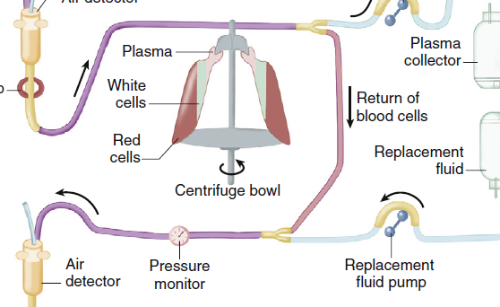
Plasmapheresis
Indications
TTP
Goodpasture’s
RPGN
Renal tx rejection
Cryoglobulinemia
SLE
Brenner and Rector's the Kidney , Ninth Edition

Slide 21
Clinical course
Her blood pressure is controlled
She is started on plasmapheresis and her platelets normalize in several days
ADAMTS13 Activity: 74%
(normal range > 67%)

Slide 22
Outpatient Course
Upon discharge she is started on:
  Labetalol 400mg TID
  Hydrochlorothiazide 25mg QD
Her oral contraceptive is stopped in favor of an IUD.
Smoking cessation is encouraged.
Blood pressure becomes better controlled.
She is referred to endocrinology.

Slide 23
Secondary Hypertension Work-up
Adrenocortical Evaluation
Parameter | Value | Normal Range
Plasma Renin Activity | 6.33 | 0.25-5.82 ng/mL/h
Aldosterone | 1 | 3-16 ng/dL (supine)
Renal ultrasound: No renal artery stenosis.
CT Abdomen: No masses.
TTE: Mild LVH, otherwise normal.
24-hour Urine Metanephrines
Parameter | Value | Normal Range
Metanephrine | 102 | 36-190 mcg/24 hr
Normetanephrine | 487 | 35-482 mcg/24 hr
Total Metanephrines | 589 | 115-695 mcg/24 hr
Serum Metanephrines
Parameter | Value | Normal Range
Free Metanephrines | 0.21 | <0.5 nmol/L
Free Normetanephrines | 1.6 | <0.9 nmol/L
Notes:
Great-Aunt had pheochromocytoma
Mother had HTN at 35
“A four fold elevation of urinary normetanephrines is extremely likely to be due to a tumor, while a four fold elevation of urinary metanephrines is highly suggestive, but not diagnostic of the tumor. Measurement of plasma Metanephrines and Chromogranin A is recommended for confirmation.”

Slide 24
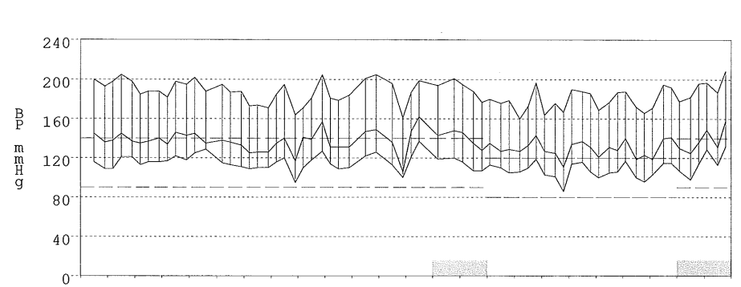
Ambulatory Blood Pressure Monitor

Slide 25
Evaluation Continues
Currently taking:
  Carvedilol 25mg BID
  Hydralazine 25mg TID
  Hydrochlorothiazide 25mg QD
  Clonidine 0.1mg QD

Slide 26
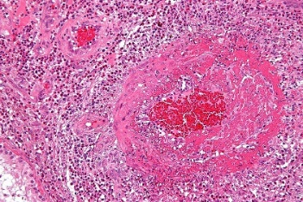
Pathophysiology:
Hypertension begets hypertension
Critical threshold
OR
Abrupt rise in BP
Pressure natriuresis
↑ blood pressure
Endothelial damage
Hypovolemia
MAHA
Fibrinoid necross
↑ RAAS
J Am Soc Nephrol. 1998
Tissue ischemia
Notes:
Kitiyakara C, Guzman NJ. Malignant hypertension and hypertensive emergencies. J Am Soc Nephrol. 1998;9(1):133-42.
Fibrinoid because turns pink on H&E stain (like fibrin) but more than just fibrin there. Usually seen in immunologically mediated conditions of vasculitis/complement deposition.

Slide 27
Learning points
Thrombotic microangiopathy (TMA) is characterized by MAHA, thrombocytopenia without obvious cause
Reduced ADAMTS13 activity is the mediator of TTP, but is a send-out lab
TTP is highly fatal if left untreated

