Slide 1




Pulmonary Case 1
Mark Tuttle, MD
Monday, September 19, 2016

Slide 2
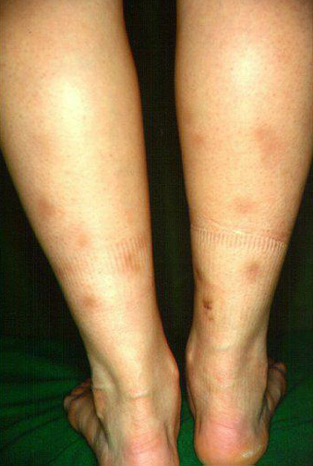
Mini-case
51 ♀ presents to your clinic with the complaint of rash. She developed these tender, warm nodules on her bilateral calves over the last month.
Describe what you see.
What is your diagnosis?
Notes:
Tender, warm nodules, present for the last 2-3 weeks.

Slide 3
Erythema Nodosum: Etiologies
Cribier et al. International Journal of Dermatology. 1998.
Notes:
EN and hilar adenopathy: Sarcoidosis, TB, histoplasmosis
EN and GI symptoms: IBD, Bechets, Whipple’s Disease
Cribier B, Caille A, Heid E, Grosshans E. Erythema nodosum and associated diseases. A study of 129 cases. Int J Dermatol. 1998;37(9):667-72.

Slide 4
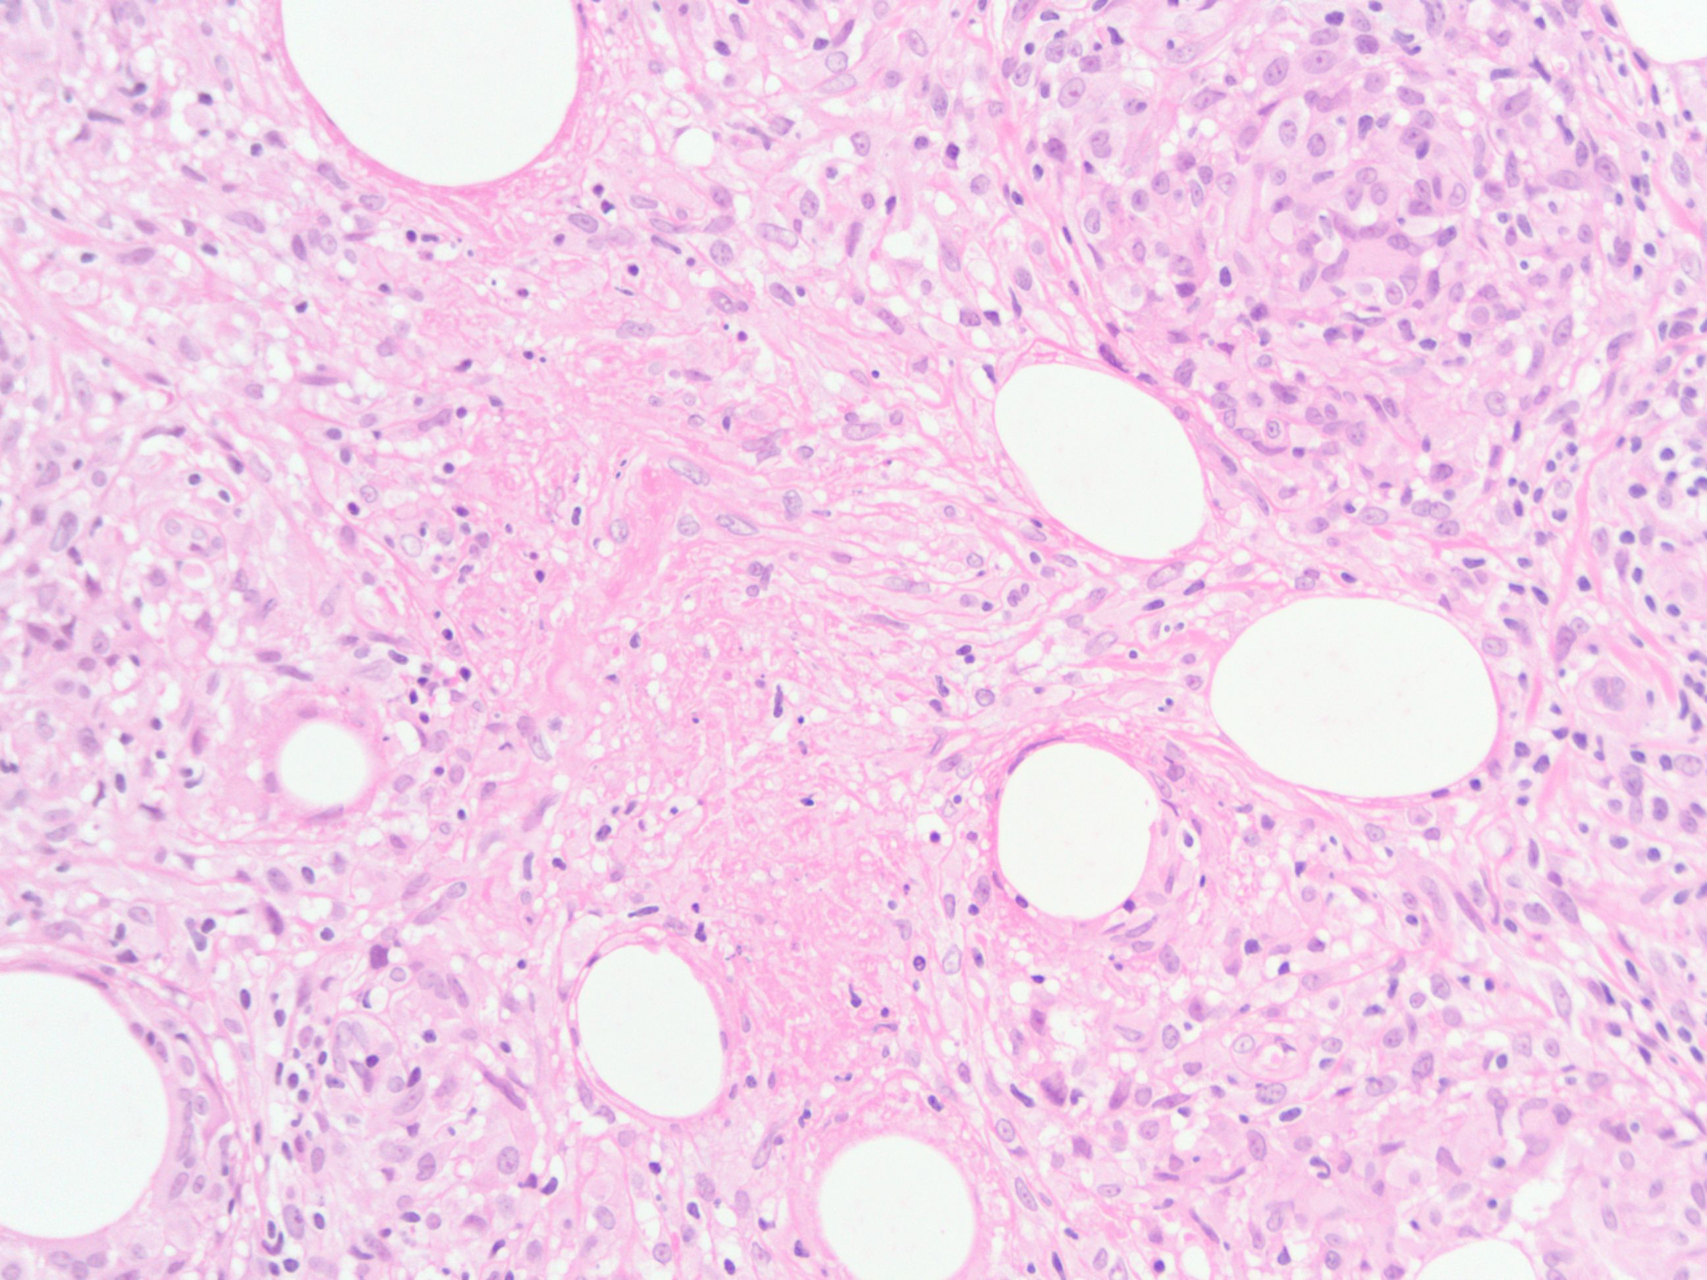
Pathology Report
Septal panniculitis with mixed cellular infiltrate of lymphocytes, histiocytes, giant cells, and occasional eosinophils Neutrophilic vasculitic infiltrate This specimen consistent with erythema induratum
Notes:
http://www.dermpedia.org/dermpedia-textbook/erythema-induratum

Slide 5
Erythema Nodosum vs. Induratum
Erythema Nodosum
Erythema Induratum
Histology
  Septal panniculitis
  No vasculitis
  No ulceration
Treatment
  Treat underlying cause
  NSAIDs
  Colchicine
Histology
  Septal panniculitis
  Neutrophilic vasculitis
  Ulceration
Treatment
  Treat underlying cause
  Dapsone
Notes:
http://www.dermnetnz.org/pathology/erythema-nodosum-path.htm
Gilchrist H, Patterson JW. Erythema nodosum and erythema induratum (nodular vasculitis): diagnosis and management. Dermatol Ther. 2010;23(4):320-7.l

Slide 6
Erythema Induratum: Etiologies
Segura et al. Journal of the American Academy of Dermatology. 2008.
Notes:
Segura S, Pujol RM, Trindade F, Requena L. Vasculitis in erythema induratum of Bazin: a histopathologic study of 101 biopsy specimens from 86 patients. J Am Acad Dermatol. 2008;59(5):839-51.

Slide 7
History of present illness
51 ♀ presents with dyspnea. For the past 1.5 weeks she has been feeling mildly short of breath. She works as an RN and decided to check her own O₂ sat and found it was 88% on room air, so she came to your office to be evaluated.
Review of systems:
Recently diagnosed with erythema induratum by her dermatologist

Slide 8
Past Medical History:
Erythema induratum
Melanoma (stage IIIA), treated with interferon, lymph node dissection
Asthma
Grave’s Disease s/p radioactive iodine ablation
Nephrolithiasis
Allergies:
NKDA
Social History:
Occupation: Works as an RN
Tobacco: Never.
Alcohol: 2-3 glasses of wine per week.
Illicits: Never.
Family History:
No history of familial disease

Slide 9
Medications
Dapsone 100mg QD
Levothyroxine Sodium 88 mcg QD
Vitamin D 1000 U QD

Slide 10
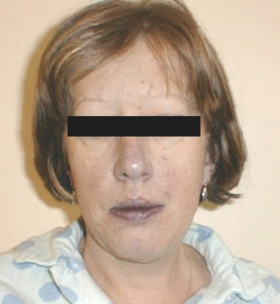
Physical Examination
T 98.7 F HR 92 BP 123/78 RR 12
SpO₂ 89% on room air at rest
SpO₂ 88% with ambulation
SpO₂ 93% on 3L nasal cannula
General: Appears well.
HEENT: Lips dusky in appearance
Chest: Clear throughout. No accessory muscle use.
Heart: RRR, no m/r/g
Extremities: Pitting edema of the left leg to the mid calf. Healed surgical scar on the left. There are palpable tender nodules on her bilateral calves.
Notes:
http://int-prop.lf2.cuni.cz/zof/avysetreni/ahlavakrk.htm
Changed HR

Slide 11
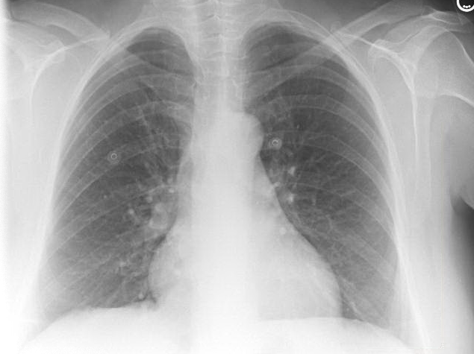
Impression
No acute intrathoracic process

Slide 12
Labs
Baseline 13
11.4
135 | 100 | 16
4.2 | 24 | 0.7
Ca: 9.1
Mg: 2.0
P: 3.8
5.5
244
33
91% PMN, 2% lymph, 6.5% mono
MCV 90, MCHC 33
Liver Function Tests: ALT 27, AST 26, LDH 299, T-bili 2.2, D-bili 0.4
Lactate: 3.0
Hemolysis: Reticulocytes 3.8%, haptoglobin <5, D-dimer 363 (<500 is normal)
Blood gases: 7.42 / 35 / 81, 7.41 / 43 / 155 Calc SpO2 100%
MetHb 8%
LENIs: Negative for DVT

Slide 13
Labs?

Slide 14
Pair up!
51 ♀ with a history of melanoma, Grave’s disease, recent diagnosis of erythema induratum presents with progressive hypoxia over the last 1.5 weeks
T 98.7 F HR 92 BP123/78 RR 12 SpO2 89% RA
What are your top 3 differential diagnoses for the cause of hypoxemia?
What are your next steps in management?

Slide 15
Gas Exchange
P_{A}O₂
Alveolus
P_{a}O₂
Blood
Vessel
S_{a}O₂
Notes:
7.41 / 43 / 155
PAO2=FIO2(700)-1.2(PaCO2) = 0.3*700 – 1.2*43 = 160
FIO2 estimation = 21 + (Nasal_cannula_O2 * 3)

Slide 16
Hemoglobin dissociation curve
Left Shift:
↓ Temperature
↓ 2,3 DPG
↓ H+
COHb
Right Shift:
↑ Temperature
↑ 2,3 DPG
↑ H+
Notes:
Left shift: decreased temp, decreased 2,3-DPG, decreased H+, CO
Right shift: increased temp, increased 2-3-DPG, increased H+

Slide 17
Co-oximetry
Oxyhemoglobin: 90%
Methemoglobin: 8%
Carboxyhemoglobin: 0%

Slide 18
Pulse Oximetry
SpO2 determined by ratio of red/infrared
Low R/IR → high SpO2
High R/IR → low SpO2
660 nm (red)
940 nm (infrared)
MetHb
OxyHb
DeoxyHb
COHb
Adapted from: Konig and Dolinski. Chest. 2003.
Notes:
R/IR of 0.5: 100% SpO₂, 1.0: 82% SpO₂, 2.0: 0% SpO₂
MetHb: At low MetHb % of blood, gives falsely low SpO2, SaO2 may or may not be low
At higher Met Hb % of blood, gives falsely elevated SpO2 readings. Approaches plateau 85%.
CoHb: Gives falsely elevated SpO2 at all CoHb % of blood levels
König MW, Dolinski SY. A 74-year-old woman with desaturation following surgery. Co-oximetry is the first step in making the diagnosis of dyshemoglobinemia. Chest. 2003;123(2):613-6.

Slide 19
Signs and Symptoms of MetHb
% MetHb | Symptoms
10% | None
10-20% | Cyanotic skin discoloration
20-30% | Anxiety, lightheadedness, headache
30-50% | Confusion, tachypnea, tachycardia
50-70% | Coma, seizures, arrhythmia, acidosis
>70% | Death
Wright et al. Annals of Emergency Medicine. 1999.
Signs
Hemolysis
Bite cells and Heinz bodies on blood smear
Notes:
Wright RO, Lewander WJ, Woolf AD. Methemoglobinemia: etiology, pharmacology, and clinical management. Ann Emerg Med. 1999;34:646-56

Slide 20
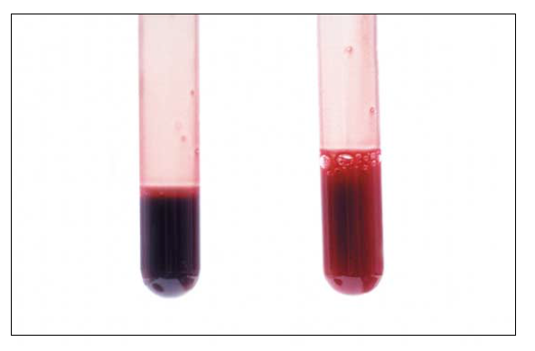
MetHb
OxyHb
Donnelly. TheNew England Journal of Medicine. 2000.

Slide 21
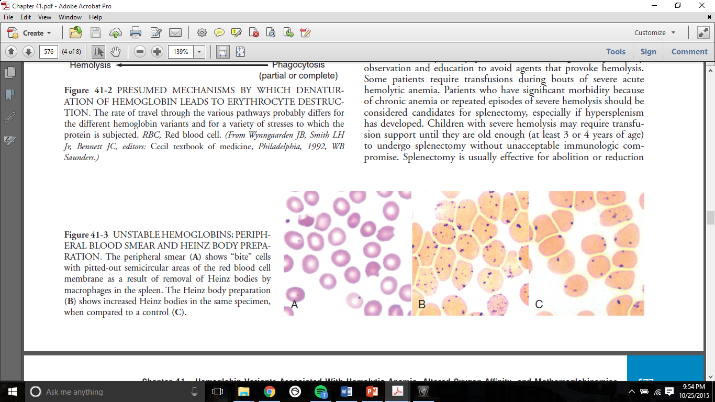
Heinz Prep
Blood smear
Notes:
Bite cells from macrophages removing abnormal Hb
Heinz bodies, showing precipitated hemoglobin
Chapter 41: HEMOGLOBIN VARIANTS ASSOCIATED WITH HEMOLYTIC ANEMIA, ALTERED OXYGEN AFFINITY, AND METHEMOGLOBINEMIAS. Edward Benz Hematology: Basic Principles and Practice

Slide 22
Methemoglobinemia
Fe³⁺
Fe²⁺
NADH
Cytochrome B5 reductase
NAD⁺
NADPH
NADPH MetHb reductase
NADP⁺

Slide 23
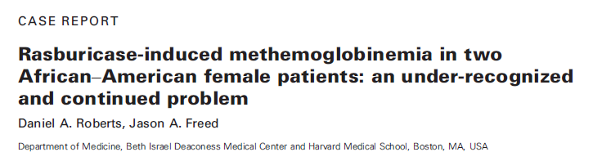
Methemoglobinemia
Underlying cause
Dapsone (most common)
Topical anesthetic (common, most severe)
Nitrates
Anti-epileptics (phenytoin, valproate)

Slide 24
Treatment of MetHb
Proven therapies
  Methylene blue (with dextrose)
  Hyperbaric oxygen
  Exchange transfusion
Experimental therapies
  N-acetylcysteine (works in vivo)
  Cimetidine (works in chronic dapsone metHb)
  Ketoconazole
Rehman. Western Journal of Medicine. 2001.
Notes:
Rehman HU. Methemoglobinemia. West J Med. 2001;175(3):193-6.

Slide 25
Should we give her methylene blue?

Slide 26
Methemoglobinemia
Fe³⁺
Fe²⁺
NADH
Cytochrome B5 reductase
NAD⁺
NADPH
NADPH MetHb reductase
NADP⁺
G6PD
Pentose phosphate pathway
Notes:
Methylene blue oxidizes NADPH to NADP+, but in the absence of NADPH, it oxidizes Fe2 to Fe3
https://www.pharmgkb.org/pathway/PA165980834

Slide 27
Learning points
Erythema induratum mimics erythema nodosum, but is associated with TB and cutaneous vasculitis
Suspect a dyshemoglobinemia (MetHb, COHb, SulfaHb) when there is a “saturation gap” between measured SpO2 and ABG-calculated SpO2
Mild methemoglobinemia can be observed
Severe, methemoglobinemia should be treated with methylene blue, but take caution in G6PD deficiency

