Slide 1
Friday Imaging Case Conference
DIVISION OF CARDIOLOGY
May 25, 2017
PRESENTED BY:
Mark Tuttle, MD
Notes:
Belenky 0827623

Slide 2
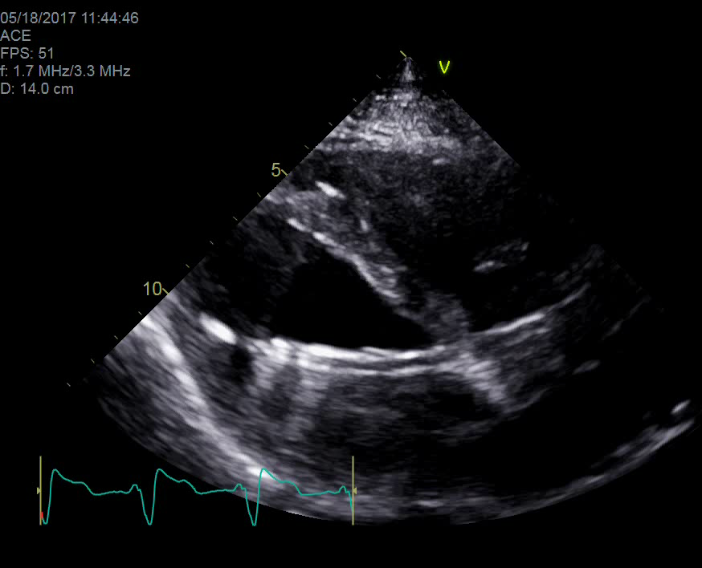
Describe the positioning of this Impella.
Optimally positioned
Too deep.
Encroaching on papillary msucles
Too shallow.
Extracardiac.

Slide 3
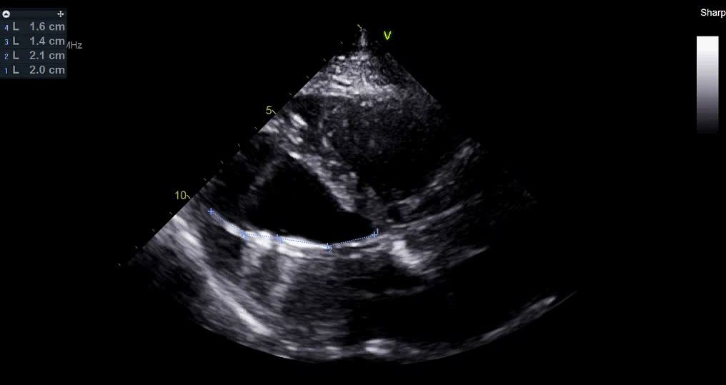
The Impella is too far below the aortic valve.

Slide 4
Optimal positioning of an Impella
Inlet 3.5 cm below aortic valve
Not encroaching on papillary muscles
3.5cm
Abiomed, Inc. Impella Instructions for Use (USA)
Notes:
Abiomed. Impella Instructions for Use and Clinical Reference Manual (USA)
http://www.abiomed.com/impella/impella-25

Slide 5
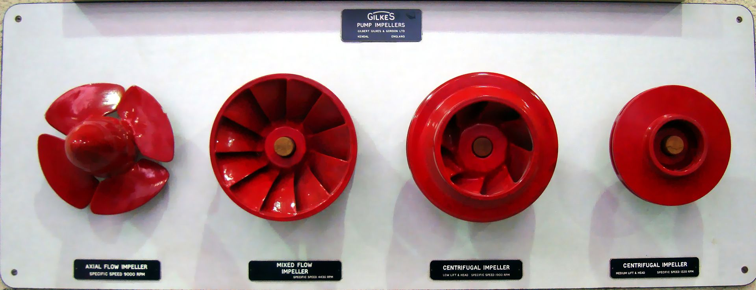
Impellers
en.wikipedia.org/wiki/Impeller

Slide 6

abiomed.com/impella

Slide 7
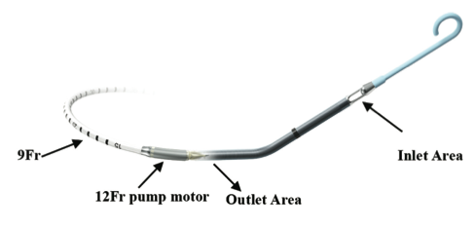
Impella Review
Abiomed, Inc. Impella Instructions for Use (USA)

Slide 8
Positioning by color Doppler
Correct
Incorrect
Abiomed, Inc. Impella Instructions for Use (USA)

Slide 9
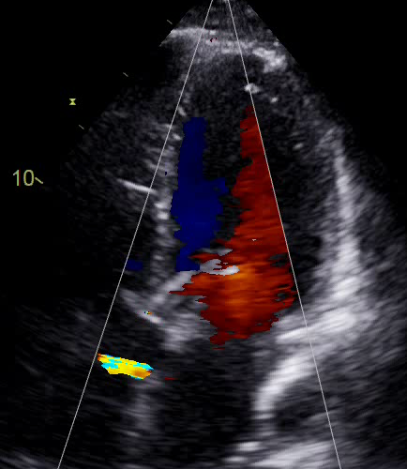
Does the color Doppler indicate correct positioning?
Yes.
No.
Indeterminate.

Slide 10
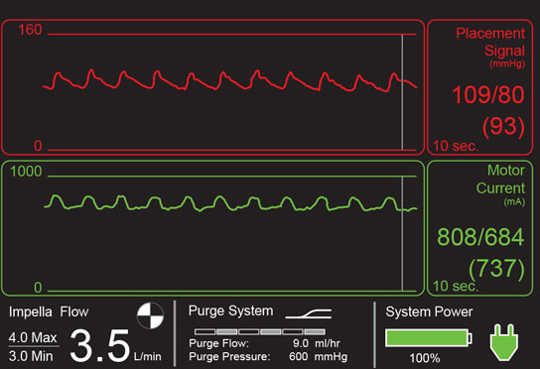
Other clues to malpositioning
Pressure tracing from the Impella outflow
→ Should look like an aortic pressure waveform
Energy intake of motor varies with motor speed and pressure difference
→ Should by pulsatile
Abiomed, Inc. Impella Instructions for Use (USA)
Notes:
Motor current is a measure of the energy intake of the Impella® Catheter motor. The energy intake varies with motor speed and the pressure difference between the inlet and outlet areas of the cannula. Motor current (see Figure 4.4) provides information about the catheter position relative to the aortic valve. When the Impella® Catheter is positioned correctly, with the inlet area in the ventricle and the outlet area in the aorta, the motor current is pulsatile because the pressure difference between the inlet and outlet areas changes with the cardiac cycle. When the inlet and outlet areas are on the same side of the aortic valve, the motor current will be dampened or flat because there is little or no pressure difference between the inlet and outlet areas.

Slide 11
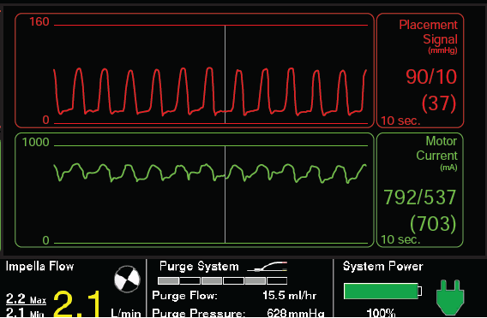
How is this Impella positioned?
Ventricular waveform
Outflow is inside LV
Optimally positioned.
Too deep in LV.
Too shallow in aorta.
Tangled in pap muscles.
Abiomed, Inc. Impella Instructions for Use (USA)
Notes:
Although inflow and outflow are within LV, motor current is not a flatline because there is still some intrinsic pulsatility of LV
IF A VENTRICULAR WAVEFORM IS DISPLAYED (from manual):
Pull the catheter back until an aortic waveform is present on the placement screen.
When the aortic waveform is present, pull the catheter back an additional 4 cm.

Slide 12
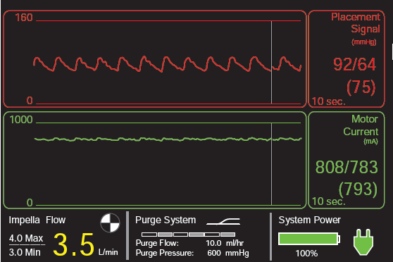
How is this Impella positioned?
Aortic waveform
Outflow is outside LV
Optimally positioned.
Too deep in LV.
Too shallow in aorta.
Tangled in pap muscles.
Flat motor current
No pulsatility – no gradient between inflow and outflow
Abiomed, Inc. Impella Instructions for Use (USA)
Notes:
Although inflow and outflow are within LV, motor current is not a flatline because there is still some intrinsic pulsatility of LV
IF A VENTRICULAR WAVEFORM IS DISPLAYED (from manual):
Pull the catheter back until an aortic waveform is present on the placement screen.
When the aortic waveform is present, pull the catheter back an additional 4 cm.

Slide 13
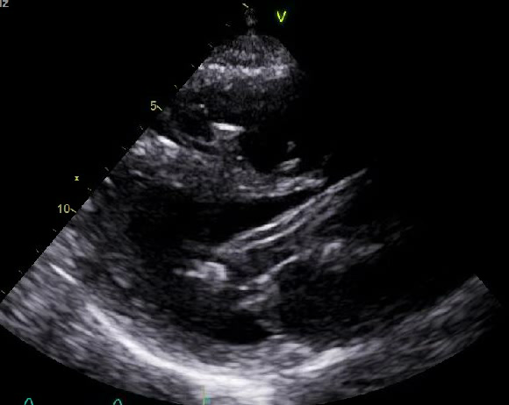
Optimally-positioned Impella

Slide 14
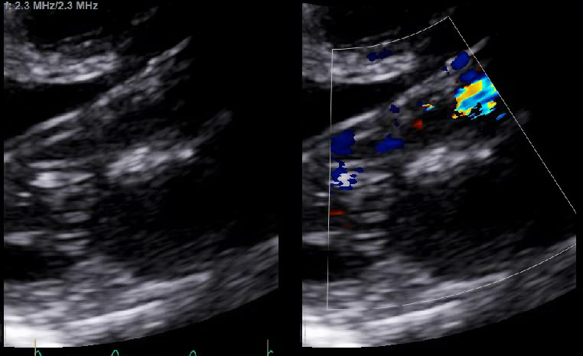
Optimally-positioned Impella

Slide 15
Impella 2.5 Flow Rates
P-level | Flow Rate (L/min) | RPM
P-0 | 0.0 | 0
P-1 | 0.0-1.1 | 25,000
P-2 | 0.8-1.5 | 35,000
P-3 | 1.1-1.7 | 38,000
P-4 | 1.3-1.8 | 40,000
P-5 | 1.5-1.9 | 43,000
P-6 | 1.7-2.1 | 45,000
P-7 | 1.8-2.2 | 47,000
P-8 | 2.1-2.4 | 50,000
BOOST | 2.1-2.5 | 51000
Abiomed, Inc. Impella Instructions for Use (USA)

