Slide 1




Cardiology Case 2
Mark Tuttle, MD
Sunday, September 18, 2016
Notes:
Beta Blocker Toxicity

Slide 2
History of present illness
67 year ♂ with diabetes mellitus, cerebrovascular disease, and atrial flutter presents with nausea, nonbloody/bilious vomiting, and lightheadedness.
Review of systems:
Negative for sick contacts
Negative for fever, chills

Slide 3
Past Medical History:
Cerebrovascular disease
Pulmonary embolism
Diabetes mellitus, type 2
Hypertension
PTSD
Bipolar disorder
Allergies:
NKDA
Social History:
Occupation: Retired postal worker
Tobacco: Never smoker
Alcohol: Quit 20 years ago
Illicits: Denies
Family History:
No history of familial disease

Slide 4
Medications
Aspirin 81mg QD
Amlodipine 10mg QD
Atenolol 100mg BID
Atorvastatin 80mg QD
Hydrochlorothiazide 50mg QD
Lisinopril 40mg QD
Metformin 500mg BID
Pioglitazone 45mg QD
Rivaroxaban 15mg BID
NPH 99 U BID
Insulin aspart 15 U QAC
Fluoxetine 20mg QD
Terazosin 5mg QD
Notes:
Pioglitazone selectively stimulates the nuclear receptor peroxisome proliferator-activated receptor gamma (PPAR-γ) and to a lesser extent PPAR-α. It modulates the transcription of the insulin-sensitive genes involved in the control of glucose and lipid metabolism in the muscle, adipose tissue, and the liver.

Slide 5
Physical Examination
BP 80/40
1L IVF
T 97.2 F HR 51
General: Obese, mildly diaphoretic
Chest: Decreased breath sounds
Heart: Distant heart sounds. Normal S₁ & S₂
Abdomen: Protuberant, soft, nontender
Extremities: 3+ edema bilaterally to knees
Neurological: Alert & oriented x 3
BP 94/48
Notes:
Changed HR from 58 -> 51

Slide 6
Labs
11.2
136 | 104 | 39
4.2 | 24 | 2.1
Ca: 9.5
Mg: 1.8
P: 3.1
8
263
58
35
73% PMN, 16% lymph, 8% mono, 2% eos
MCV 91
Baseline 1.1
Liver Function: ALT 23, AST: 15, T-bili 0.6, Alk-Phos 69, Albumin 3.2
Cardiac Biomarkers: CK: 77, Troponin-I: 0.02
Coagulation: INR 1.4
Lactate: 1.4
Cortisol: 14 (8am)
HbA1c: 8.1%
Urinalysis: Yellow, specific gravity 1.016, pH 5.0, protein 30, Negative glucose, ketones, large blood, leuk. esterase, 11 WBCs, >164 RBCs

Slide 7
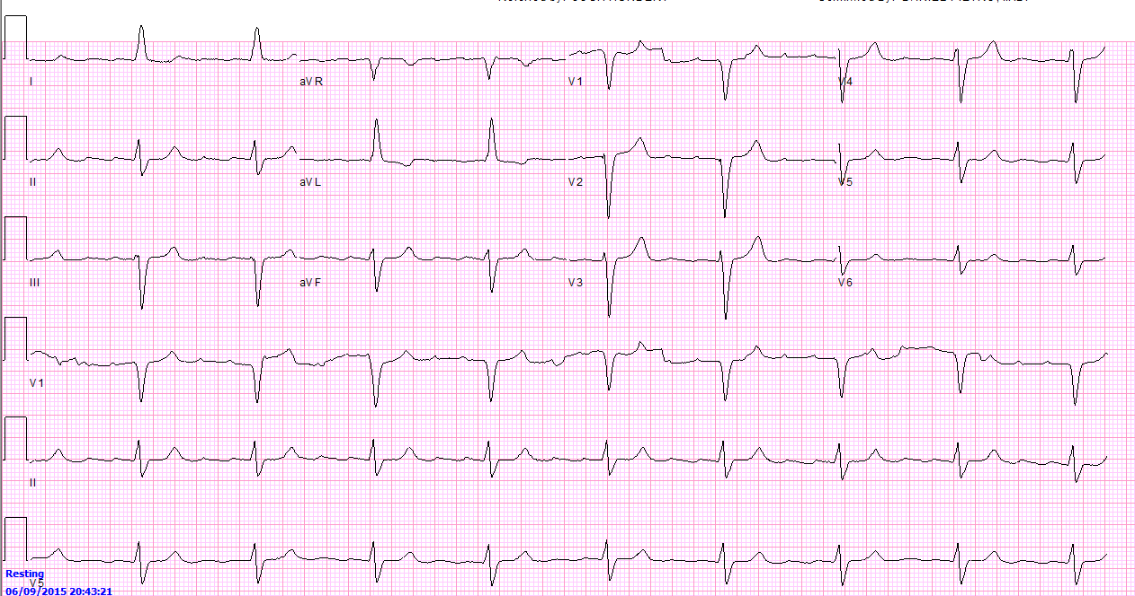

Electrocardiogram
Notes:
Probably atrial flutter with 4:1 block

Slide 8
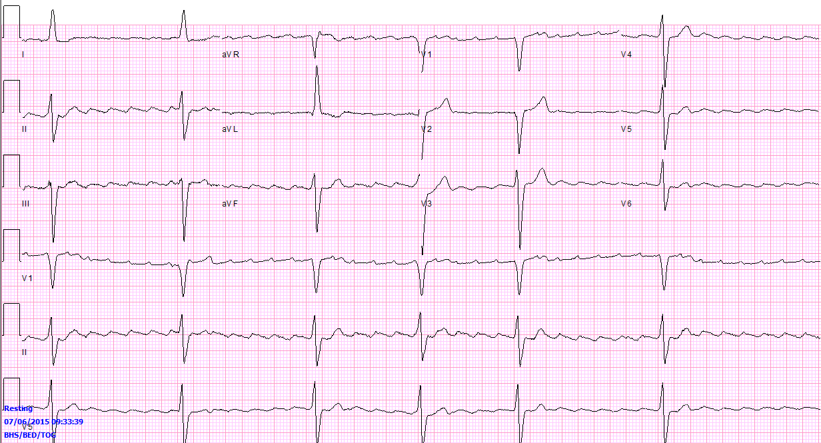
Electrocardiogram
Notes:
Atrial flutter with variable block

Slide 9
Fingerstick glucose trend
D5 NS @ 250cc/hr
Orange Juice
Bolus
Notes:
Gets started on D5 NS at 250 / hr

Slide 10
Differential Diagnosis
Bradycardia
Increased vagal tone Fibrosis of AVN Ischemia Myocarditis/infiltrative Lyme carditis Drugs Procedures
Hypotension
Hypovolemic Cardiogenic Septic Distributive
Hypoglycemia
Drugs Liver failure Hormone deficiency

Slide 11
Team Up!
Team 1: Make your case that this patient has beta blocker toxicity.
Team 2: Make the case that this patient does NOT have beta blocker toxicity.

Slide 12
β-blocker level?
Is a send-out lab at most institutions
Blood levels (of metoprolol) do not correlate well with toxicity
  One patient had a metoprolol level of 7,140 ng/mL and was asymptomatic
  Another patient had a metoprolol level of 648 ng/mL and was in shock with prolonged PR interval, lethargy, hypotension
Love. American Journal of Emergency Medicine. 1994.
Notes:
Love JN. Beta-blocker toxicity: a clinical diagnosis. Am J Emerg Med. 1994;12(3):356-7.

Slide 13
Manifestations of β-blocker Toxicity
Hypotension
Arrhythmia
  Bradycardia: Can be a late manifestation
    Sinus node dysfunction
    Heart block
    AV delay (most common)
  QRS prolongation: With beta blockers that have “membrane stabilization” effects (propranolol)
  QT prolongation: Suggests sotalol
Seizures: Suggests lipophilic beta blocker (ex. propanolol)
Hypoglyemia: Distinguishes from CCB toxicity which causes hyperglycemia
DeMott et al. Chapter 3: Overdose of Cardiotoxic Drugs. Noncoronary Disease.
Notes:
DeMott et al. Chapter 3: Overdose of Cardiotoxic Drugs. Noncoronary Disease: Diagnosis and Management

Slide 14
Pharmacology of β-blockers
Hepatic metabolism | Renal metabolism
Propanolol Carvedilol Metoprolol | Atenolol Nadolol Sotalol
Haeusler. Journal of Cardiovascular Pharmacology. 1990.
Notes:
Haeusler G. Pharmacology of beta-blockers: classical aspects and recent developments. J Cardiovasc Pharmacol. 1990;16 Suppl 5:S1-9.

Slide 15
Fatal β-Blockers
Love et al. Journal of Toxicology & Clinical Toxicology. 1997.
Notes:
From 1985-1995, the American Association of Poison Control Centers collected data on beta blocker toxicity. Found 52,156 instances and 164 resulted in death (0.314%)
Love JN, Litovitz TL, Howell JM, Clancy C. Characterization of fatal beta blocker ingestion: a review of the American Association of Poison Control Centers data from 1985 to 1995. J Toxicol Clin Toxicol. 1997;35(4):353-9.

Slide 16
Treatment of β-blocker toxicity?

Slide 17
Adrenergic Receptors
β₁
_{Glucagon}
cAMP
PDE₃
PKA
RyR
Calcium effects
Inotropy ↑ Chronotropy ↑ Lusitropy ↑
Ca²⁺
Sarcoplasmic Reticulum
Notes:
http://www.intechopen.com/source/html/41316/media/image1.png
http://bme.virginia.edu/saucerman/images/bARsignaling300.jpg
Lusitropy: myocardial relaxation
UpToDate:
Glucagon: 5 mg intravenously is administered over one minute; if there is no increase in pulse or blood pressure after 10 to 15 minutes, a second bolus should be administered. An effect should be observed within one to three minutes, with a peak response at five to seven minutes. If there is no observed effect after 10 minutes following a second dose, it is unlikely an infusion will provide benefit. Nausea is common and patients are often pre-treated with ondansetron.

Slide 18
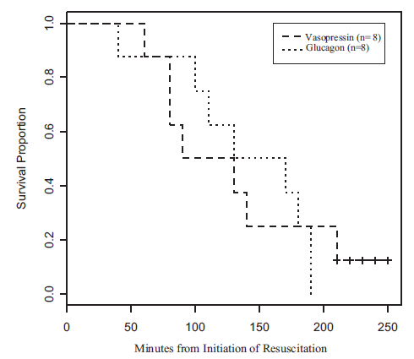
Glucagon versus vasopressin in beta blocker toxicity
Holger et al. Clinical Toxicology. 2007.
Notes:
16 pigs underwent propranolol infusion and then were randomized to vasopressin or glucagon. No statistical difference was detected in survival
Holger JS, Engebretsen KM, Obetz CL, Kleven TL, Harris CR. A comparison of vasopressin and glucagon in beta-blocker induced toxicity. Clin Toxicol (Phila). 2006;44(1):45-51.

Slide 19
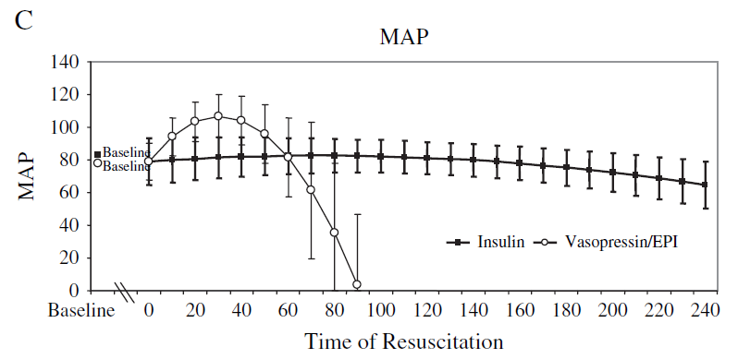
Vasopressin versus insulin in beta blocker toxicity
Holger et al. Clinical Toxicology. 2007.
Notes:
Ten pigs received a 0.5 mg/kg bolus of propranolol IV followed by a continuous
infusion. At the point of toxicity 20 ml/kg normal saline was rapidly infused and the propranolol drip continued at 0.125 mg/kg/min over
four hours of resuscitation. Each pig was randomized to either IN/G or V/E.
Holger JS, Engebretsen KM, Fritzlar SJ, Patten LC, Harris CR, Flottemesch TJ. Insulin versus vasopressin and epinephrine to treat beta-blocker toxicity. Clin Toxicol (Phila). 2007;45(4):396-401.
Engebretsen KM, Kaczmarek KM, Morgan J, Holger JS. High-dose insulin therapy in beta-blocker and calcium channel-blocker poisoning. Clin Toxicol (Phila). 2011;49(4):277-83.

Slide 20
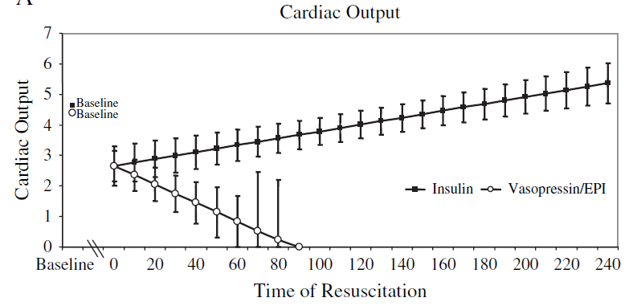
Vasopressin versus insulin in beta blocker toxicity
Holger et al. Clinical Toxicology. 2007.
Notes:
Ten pigs received a 0.5 mg/kg bolus of propranolol IV followed by a continuous
infusion. At the point of toxicity 20 ml/kg normal saline was rapidly infused and the propranolol drip continued at 0.125 mg/kg/min over
four hours of resuscitation. Each pig was randomized to either IN/G or V/E.
Holger JS, Engebretsen KM, Fritzlar SJ, Patten LC, Harris CR, Flottemesch TJ. Insulin versus vasopressin and epinephrine to treat beta-blocker toxicity. Clin Toxicol (Phila). 2007;45(4):396-401.

Slide 21
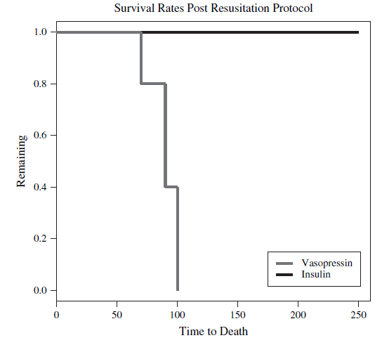
Vasopressin versus insulin in beta blocker toxicity
Holger et al. Clinical Toxicology. 2007.
Notes:
Ten pigs received a 0.5 mg/kg bolus of propranolol IV followed by a continuous
infusion. At the point of toxicity 20 ml/kg normal saline was rapidly infused and the propranolol drip continued at 0.125 mg/kg/min over
four hours of resuscitation. Each pig was randomized to either IN/G or V/E.
Holger JS, Engebretsen KM, Fritzlar SJ, Patten LC, Harris CR, Flottemesch TJ. Insulin versus vasopressin and epinephrine to treat beta-blocker toxicity. Clin Toxicol (Phila). 2007;45(4):396-401.

Slide 22
Why does insulin work?
Increased inotropy
Increased carbohydrate uptake in the myocardium
Increased vasodilation
But we really don’t know for sure
Holger et al. Clinical Toxicology. 2007.
Notes:
Engebretsen KM, Kaczmarek KM, Morgan J, Holger JS. High-dose insulin therapy in beta-blocker and calcium channel-blocker poisoning. Clin Toxicol (Phila). 2011;49(4):277-83.

