Slide 1

What condition confers a higher mortality rate?
  STEMI
  NSTEMI
Pollev.com/vachief
Notes:
Roe MT, Messenger JC, Weintraub WS, et al. Treatments, trends, and outcomes of acute myocardial infarction and percutaneous coronary intervention. J Am Coll Cardiol. 2010;56(4):254-63.
Mcmanus DD, Gore J, Yarzebski J, Spencer F, Lessard D, Goldberg RJ. Recent trends in the incidence, treatment, and outcomes of patients with STEMI and NSTEMI. Am J Med. 2011;124(1):40-7.

Slide 2
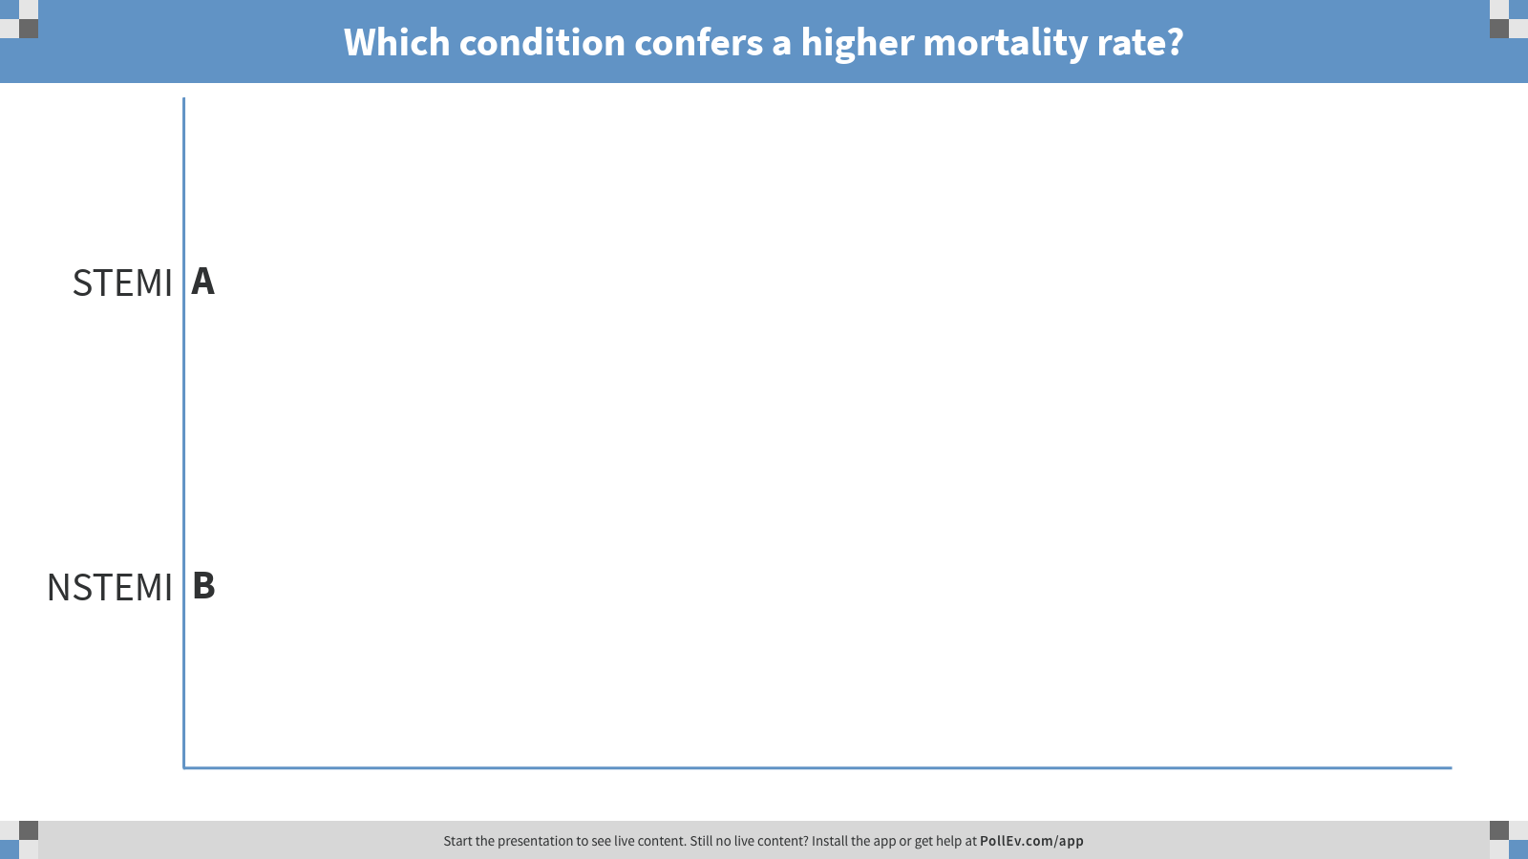
Notes:
Poll Title: Which condition confers a higher mortality rate?
https://www.polleverywhere.com/multiple_choice_polls/0efGYqqNf4EkFax

Slide 3


All you (n)ever wanted to know about STEMI
DIVISION OF CARDIOLOGY
January 5, 2018
PRESENTED BY:
Mark Tuttle, MD

Slide 4
Learning Objectives
Know the epidemiology of acute MI in the USA
Define myocardial infarction
Understand the mechanism of ischemic ST changes
Diagnose STEMI (even with LVH or LBBB)
Use the ECG in STEMI to localize the culprit artery
Understand medical and device therapy for STEMI

Slide 5
Non-Cardiac
Chest
Pain
Acute Coronary Syndrome
Unstable
Angina
STEMI
NSTEMI
Managed the same
Notes:
Unstable angina (NCDR definition)
Rest angina (occurring at rest and prolonged, usually >20 minutes)
New onset angina (within the past 2 months, of at least Canadian Cardiovascular Society Class III severity)
Increasing angina (previously diagnosed angina that has become distinctly more frequent, longer in duration, or increased by 1 or more Canadian Cardiovascular Society class to at least CCS III severity).
https://www.ncdr.com/WebNCDR/docs/public-data-collection-documents/cathpci_v4_codersdictionary_4-4.pdf

Slide 6
What condition confers a higher mortality rate?
  STEMI
  NSTEMI
Condition | In-Hospital | 1-year
STEMI | 5.5% | 8%
NSTEMI | 3.9% | 18%
Roe et al. JACC. 2010 & McManus et al. Am J Med. 2011.
Notes:
Roe MT, Messenger JC, Weintraub WS, et al. Treatments, trends, and outcomes of acute myocardial infarction and percutaneous coronary intervention. J Am Coll Cardiol. 2010;56(4):254-63.
Mcmanus DD, Gore J, Yarzebski J, Spencer F, Lessard D, Goldberg RJ. Recent trends in the incidence, treatment, and outcomes of patients with STEMI and NSTEMI. Am J Med. 2011;124(1):40-7.

Slide 7
Mortality from CAD in the USA
1986
Systemic streptokinase
1994
Stents FDA approved
1923
Bedrest
Present/future
Absorbable stents
1961
CCU
1976
Intracoronary
thrombolysis
1988
Aspirin
1999
Drug-eluting stents
National Heart, Lung, and Blood Institute. 2012.
Braunwald. Lancet. 1998.
Iqbal et al. British Medical Bulletin. 2013.
Notes:
National Heart, Lung and Blood Institute (NHLBI). Morbidity & Mortality: 2012 Chart Book on Cardiovascular, Lung and Blood Diseases. Available at: http://www.nhlbi.nih.gov/resources/docs/2012_ ChartBook_508.pdf
Braunwald E. Evolution of the management of acute myocardial infarction: a 20th century saga. Lancet. 1998;352(9142):1771-4.
Iqbal J, Gunn J, Serruys PW. Coronary stents: historical development, current status and future directions. Br Med Bull. 2013;106:193-211.

Slide 8
Incidence of acute MI in the USA
Yeh et al. NEJM. 2010.
Notes:
Yeh RW, Sidney S, Chandra M, et al. Population trends in the incidence and outcomes of acute myocardial infarction. N Engl J Med.
2010;362:2155–65.

Slide 9
Myocardial infarction subtype in the USA
Rogers et al. AHJ. 2008.
Notes:
Rogers WJ, Frederick PD, Stoehr E, et al. Trends in presenting characteristics and hospital mortality among patients with ST elevation and non-ST elevation myocardial infarction in the National Registry of Myocardial Infarction from 1990 to 2006. Am Heart J. 2008;156(6):1026-34.

Slide 10

Myocardial infarctions at BIDMC
In 2017 (by ICD-10 code):
524 STEMIs
2,456 NSTEMIs
Clinical Query Database

Slide 11
Myocardial infarctions at WX VA
In 2017 (by ICD-10 code):
8 STEMIs
119 NSTEMIs
Boston VA MySQL database. Thanks to Jason Brown!

Slide 12
Top Admitting Diagnoses at WX VA in 2017
Rank | Diagnosis | Number
1 | Alcohol-related disorders | 1869
2 | Chronic ischemic heart disease | 591
3 | Heart failure | 551
4 | PTSD | 493
5 | Opioid-related disorders | 509
6 | COPD | 281

Slide 13
In-hospital mortality with acute MI in the USA
Rogers et al. AHJ. 2008.
Notes:
Rogers WJ, Frederick PD, Stoehr E, et al. Trends in presenting characteristics and hospital mortality among patients with ST elevation and non-ST elevation myocardial infarction in the National Registry of Myocardial Infarction from 1990 to 2006. Am Heart J. 2008;156(6):1026-34.

Slide 14
We can still do better
25% of patients with STEMI die before reaching the hospital¹
Only 10% of STEMI patients get pre-hospital ECG²
Only 35% of patients get PCI³
  35% get thrombolysis alone
  30% get no reperfusion therapy
Of patients who undergo PCI, only 40% meet goal of door to balloon time < 90 minutes³
Keeley and Hillis. NEJM. 2007.
Movahed et al. Clinical Cardiology. 2011.
Eagle et al. Lancet. 2002.
Notes:
Jacobs AK, Antman EM, Faxon DP, Gregory T, Solis P. Development of systems of care for ST-elevation myocardial infarction patients: executive summary. Circulation. 2007;116(2):217-30.
Keeley EC, Hillis LD. Primary PCI for myocardial infarction with ST-segment elevation. N Engl J Med. 2007;356(1):47-54.
Eagle KA, Goodman SG, Avezum A, et al. Practice variation and missed opportunities for reperfusion in ST-segment-elevation myocardial infarction: findings from the Global Registry of Acute Coronary Events (GRACE). Lancet. 2002;359(9304):373-7.

Slide 15
Definition of Myocardial Infarction
Detection of a rise and/or fall of cardiac biomarker values (preferably troponin) with at least one value >99%ile and
with at least one of the following:
  Symptoms of ischemia
  New or presumed new ST-segment changes or new LBBB
  Development of pathological Q waves
  Imaging evidence of loss of viable myocardium or RWMA
  Identification of intracoronary thrombus by angiography or biopsy
Third Universal Definition of MI. Circulation. 2012.
Notes:
Thygesen K., Alpert J.S., Jaffe A.S., et al; Third universal definition of myocardial infarction. Circulation. 2012;126:2020-2035.

Slide 16
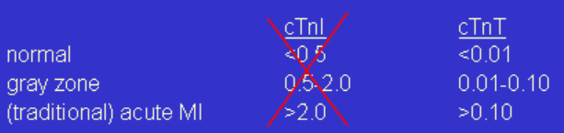
BIDMC Lab Manual
Troponin-T (Roche ElectrochemiLuminescence ImmunoAssay [ECLIA])
The reference range of <0.01 ng/mL is the 99th percentile of the healthy population. Values as high as 0.10 ng/mL are frequently seen in hospitalized, cardiac patients WITHOUT acute myocardial infarction.
In general, values >0.10 ng/mL are consistent with acute myocardial infarction.
In other words, values between 0.01 ng/mL and 0.10 ng/mL are not normal but are not necessarily associated with acute myocardial infarction and represent a gray zone.

Slide 17
VA WX Lab Manual
Troponin-I (Chemiluminescent microparticle immunoassay)
Reference range: 0-0.3 ng/mL

Slide 18
Case Example
64 F with ESRD, HTN, DM2 presents with erythematous, tender right lower extremity. She has no other complaints and other testing is normal. ECG and TTE are unremarkable.
T 99 HR 72 BP 162/84 RR 18 SpO2 100% on RA
13
138 | 99 | 34
4.6 | 21 | 5.4
Troponin: 0.14 ng/dL
12
227
40
Is this a Type II (demand) NSTEMI?
No. Meets no other criteria besides troponin elevation.

Slide 19
Aside: Troponins in ESRD
Probably not from decreased clearance
  TnT and TnI are bound to large molecules that are too big to be filtered by the glomerulus anyway
  Troponins remain elevated in kidney transplant patients
  During MI, elimination half-life of troponin not significantly different between ESRD and non-ESRD patients
May be due to subclinical myocardial injury
  Degree of Tn correlates with burden of CAD in stable ESRD patients
Wang and Lai. Journal of the American Society of Nephrology. 2008.
Notes:
Wang AY, Lai KN. Use of cardiac biomarkers in end-stage renal disease. J Am Soc Nephrol. 2008;19(9):1643-52.

Slide 20
ECG Criteria for STEMI
In the absence of LBBB and LVH:
ST segment elevation of ≥1 mm (0.1 mV) in contiguous chest leads or limb leads
EXCEPT: ST segment elevation of ≥2 mm (0.2 mV) in men or ≥1.5 mm (0.15 mV) in women in leads V2–V3
Third Universal Definition of MI. Circulation. 2012.
Notes:
Thygesen K., Alpert J.S., Jaffe A.S., et al; Third universal definition of myocardial infarction. Circulation. 2012;126:2020-2035.

Slide 21
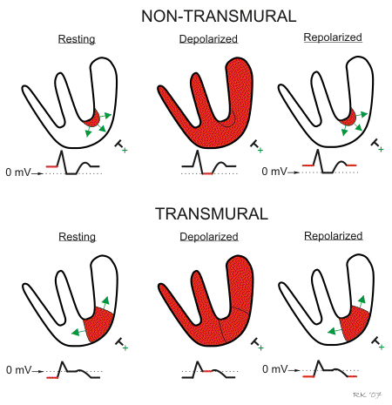
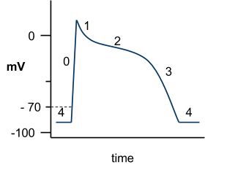
Mechanism of ST changes
Myocyte action potential
CVphysiology.com
Notes:
TP segment is actually what shifts, but cannot be seen on ECG unless drawn out over a long period of time.
http://www.cvphysiology.com/CAD/CAD012
Classic paper: Samson WE, Scher AM. Mechanism of S-T segment alteration during acute myocardial injury. Circ Res. 1960;8:780-7.

Slide 22
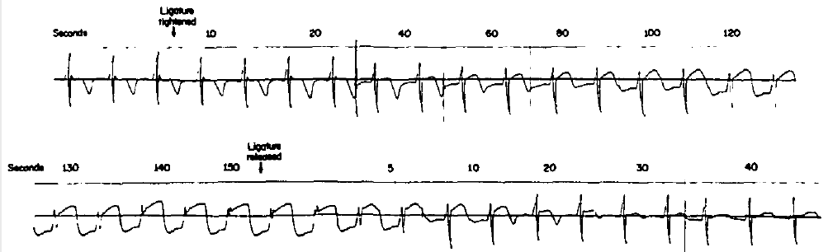
Mechanism of ST elevation
Samson and Scher. Circulation Research. 1960.
Notes:
During coronary occlusion in dogs, baseline actually is the ST segment (since this is when all cells are completely depolarized), and the TP segment is what appears to shift.
Samson WE, Scher AM. Mechanism of S-T segment alteration during acute myocardial injury. Circ Res. 1960;8:780-7.

Slide 23
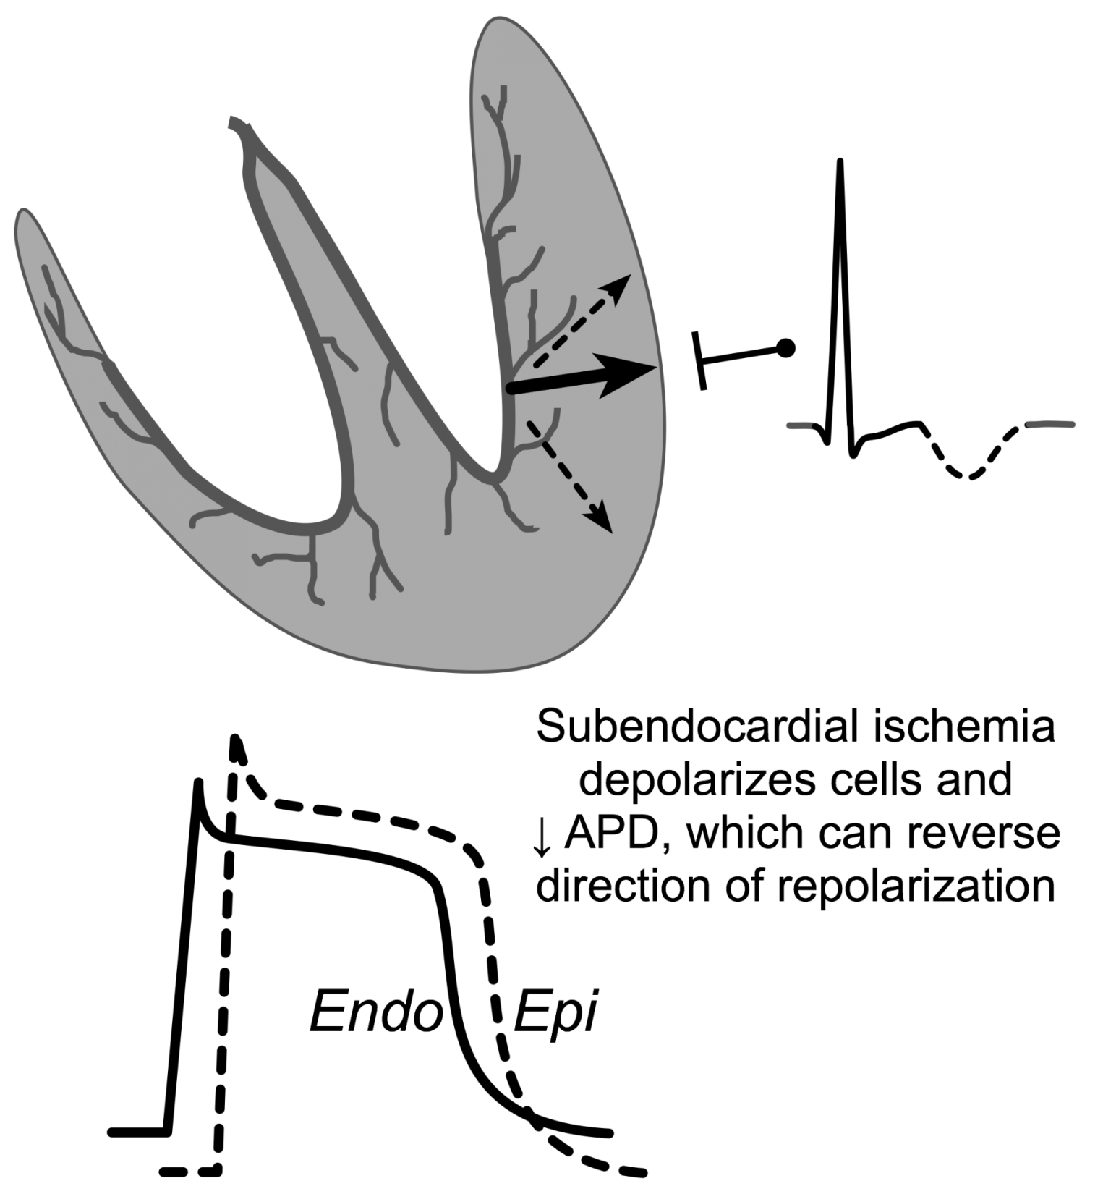
Mechanism of T wave inversion
CVphysiology.com

Slide 24
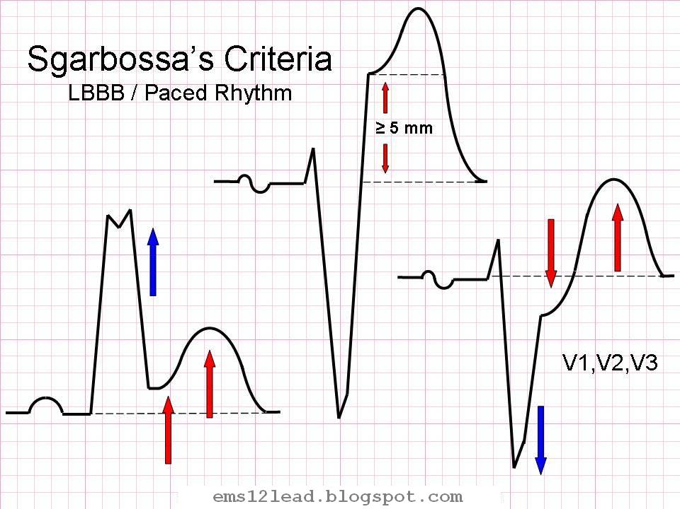
Acute MI with LBBB (Sgarbossa’s Criteria)
Considered positive if ANY are present:
Concordant STE ≥ 1 mm
Discordant STE ≥ 5 mm
STD ≥ 1 mm in V1, V2, or V3
Sgarbossa et al. NEJM. 1996.
Notes:
Looked at ECGs from GUSTO-1 trial of patients with LBBB and were diagnosed with MI (by biomarkers) and compared to those with LBBB but without MI from separate cohort.
Sgarbossa EB, Pinski SL, Barbagelata A, et al. Electrocardiographic diagnosis of evolving acute myocardial infarction in the presence of left bundle-branch block. GUSTO-1 (Global Utilization of Streptokinase and Tissue Plasminogen Activator for Occluded Coronary Arteries) Investigators. N Engl J Med. 1996;334(8):481-7.

Slide 25
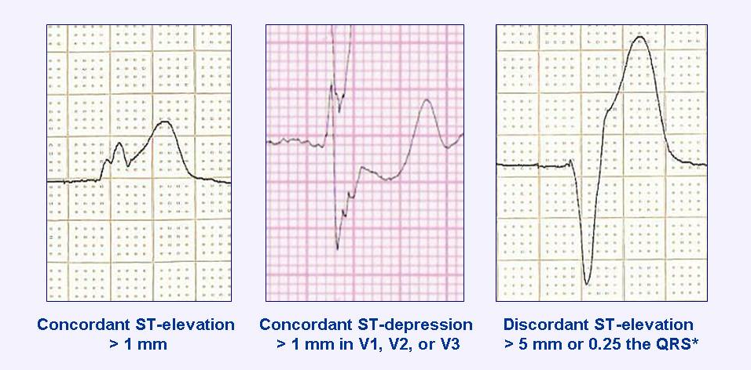
Acute MI with LBBB
Ems12lead.blogspot.com

Slide 26
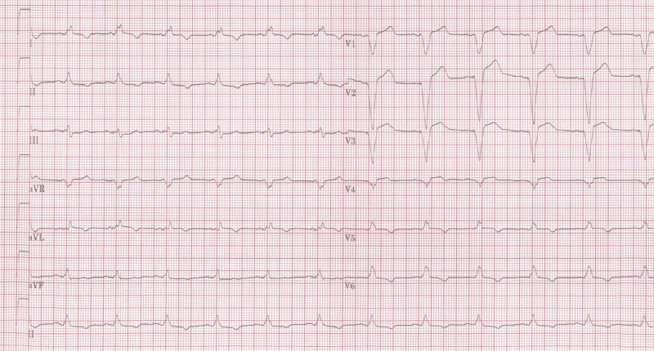
No acute MI, just LBBB
ECGpedia.org
Notes:
https://en.ecgpedia.org/index.php?title=File:MI_in_LBBB_02.jpg

Slide 27
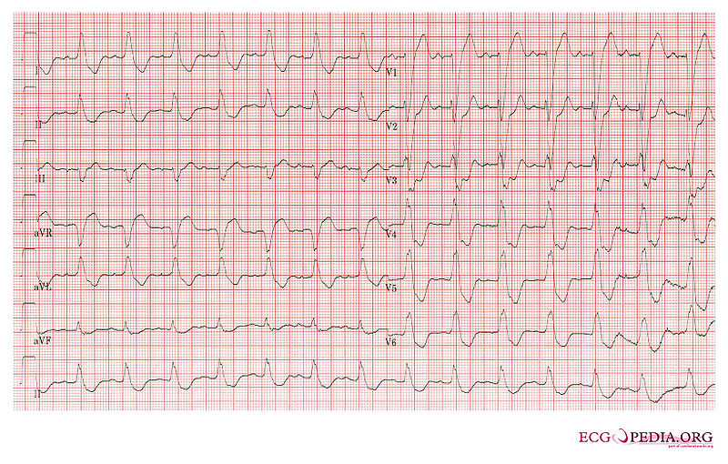
True Acute MI, ≥ 1 STD in V3
Notes:
https://en.ecgpedia.org/index.php?title=File:E000003.jpg

Slide 28
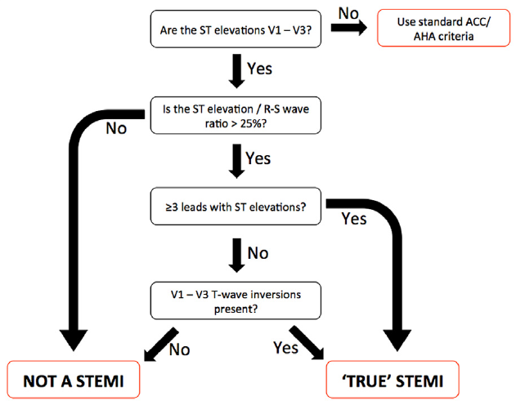
Acute MI with LVH (Armstrong’s Criteria)
In V1-V3, STE ≥ 25% of the RS wave amplitude
WITH
≥ 3 leads with ST elevations
OR
T-wave inversions in V1-V3
Armstrong et al. AJC. 2012.
Notes:
Armstrong EJ, Kulkarni AR, Bhave PD, et al. Electrocardiographic criteria for ST-elevation myocardial infarction in patients with left ventricular hypertrophy. Am J Cardiol. 2012;110(7):977-83.

Slide 29
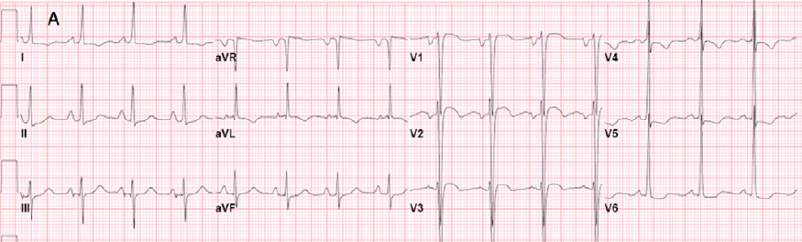
No acute MI, just LVH. Anterior STE not >25% of RS wave
Armstrong et al. AJC. 2012.
Notes:
Armstrong EJ, Kulkarni AR, Bhave PD, et al. Electrocardiographic criteria for ST-elevation myocardial infarction in patients with left ventricular hypertrophy. Am J Cardiol. 2012;110(7):977-83.

Slide 30
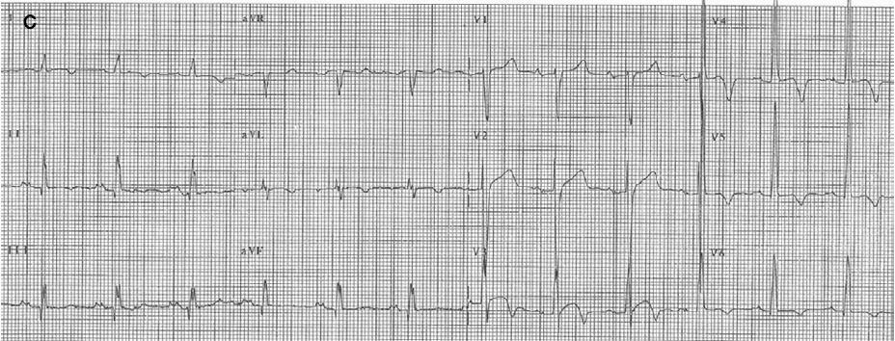
True Acute MI. V3 STE >25% of RS wave and V3 TWI
Armstrong et al. AJC. 2012.
Notes:
Armstrong EJ, Kulkarni AR, Bhave PD, et al. Electrocardiographic criteria for ST-elevation myocardial infarction in patients with left ventricular hypertrophy. Am J Cardiol. 2012;110(7):977-83.

Slide 31
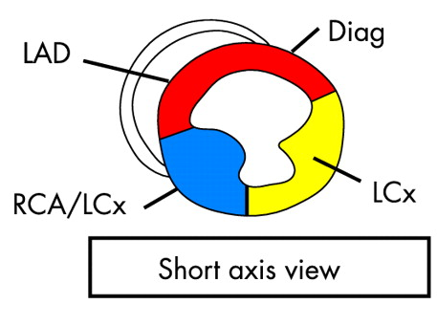
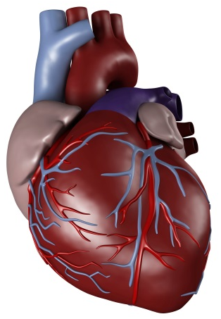
Infarct Localization
aVR
aVL
I
III
II
aVF
Marwick. Heart. 2003.
Breakdown of fatal STEMIs
Location | Anterior | Lateral | Inferior
Proportion | 40% | 33% | 27%
Movahed et al. AJC. 2009.
Notes:
Marwick TH. Techniques for comprehensive two dimensional echocardiographic assessment of left ventricular systolic function. Heart. 2003;89 Suppl 3:iii2-8.
Movahed MR, John J, Hashemzadeh M, Jamal MM, Hashemzadeh M. Trends in the age adjusted mortality from acute ST segment elevation myocardial infarction in the United States (1988-2004) based on race, gender, infarct location and comorbidities. Am J Cardiol. 2009;104(8):1030-4.

Slide 32
Infarct Localization
ST elevation in II, III, aVF (inferior, 40-50% of MIs)
  II > III suggests LCx lesion
  III > II suggests RCA lesion
    V4R: ST elevation (proximal), isoelectric (distal)
ST elevation in V₁, V₂, V₃: LAD
  ST elevation > 2.5 mm in V₁: pLAD (12% Sn, 100% Sp)
  ST elevation in II, III, aVF: pLAD (66% Sn, 73% Sp)
aVR
aVL
I
III
II
aVF
Zimetbaum & Josephson. NEJM. 2003
Notes:
Zimetbaum PJ, Josephson ME. Use of the electrocardiogram in acute myocardial infarction. N Engl J Med. 2003;348(10):933-40.

Slide 33
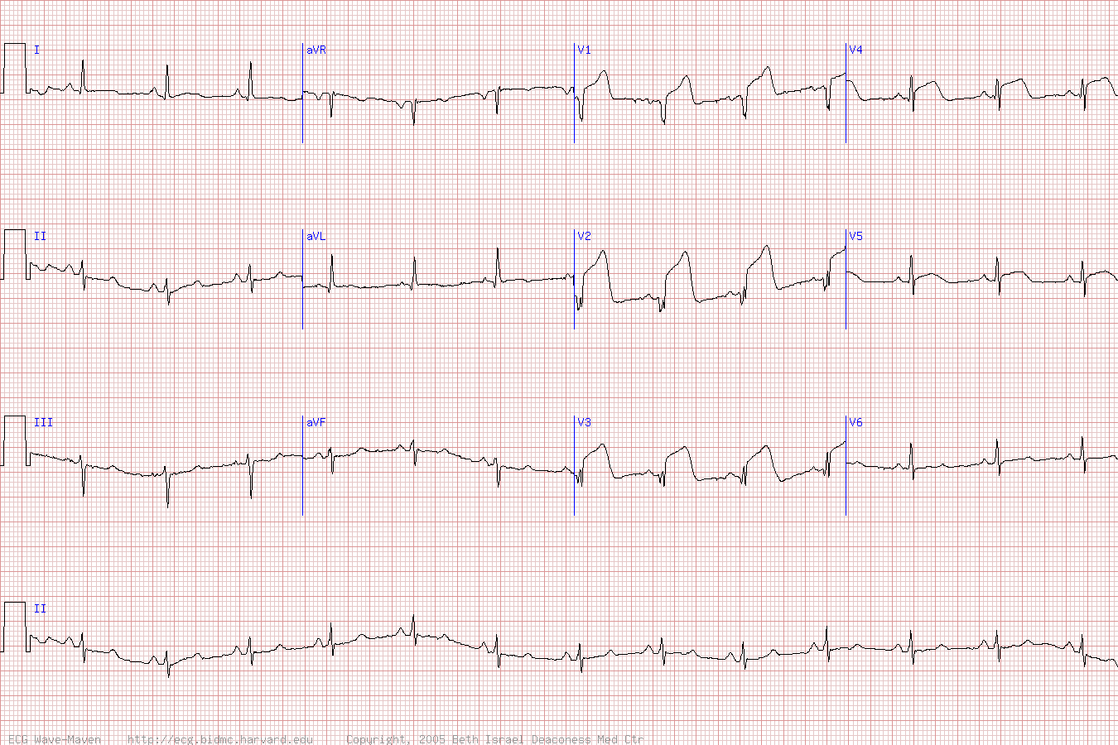
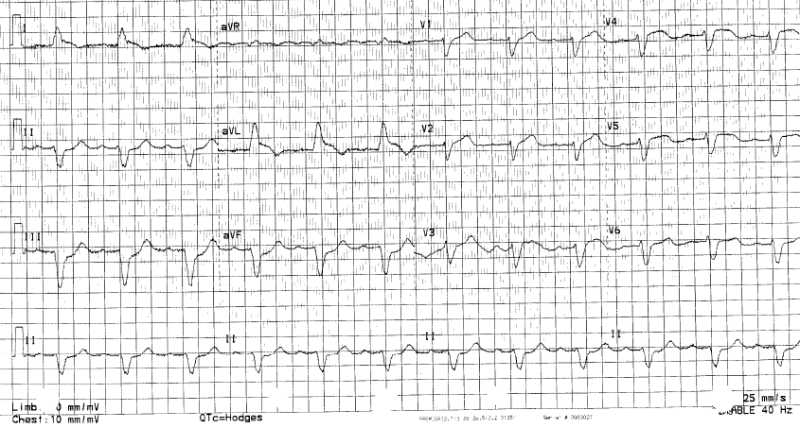
Notes:
Grasso 2586025
Used wave maven ecg since easier
https://ecg.bidmc.harvard.edu/maven/dispcase.asp?rownum=90&ans=1&caseid=91

Slide 34
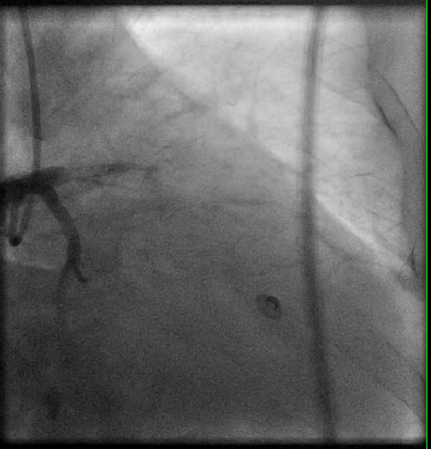
Notes:
Grasso 2586025

Slide 35
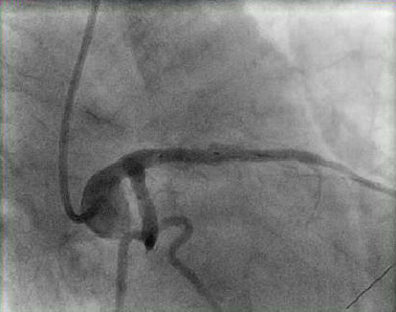
Notes:
Grasso 2586025

Slide 36
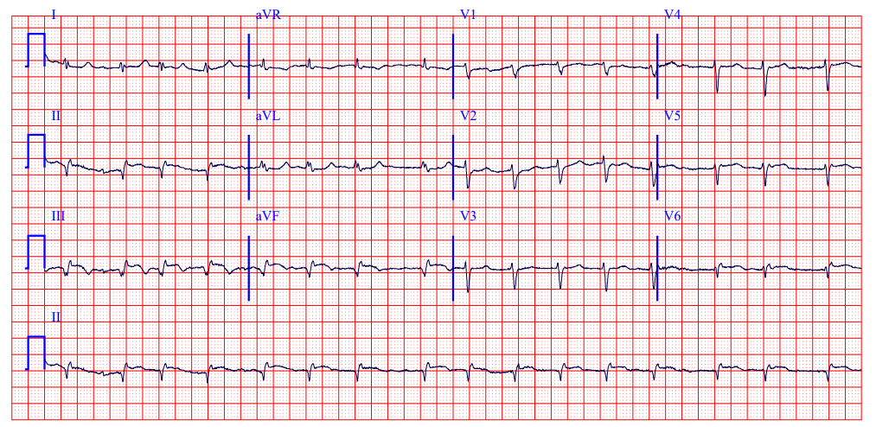
Notes:
Deal 2933460

Slide 37
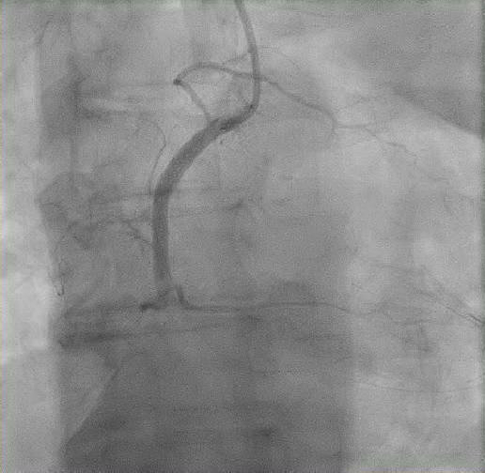
Notes:
Deal 2933460

Slide 38
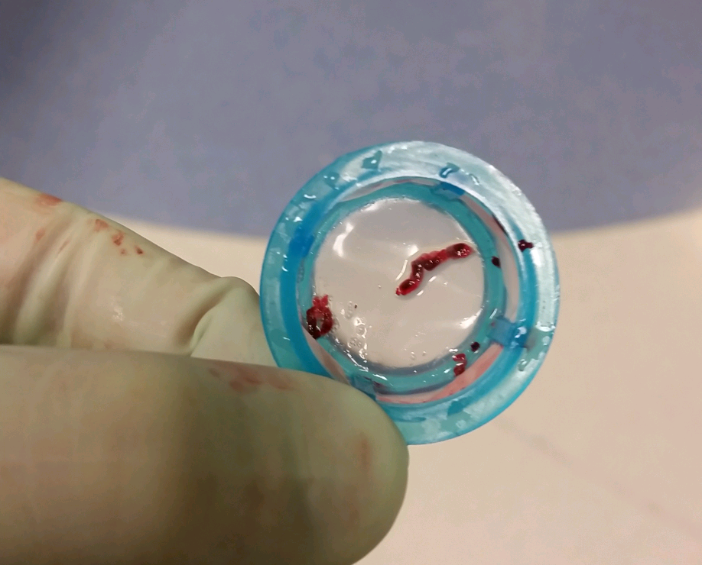
Aspirate
Notes:
Deal 2933460

Slide 39
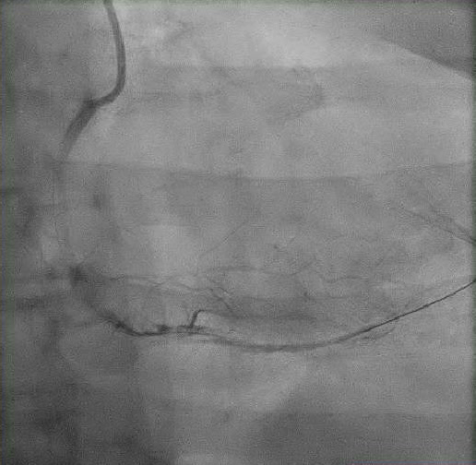
Notes:
Deal 2933460

Slide 40
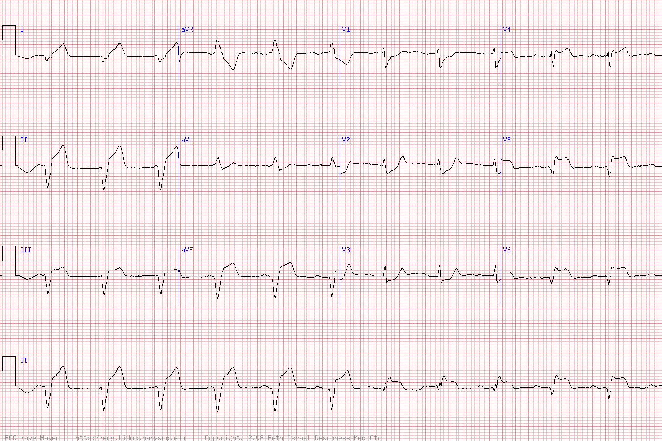
Notes:
Blackman 1235264
Exaggerated example: https://ecg.bidmc.harvard.edu/maven/dispcase.asp?rownum=382&ans=1&caseid=383

Slide 41
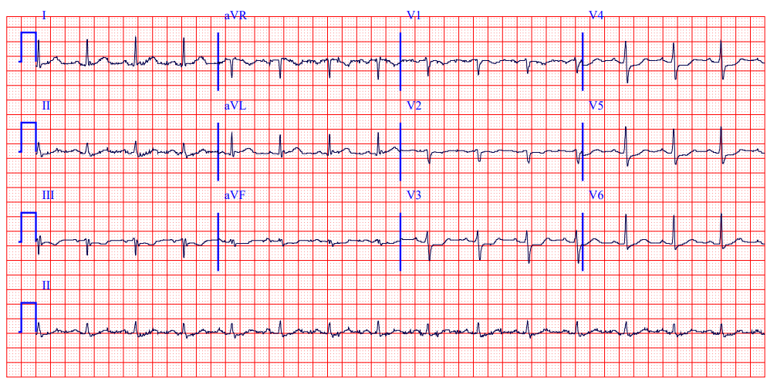
Notes:
Blackman 1235264 – real ECG

Slide 42
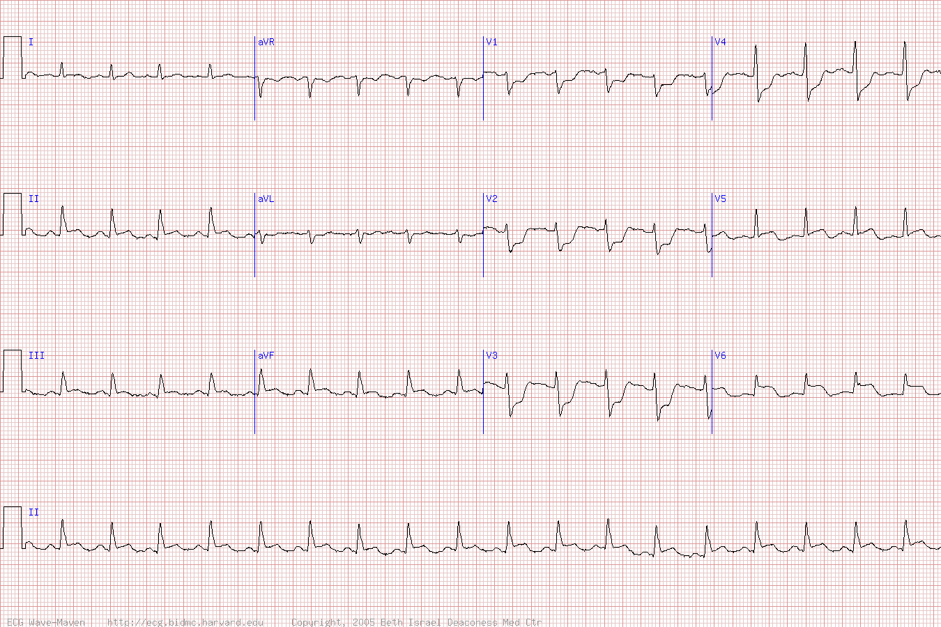
Notes:
Blackman 1235264
Exaggerated example: https://ecg.bidmc.harvard.edu/maven/dispcase.asp?rownum=229&ans=1&caseid=230

Slide 43
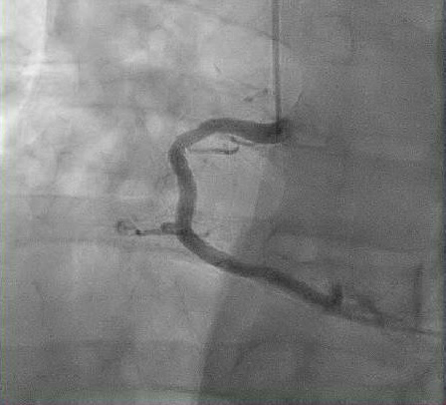
Notes:
Blackman 1235264

Slide 44
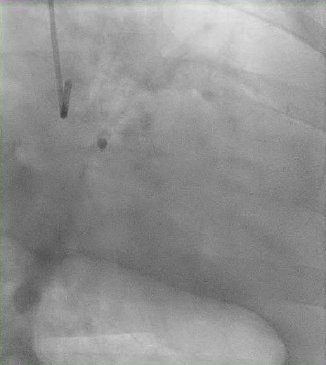
Notes:
Blackman 1235264

Slide 45
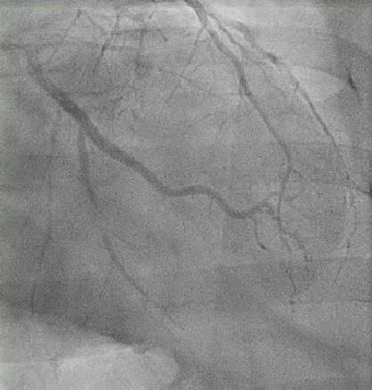
Notes:
Blackman 1235264

Slide 46
STEMI Case Example
55 M with hypertension presents to rural hospital in Maine with chest pain for the last 18 hours which is improving but is still present.
ECG demonstrates STEMI
The nearest PCI capable hospital is 90 minutes away
How should this patient be managed?

Slide 47
STEMI Case Example #2
72 F with diabetes and dyslipidemia presents to clinic in rural Alaska with ongoing chest pain for the last two hours.
ECG demonstrates STEMI
The nearest PCI capable hospital is four hours away.
“Drip ‘em and ship ‘em”
- Anonymous rural cardiologist
How should this patient be managed?
Notes:
tPA dosing: Bolus 15 mg, infusion 0.75 mg/kg for 30 min (maximum 50 mg), then 0.5 mg/kg (maximum 35 mg) over the next 60 min; total dose not to exceed 100 mg.

Slide 48
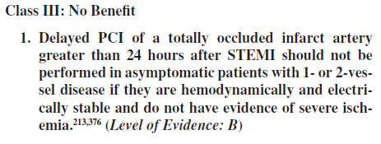
When should we go to cath?
PCI-capable hospital: PCI in < 90 minutes¹
Non-PCI capable hospital:¹
  Transfer if < 120 minutes away from PCI hospital
  Give fibrinolytics, then transfer patient if > 120 minutes away
Time is myocardium: Each increment of 30 minutes from symptom onset increases mortality by 4%²
Delayed > 24 hours from symptom onset¹
  Do not perform PCI if > 24 hours after symptom onset on a completely occluded artery if patient is hemodynamically stable
  If in cardiogenic shock/severe heart failure, reasonable to attempt revascularization
AHA Guidelines. Circulation. 2013.
Rathocore et al. AJC. 2009.
Notes:
Rathore SS, Curtis JP, Nallamothu BK, et al. Association of door-to-balloon time and mortality in patients > or =65 years with ST-elevation myocardial infarction undergoing primary percutaneous coronary intervention. Am J Cardiol. 2009;104(9):1198-203.
FMC-to-device time is replacement term for door to balloon; it means first medical contact to “device” time (meaning PCI, POBA or DES)
O'gara PT, Kushner FG, Ascheim DD, et al. 2013 ACCF/AHA guideline for the management of ST-elevation myocardial infarction: a report of the American College of Cardiology Foundation/American Heart Association Task Force on Practice Guidelines. Circulation. 2013;127(4):e362-425.

Slide 49
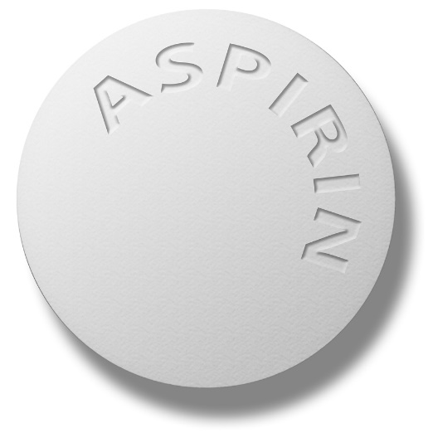
Aspirin
↓ vascular mortality by 23 % in acute MI (ISIS-2 trial, 1988)
↓ vascular mortality and non-fatal MI/stroke in unstable angina (14% -> 9%) (Antiplatelet Trialists Collaboration, 1994)
Notes:
Randomised trial of intravenous streptokinase, oral aspirin, both, or neither among 17,187 cases of suspected acute myocardial infarction: ISIS-2. ISIS-2 (Second International Study of Infarct Survival) Collaborative Group. Lancet. 1988;2(8607):349-60.
Collaborative overview of randomised trials of antiplatelet therapy--I: Prevention of death, myocardial infarction, and stroke by prolonged antiplatelet therapy in various categories of patients. Antiplatelet Trialists' Collaboration. BMJ. 1994;308(6921):81-106.

Slide 50
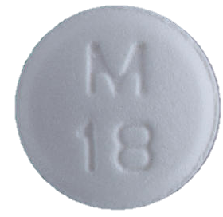
Beta blockers
↓ overall mortality by 40% (relative reduction)
  Norwegian Multicenter Study of Timolol (1983)
  Little short term benefit
  IV beta blocker worsens outcomes
Contraindicated in:
  Cocaine-induced MI. (Give benzodiazepines instead!) Or labetalol.
  Hypotension
  Decompensated heart failure
  Reactive airway disease
  AV conduction delay > 0.24 s, or 2nd degree AV block
Mechanism of benefit:
↓ MVO₂
↓ ventricular arrhythmias
Notes:
Pedersen TR. The Norwegian Multicenter Study of Timolol after Myocardial Infarction. Circulation. 1983;67(6 Pt 2):I49-53.
The life-table cumulative probability of total death was 21.9% in the placebo group and 13.3% in the timolol group, corresponding to a relative reduction of 39.4% (p = 0.0003)

Slide 51
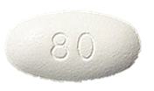
Statins
PROVE-IT TIMI 22: Randomized 4162 patients with acute MI to pravastatin 40mg versus atorvastatin 80mg
  Primary end-point was death from any cause, myocardial infarction, documented unstable angina requiring rehospitalization, revascularization
  At 2 years, endpoint occurred in 26.3% of pravastatin group and 22.4 % of atorvastatin group (p<0.005)
  Difference emerged at 30 days and was persistent
Cannon et al. NEJM. 2004.
Notes:
Cannon CP, Braunwald E, Mccabe CH, et al. Intensive versus moderate lipid lowering with statins after acute coronary syndromes. N Engl J Med. 2004;350(15):1495-504.

Slide 52
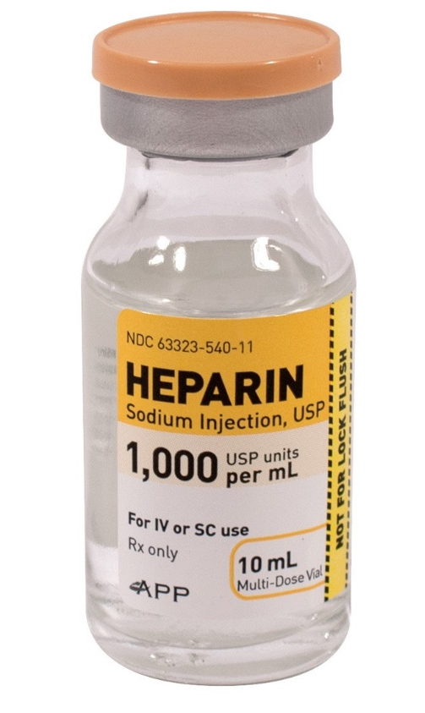
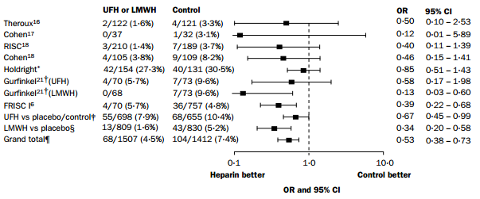
Heparin
↓ 33% composite of death or MI
  driven almost entirely by reduction in MI
Eikkelboom. Lancet. 2000.
Notes:
Studies supporting the addition of a parenteral anticoagulant to aspirin in patients with NSTE-ACS were performed primarily on patients with a diagnosis of “unstable angina” in the before DAPT and early catheterization and revascularization.
Amsterdam EA, Wenger NK, Brindis RG, et al. 2014 AHA/ACC guideline for the management of patients with non-ST-elevation acute coronary syndromes: a report of the American College of Cardiology/American Heart Association Task Force on Practice Guidelines. Circulation. 2014;130(25):e344-426.
Eikelboom JW, Anand SS, Malmberg K, Weitz JI, Ginsberg JS, Yusuf S. Unfractionated heparin and low-molecular-weight heparin in acute coronary syndrome without ST elevation: a meta-analysis. Lancet. 2000;355(9219):1936-42.

Slide 53
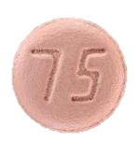
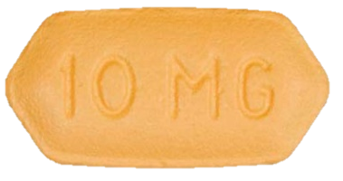
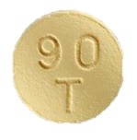
Second Anti-Platelet Agent
Clopidogrel (PlavixTM)
Prasugrel (EffientTM)
Ticagrelor (BrillintaTM)
CURE Trial (2001)
ASA vs. ASA + Plavix
11.4 vs. 9.3% CV death/non-fatal MI
NNT=50
TRITON-TIMI 38 (2007)
ASA+Clopidogrel vs ASA+Prasugrel
↓ risk of CV death, non-fatal MI, CVA with prasugrel (9.9% versus 12.1%)
↑ fatal bleeding
Do not give if history of TIA/stroke or elderly
Cannot give unless PCI planned
PLATO Trial (2009)
ASA+Clopidogrel vs. ASA+Ticagrelor
↓ all-cause mortality (4.5% versus 5.9%)
↑ dyspnea

Slide 54

When to give second antiplatelet agent
As soon as possible or at the time
of PCI¹
Pre-hospital administration²
  Reduces rate of stent thrombosis
  Does not resolve STE before angiography
  Does not improve pre-stent flow
AHA Gudelines. Circulation. 2013.
Montalescot et al. NEJM. 2014.
Notes:
Montalescot G, Van 't hof AW, Lapostolle F, et al. Prehospital ticagrelor in ST-segment elevation myocardial infarction. N Engl J Med. 2014;371(11):1016-27.
O'gara PT, Kushner FG, Ascheim DD, et al. 2013 ACCF/AHA guideline for the management of ST-elevation myocardial infarction: a report of the American College of Cardiology Foundation/American Heart Association Task Force on Practice Guidelines. Circulation. 2013;127(4):e362-425.

Slide 55
For how long to give DAPT?
At least 12 months (in general)
Older thinking was that bare metal stents did not need as long duration DAPT compared to drug-eluting stents
DAPT trial showed benefit of DAPT in BMS for at least a year
Yeh et al. NEJM. 2014.
Notes:
Mauri L, Kereiakes DJ, Yeh RW, et al. Twelve or 30 months of dual antiplatelet therapy after drug-eluting stents. N Engl J Med. 2014;371(23):2155-66.

Slide 56

Who should get DAPT > 12 months
DAPT SCORE
Age
Vein Graft Stent
Smoker
Diabetic
Acute MI
Stent diameter < 3 mm
Heart failure with reduced EF
When DAPT score is ≥2, the number needed to treat (NNT) to prevent an ischemic event was 33 and the number needed to harm (NNH) with a bleeding event was 263.
When the DAPT score is <2, NNT to prevent an ischemic event climbs to 169 and NNH to cause a bleeding complication drops to 69.
Yeh et al. JAMA. 2016.
Notes:
Yeh RW, Secemsky EA, Kereiakes DJ, et al. Development and Validation of a Prediction Rule for Benefit and Harm of Dual Antiplatelet Therapy Beyond 1 Year After Percutaneous Coronary Intervention. JAMA. 2016;315(16):1735-49.

Slide 57
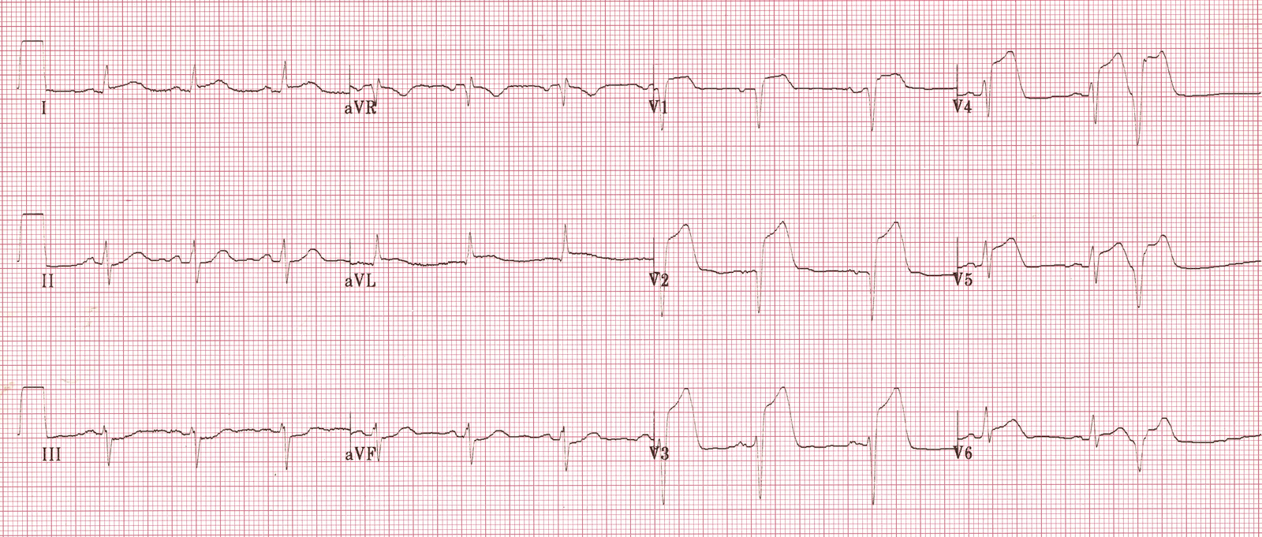
Notes:
https://lifeinthefastlane.com/ecg-library/anterior-stemi/

Slide 58
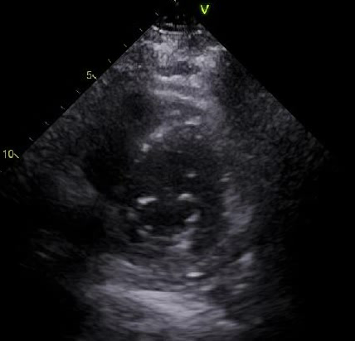
LVEF 29%
Notes:
Mirabello 2961776

Slide 59
Anticoagulation after STEMI
Anticoagulant therapy with a vitamin K antagonist is reasonable for patients with STEMI and asymptomatic LV mural thrombi. (Class IIa, Level of Evidence: C)
  The duration of empiric vitamin K antagonist therapy can be limited to 3 months
Anticoagulant therapy may be considered for patients with STEMI and anterior apical akinesis or dyskinesis. (Class IIb, Level of Evidence: C)
  We don’t know how long to anticoagulate
AHA Guidelines. Circulation. 2013.
Notes:
O'gara PT, Kushner FG, Ascheim DD, et al. 2013 ACCF/AHA guideline for the management of ST-elevation myocardial infarction: a report of the American College of Cardiology Foundation/American Heart Association Task Force on Practice Guidelines. Circulation. 2013;127(4):e362-425.

Slide 60
Anticoagulation after STEMI: Rationale
Larger, anterior infarctions are associated with higher rates of LV thrombus formation
Meta-analysis suggests anticoagulation reduces the rate of LV thrombus formation by 68%
Risk of ischemic stroke is higher following aute MI (1.5-3.6%) and highest within the first month and more common in anterior MIs.
McDaniel. JACC Cardiovascular Interventions. 2015.
Notes:
Mcdaniel MC. Anticoagulation after anterior myocardial infarction: primum non nocere, or first do no harm. JACC Cardiovasc Interv. 2015;8(1 Pt B):163-165.

Slide 61
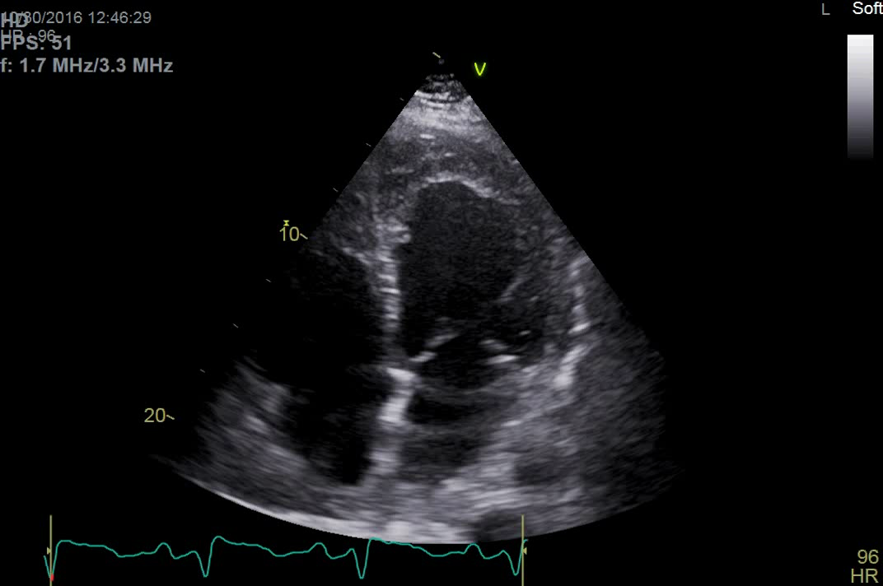
Anterior STEMI
Notes:
Nardone (2938998)

Slide 62
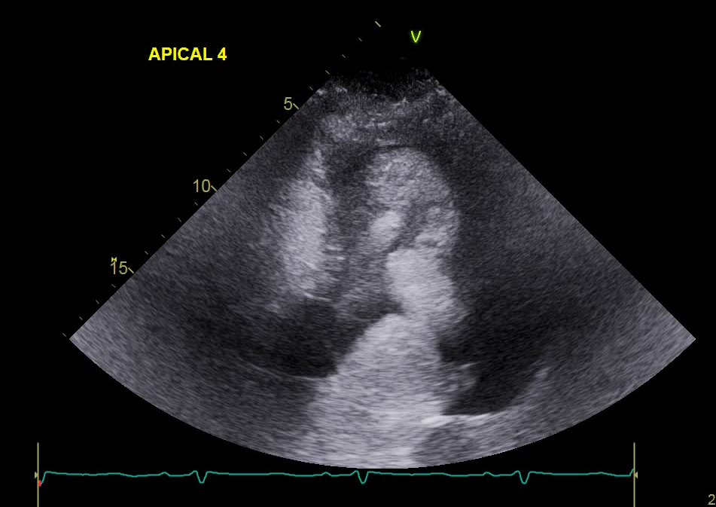
Anterior STEMI

Slide 63
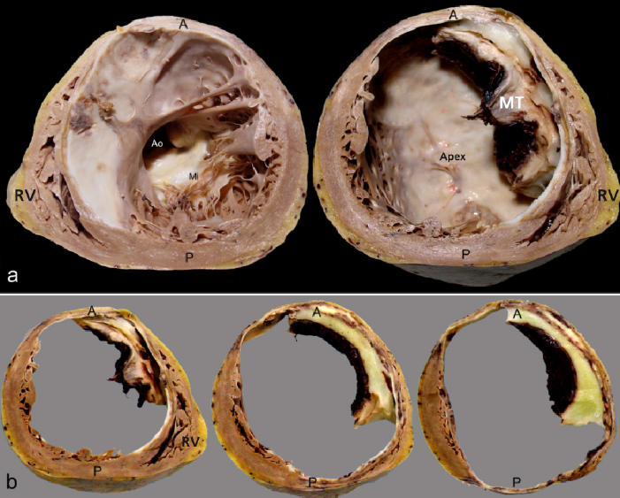
Mural Thrombus Complicating MI
Hironaka et al. Arq Bras Cardiol. 2009.
Notes:
Hironaka GK, Esper RB, Cesar LA, Dias CG, Mathias W, Castelli JB. Case 3/2009--a 75-year-old man with heart failure after myocardial infarction and ventricular aneurysm. Arq Bras Cardiol. 2009;93(1):64-73.

Slide 64
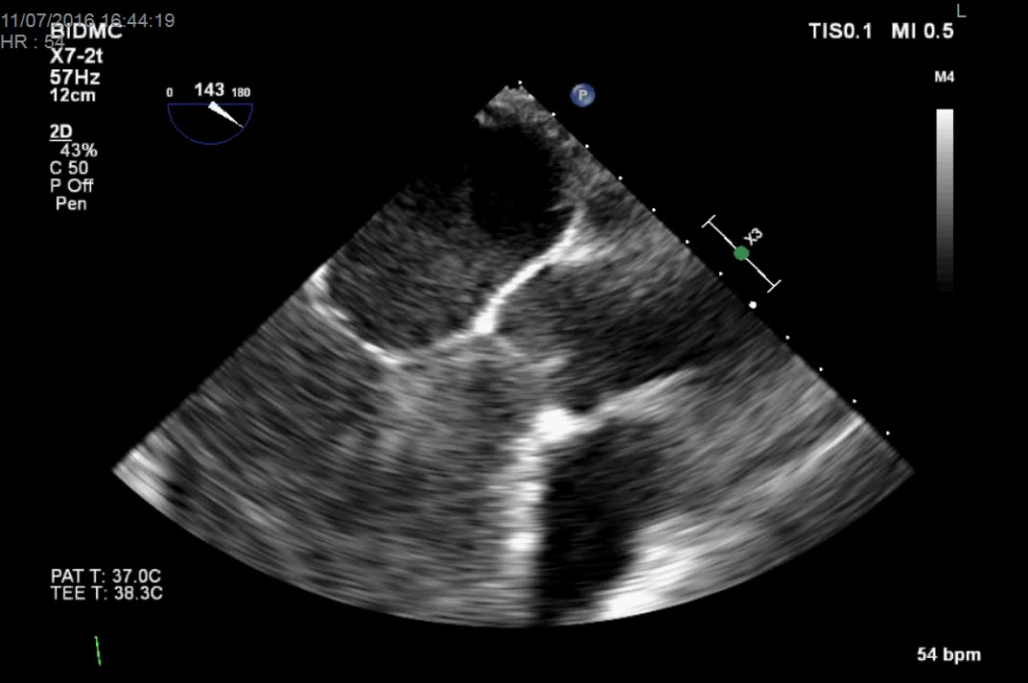
Anterior STEMI

Slide 65
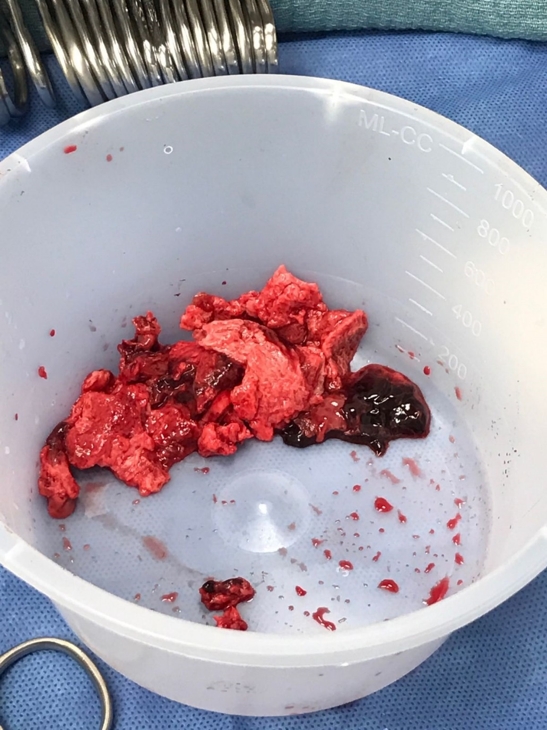

Slide 66
ICD for primary prevention of SCD after MI
DINAMIT: Defibrillator IN Acute Myocardial Infarction Trial¹⁵: Early post-MI ICD does NOT reduce mortality
674 patients with MI within 40 days randomized to ICD or medical therapy
At an average of 30 months, annual mortality was 7.5% (medical therapy) vs. 9.2% (ICD)
  HR, 1.08; 95 percent CI, 0.76 to 1.55; two-sided P=0.66
This study is why the guidelines have the “40-day post MI” requirement
➔ Maybe a LifeVest for 40 days, then repeat echo.
Hohnloser et al. NEJM. 2004.
Notes:
Hohnloser, Stefan H., Karl Heinz Kuck, Paul Dorian, Robin S. Roberts, John R. Hampton, Robert Hatala, Eric Fain, Michael Gent, and Stuart J. Connolly. "Prophylactic Use of an Implantable Cardioverter–Defibrillator after Acute Myocardial Infarction." New England Journal of Medicine 351 (2004): 2481-488.

Slide 67
Learning Points
STEMI incidence and mortality have markedly decreased but there is still work to do.
The diagnosis of MI requires biomarkers AND symptoms/ECG changes/loss of viable myocardium
Diagnose STEMI on ECG by > 1 mm STE in contiguous leads
  LBBB: Use Sgarbossa’s criteria (concordant STE, marked STD)
  LVH: Use Armstrong’s criteria (STE > 25% of RS amplitude)
ECG STEMI localization:
  II/III/aVF: Inferior infarct (if III > II → RCA, if II > III it’s LCx)
  I,aVL, anterior precordial leads: LAD
Anticoagulate for anterior akinesis/dyskinesis or confirmed LV thrombus
No benefit of ICD until at least 40 days post MI.

