Slide 1

Angiographic Projections Primer
Mark Tuttle, MD
July 12, 2020
Notes:
Purdy (2394966)

Slide 2
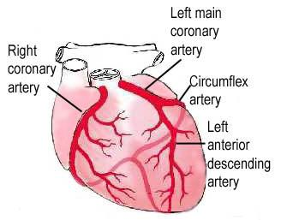
Coronary Anatomy

Slide 3
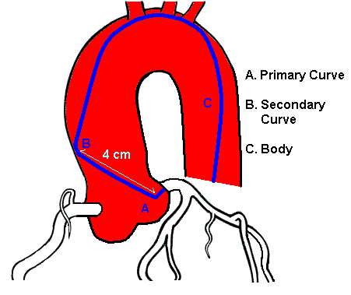
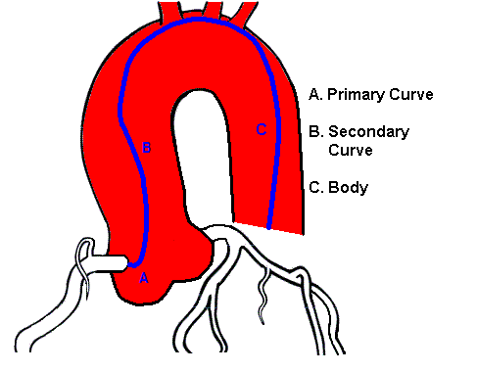
Coronary Angiography Catheters
Accessing left main coronary
artery (LMCA)
Accessing right coronary artery (RCA)
Notes:
Catheters are designed with specific bends that will engage either the LMCA or the RCA.

Slide 4
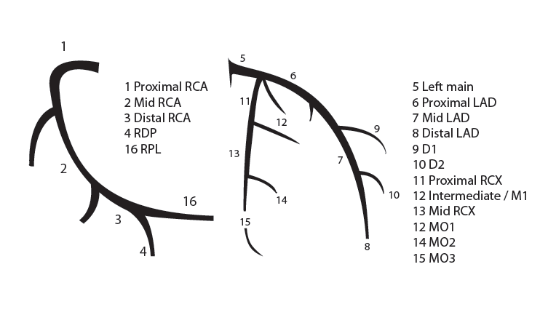
Coronary Anatomy
RCA
LMCA
Notes:
Sections of the LAD are designated as pLAD (proxmial LAD), mLAD (mid-LAD), and dLAD (distal LAD) based on where it’s branches (diagonals) arise. E.g before the first diag is the pLAD.
A similar phenomenon exists for the LCx and RCA.
What if the LMCA trifurcates instead of bifircates? This is called a ramus intermedius, and is present in about 20% of people.

Slide 5

Angiographic Projections: Two rules*
Anteroposterior (AP)
1
The positioning of the spine indicates which projection you are looking at.
If the spine is on the patient’s left, this is a left anterior oblique (LAO) projection
If the spine is on the patient’s right, this is a right anterior oblique (RAO) projection
2
When engaging the LMCA, the spine indicates which branch is the LAD and which is LCx.
The branch closer to the spine is the LCx
*This is an oversimplication and is not applicable to certain projections (ex. “spider” project), but in general is true.

Slide 6
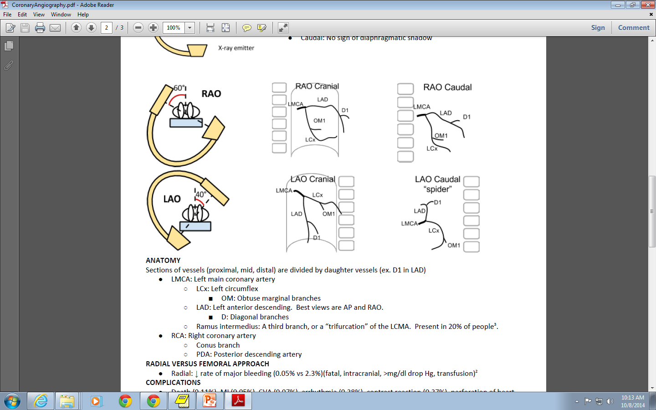
What projection is this? Can you identify the vessels?
The spine is on the patient’s right side
Right anterior oblique (RAO)
LMCA
LAD
D1
LCx
OM1
The LCx is closer to the spine than the LAD
Notes:
LMCA = Left main coronary artery
LAD = Left anterior descending
D1 = First diagnoal branch
OM1 = First obtuse marginal branch

Slide 7
What projection is this? Can you identify the vessels?
Right anterior oblique (RAO)
RCA
SA nodal
AM
PDA
Notes:
RCA = right coronary artery
AM = acute marginal
PDA = posterior descending artery

Slide 8
What projection is this? Can you identify the vessels?
Left anterior oblique (LAO)
LMCA
LCx
LAD
OM1
D1
Notes:
LMCA = Left main coronary artery
LAD = Left anterior descending
D1 = First diagnoal branch
OM1 = First obtuse marginal branch

Slide 9
What projection is this? Can you identify the vessels?
Left anterior oblique (LAO)
RCA
SA nodal
AM
PDA
Notes:
RCA = right coronary artery
AM = acute marginal
PDA = posterior descending artery

Slide 10
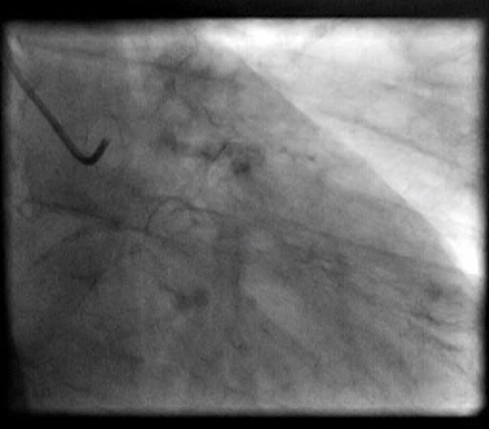
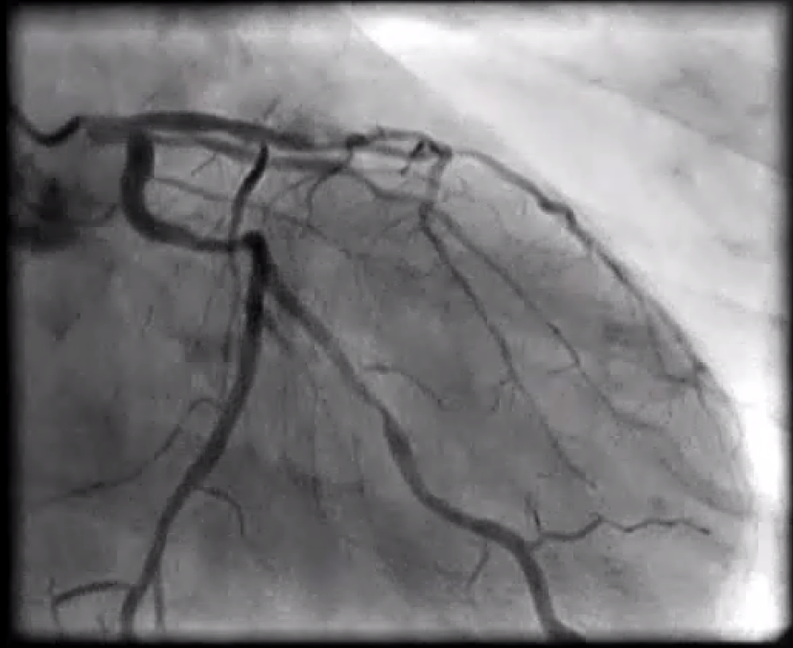
What projection is this?
LAD and diags
Right anterior oblique (RAO) of LMCA
The spine is visible on the right toward the end of the video loop.
Spine
Can you identify the vessels?
LCx and large OM1
Notes:
LAD: long 70% mid, 50% major diagonal
LCX: 60% OM1

Slide 11
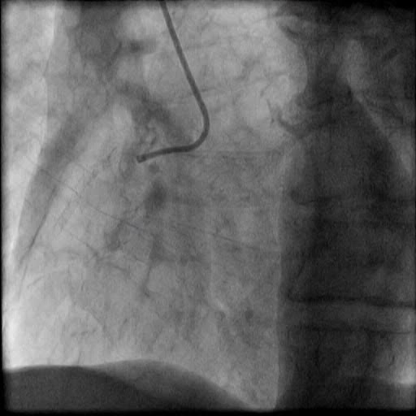
What projection is this?
Left anterior oblique (LAO) of RCA
The spine is visible on the left.
Can you identify the vessels?
RCA. Due to its characteristic L-shaped appearance

