Slide 1
Introduction to Echocardiography
DIVISION OF CARDIOLOGY
November 12, 2017
Mark Tuttle, MD

Slide 2
Learning Objectives
Know the indications for ordering TTE and also when a TTE may be low value
Learn the basic nomenclature and views of TTE
Recognize how to obtain the basic views of TTE
Perform a volume status assessment using TTE of the IVC
Recognize common “do not miss” pathologies on TTE

Slide 3
What is echocardiography?
Sound waves emitted by the transducer probe into the patient’s body are reflected back at different harmonics depending on the physical properties of the tissue
  Echodense (light) indicates more dense structures
  Echoluscent (dark) indicates less dense structures

Slide 4
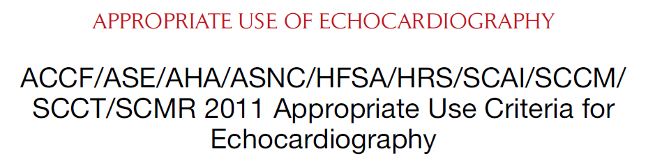
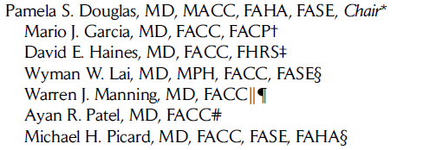
When should I order an echo?
Notes:
Douglas PS, Garcia MJ, Haines DE, et al. ACCF/ASE/AHA/ASNC/HFSA/HRS/SCAI/SCCM/SCCT/SCMR 2011 Appropriate Use Criteria for Echocardiography. A Report of the American College of Cardiology Foundation Appropriate Use Criteria Task Force, American Society of Echocardiography, American Heart Association, American Society of Nuclear Cardiology, Heart Failure Society of America, Heart Rhythm Society, Society for Cardiovascular Angiography and Interventions, Society of Critical Care Medicine, Society of Cardiovascular Computed Tomography, Society for Cardiovascular Magnetic Resonance American College of Chest Physicians. J Am Soc Echocardiogr. 2011;24(3):229-67.

Slide 5
Selected Appropriate Indications for TTE
Assessment of LV & RV function (global and regional)
Evaluation for congenital heart disease
Assessment of valvular function
Evaluation for cardioembolism
Assessment of pericardial disease
Evaluation of pulmonary hypertension
Douglas et al. JASE. 2011.
Notes:
Douglas PS, Garcia MJ, Haines DE, et al. ACCF/ASE/AHA/ASNC/HFSA/HRS/SCAI/SCCM/SCCT/SCMR 2011 Appropriate Use Criteria for Echocardiography. A Report of the American College of Cardiology Foundation Appropriate Use Criteria Task Force, American Society of Echocardiography, American Heart Association, American Society of Nuclear Cardiology, Heart Failure Society of America, Heart Rhythm Society, Society for Cardiovascular Angiography and Interventions, Society of Critical Care Medicine, Society of Cardiovascular Computed Tomography, Society for Cardiovascular Magnetic Resonance American College of Chest Physicians. J Am Soc Echocardiogr. 2011;24(3):229-67.

Slide 6

Selected Inappropriate Indications for TTE
Screening in asymptomatic individuals
Preoperative screening with no signs/symptoms or history of cardiac disease
Sinus bradycardia
Suspected pulmonary embolism in order to establish the diagnosis
Douglas et al. JASE. 2011.
Notes:
Douglas PS, Garcia MJ, Haines DE, et al. ACCF/ASE/AHA/ASNC/HFSA/HRS/SCAI/SCCM/SCCT/SCMR 2011 Appropriate Use Criteria for Echocardiography. A Report of the American College of Cardiology Foundation Appropriate Use Criteria Task Force, American Society of Echocardiography, American Heart Association, American Society of Nuclear Cardiology, Heart Failure Society of America, Heart Rhythm Society, Society for Cardiovascular Angiography and Interventions, Society of Critical Care Medicine, Society of Cardiovascular Computed Tomography, Society for Cardiovascular Magnetic Resonance American College of Chest Physicians. J Am Soc Echocardiogr. 2011;24(3):229-67.

Slide 7
Nomenclature: Describing a tomographic image (cross section)
Acoustic window: General position of the transducer on the chest
View: The image plane created by rotating/angling the transducer within a given acoustic window
Level: Short axis views only

Slide 8
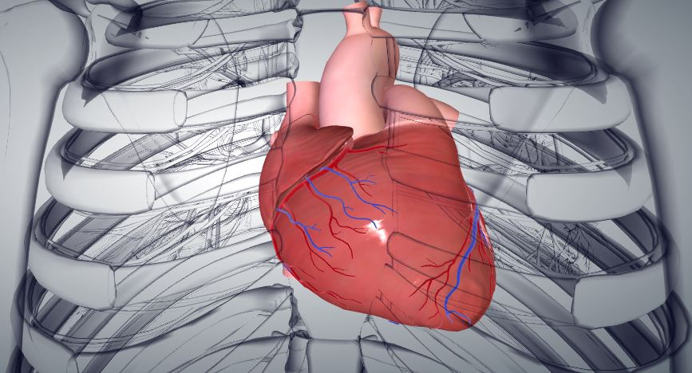
Nomenclature: Acoustic windows
Parasternal
Apical
Subcostal
1
2
Source: BioDigial Human
3

Slide 9
Views
Long Axis (hot dog) plane
Short Axis (hamburger) plane
Four chamber plane
Two chamber plane

Slide 10
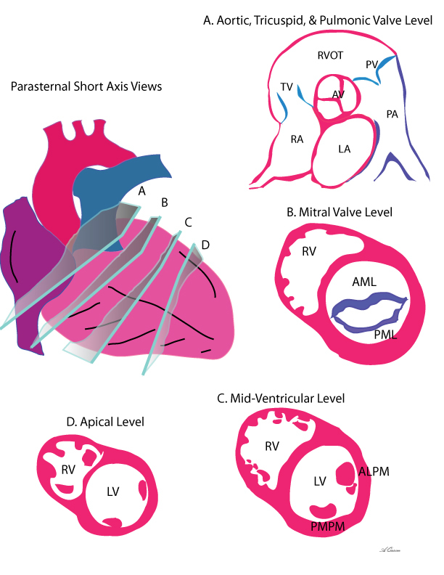
Parasternal Short Axis Levels
A. Aortic Valve Level
B. Mitral valve (basal) level
C. Papillary muscle (mid) level
D. Apical level
Source: Echocardiographer.org
Notes:
http://www.echocardiographer.org/TTE.html

Slide 11
Parasternal Short Axis Levels
Levels
Aortic Valve
Mitral Valve (Basal)
Papillary Muscle (Mid)
Apex
Source: BioDigial Human

Slide 12
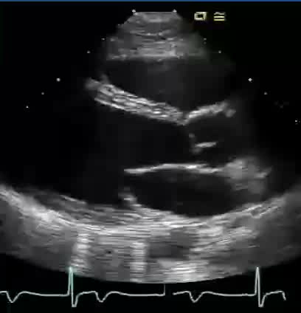
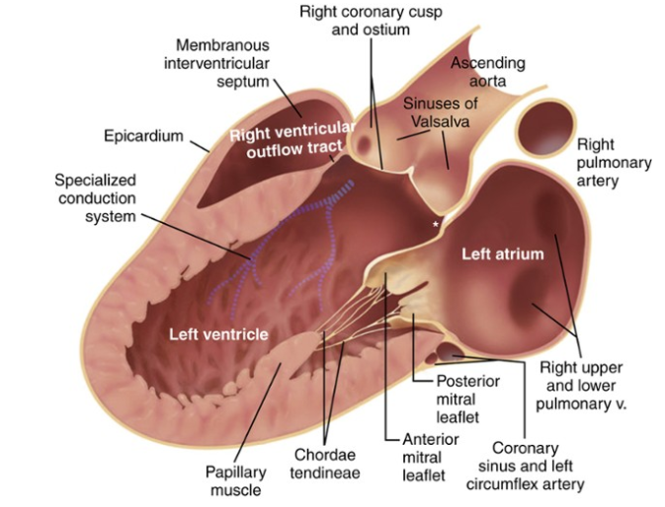
Parasternal Long Axis (PLAX)
Otto CM. Textbook of Clinical Echocardiography. 2013.
Notes:
Otto CM. Textbook of Clinical Echocardiography, Expert Consult - Online and Print. Elsevier Health Sciences; 2013.

Slide 13
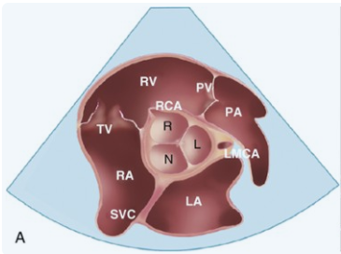
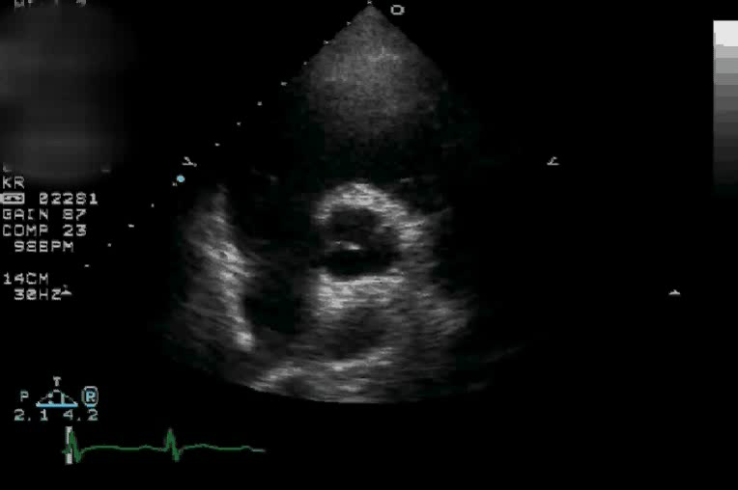
Parasternal Short Axis (PSAX)
Aortic Valve Level
Otto CM. Textbook of Clinical Echocardiography. 2013.
Notes:
Otto CM. Textbook of Clinical Echocardiography, Expert Consult - Online and Print. Elsevier Health Sciences; 2013.

Slide 14
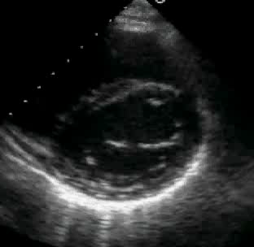
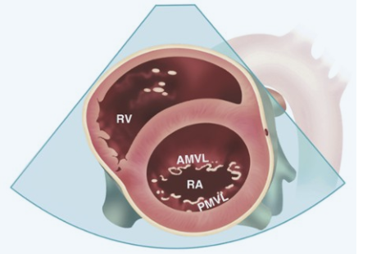
Parasternal Short Axis (PSAX)
Mitral Valve (Basal) Level
Otto CM. Textbook of Clinical Echocardiography. 2013.
Notes:
Otto CM. Textbook of Clinical Echocardiography, Expert Consult - Online and Print. Elsevier Health Sciences; 2013.

Slide 15
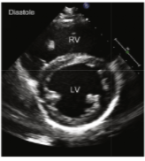
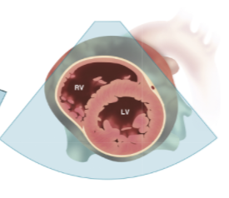
Parasternal Short Axis (PSAX)
Papillary Muscle (Mid) Level
Otto CM. Textbook of Clinical Echocardiography. 2013.
Notes:
Otto CM. Textbook of Clinical Echocardiography, Expert Consult - Online and Print. Elsevier Health Sciences; 2013.

Slide 16
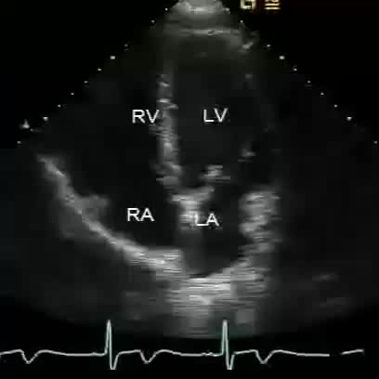
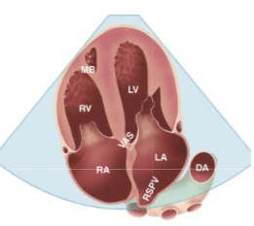
Apical Four Chamber (AP4)
Otto CM. Textbook of Clinical Echocardiography. 2013.
Notes:
Otto CM. Textbook of Clinical Echocardiography, Expert Consult - Online and Print. Elsevier Health Sciences; 2013.

Slide 17
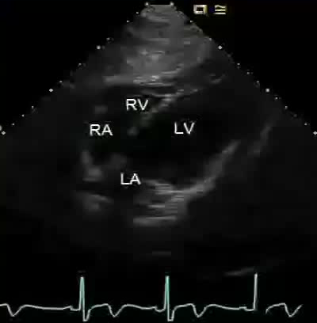
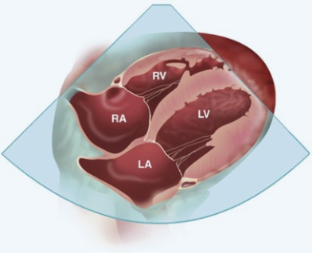
Subcostal
Otto CM. Textbook of Clinical Echocardiography. 2013.
Notes:
Otto CM. Textbook of Clinical Echocardiography, Expert Consult - Online and Print. Elsevier Health Sciences; 2013.

Slide 18
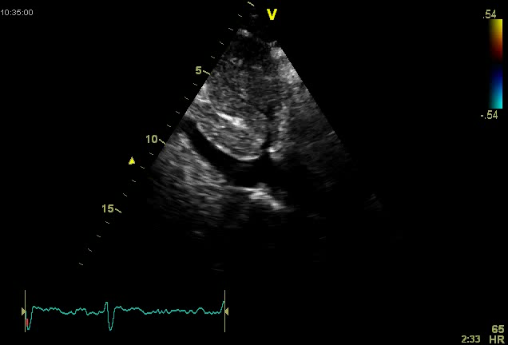
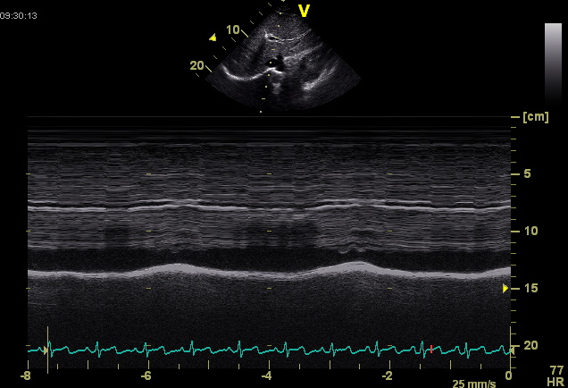
Subcostal: Inferior Vena Cava
Assessment of Central Venous Pressure
Notes:
Beigel R, Cercek B, Luo H, Siegel RJ. Noninvasive evaluation of right atrial pressure. J Am Soc Echocardiogr. 2013;26(9):1033-42.

Slide 19
Subcostal: Inferior Vena Cava
Assessment of Central Venous Pressure
IVC Diameter | Collapsibility | Central Venous Pressure
≤ 2.1 cm | > 50% | 0-5 cmH₂O
≤ 2.1 cm | < 50% | 5-10 cmH₂O
> 2.1 cm | > 50% | 10-15 cmH₂O
> 2.1 cm | < 50% | > 15 cmH₂O
Biegel et al. JASE. 2013.
Notes:
Beigel R, Cercek B, Luo H, Siegel RJ. Noninvasive evaluation of right atrial pressure. J Am Soc Echocardiogr. 2013;26(9):1033-42.

Slide 20
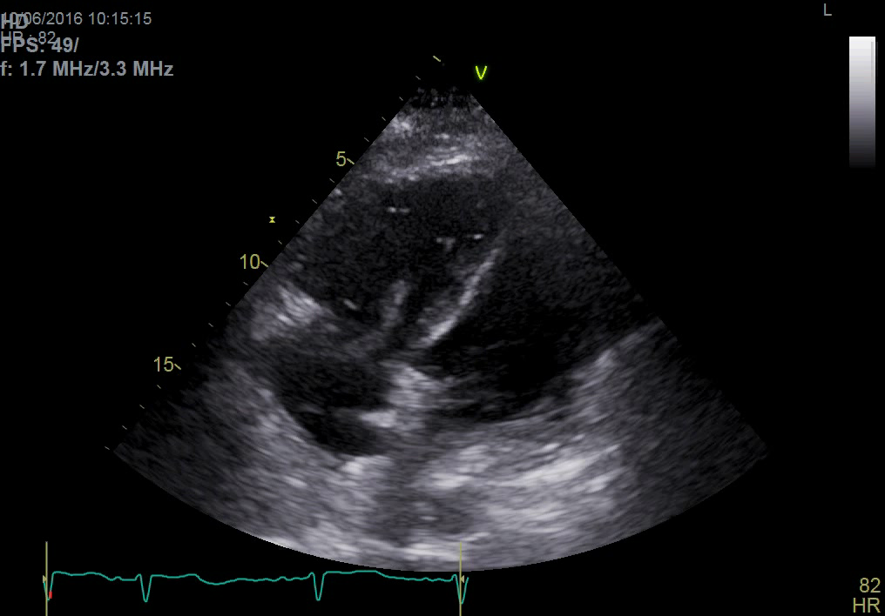
Case 1:
54 F with sudden respiratory failure after hip surgery
Notes:
DEAL 2933460

Slide 21
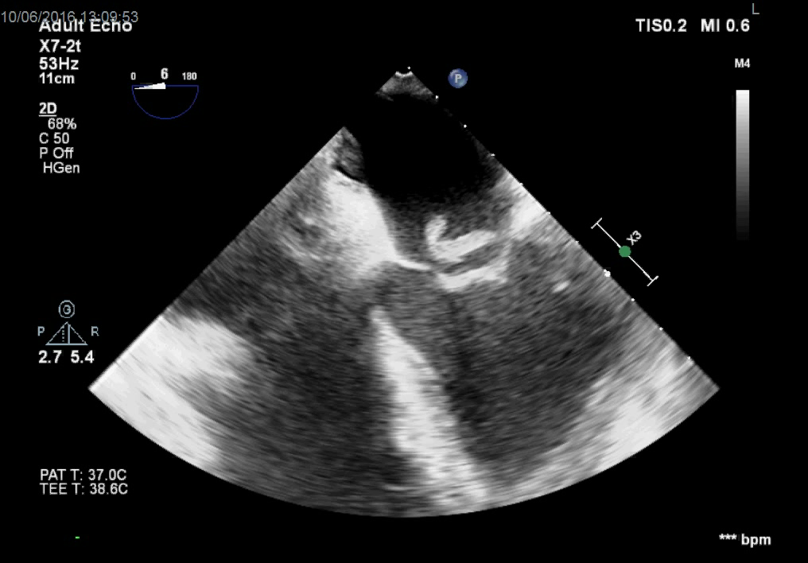

Slide 22
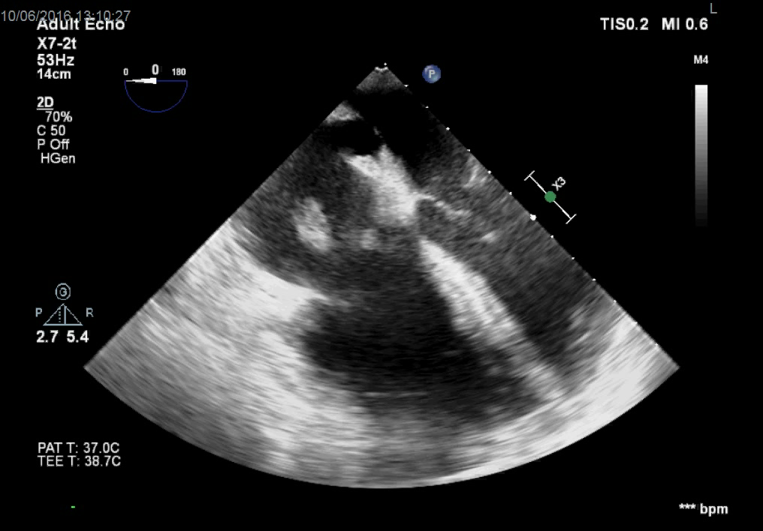

Slide 23
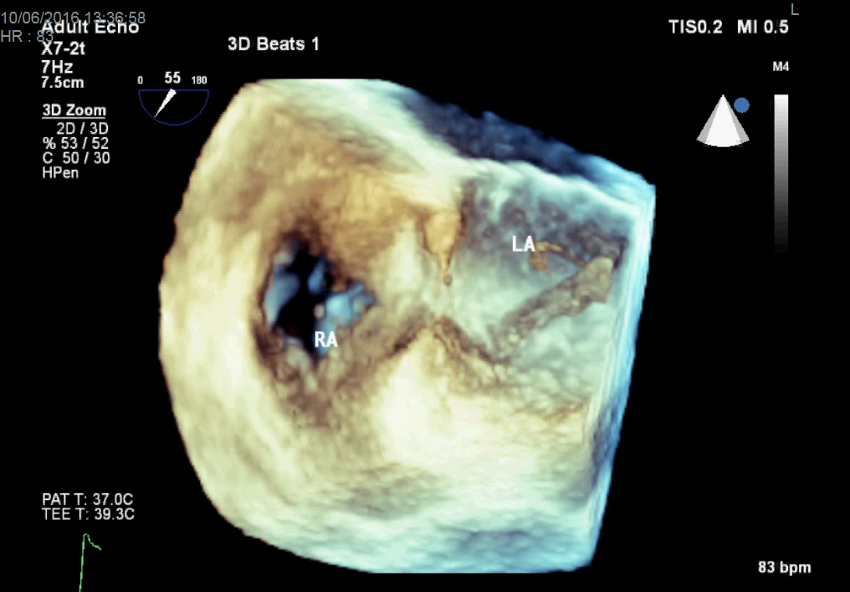

Slide 24
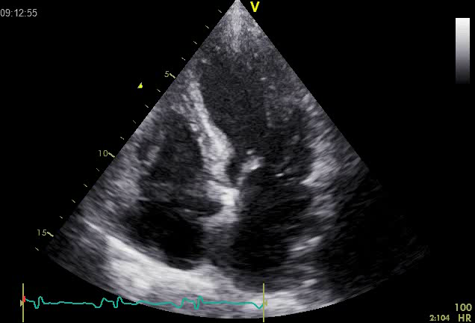
Case 2:
64 F with new heart failure, elevated troponin, clean coronaries

Slide 25
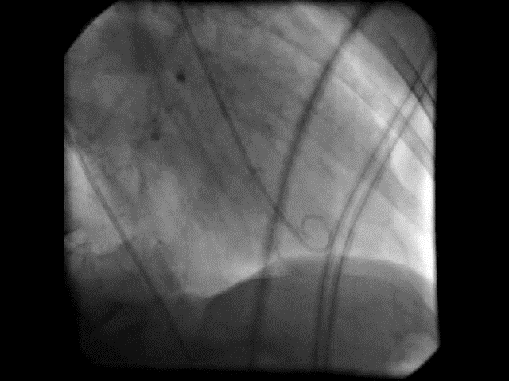
Case 2:
64 F with new heart failure, elevated troponin, clean coronaries
Notes:
Templin C, Ghadri JR, Diekmann J, et al. Clinical Features and Outcomes of Takotsubo (Stress) Cardiomyopathy. N Engl J Med. 2015;373(10):929-38.
Kurisu S, Sato H, Kawagoe T, et al. Tako-tsubo-like left ventricular dysfunction with ST-segment elevation: a novel cardiac syndrome mimicking acute myocardial infarction. Am Heart J. 2002;143(3):448-55.

Slide 26
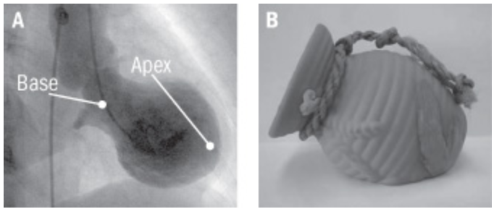
Takotsubo Cardiomyopathy
https://www.health.harvard.edu/heart-health/takotsubo-cardiomyopathy-broken-heart-syndrome
Notes:
https://www.health.harvard.edu/heart-health/takotsubo-cardiomyopathy-broken-heart-syndrome

Slide 27
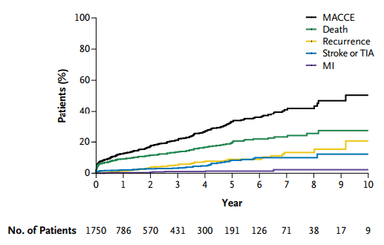
Takotsubo Cardiomyopathy
Templin et al. NEJM. 2015.
Notes:
Templin C, Ghadri JR, Diekmann J, et al. Clinical Features and Outcomes of Takotsubo (Stress) Cardiomyopathy. N Engl J Med. 2015;373(10):929-38.

Slide 28
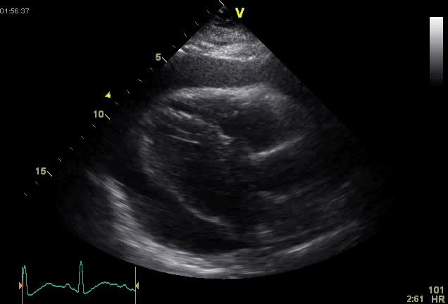
Case 3:
45 F with dyspnea, recent diagnosis of ovarian cancer

Slide 29
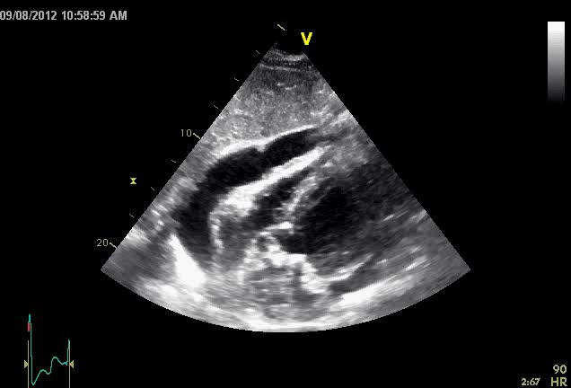
Case 3:
45 F with dyspnea, recent diagnosis of ovarian cancer

Slide 30
Etiology of Pericardial Effusions
The most common causes of moderate to large effusions in developed countries:
  Idiopathic/viral (30-40%), iatrogenic (16%), malignancy (13%), post-MI (8%), uremia (6%), bacterial/MTB infection (6%), collagen vascular disease (5%), hypothyroidism (2%)
Causes of hemodynamically significant pericardial effusions (dyspnea, tachycardia, tamponade) from a study of 173 patients with pericardicentesis⁵
  Neoplastic: 33% (20% new diagnosis of malignancy), Chronic-idiopathic: 14%, Acute pericarditis: 12%, Traumatic: 12%, Bacterial: 4%
In developing countries tuberculosis is the leading cause of pericardial effusion (up to 60% of cases)
Ben-Horin et al. Medicine. 2006.
Notes:
Ben-horin S, Bank I, Guetta V, Livneh A. Large symptomatic pericardial effusion as the presentation of unrecognized cancer: a study in 173 consecutive patients undergoing pericardiocentesis. Medicine (Baltimore). 2006;85(1):49-53.

Slide 31
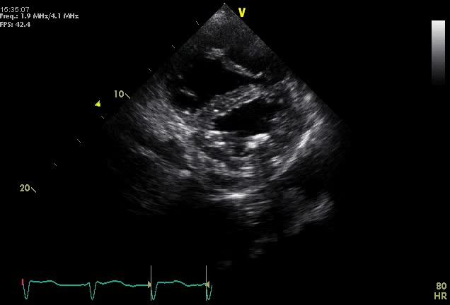
Case 4:
74 M with COPD presents with ascites, lower extremity edema, clear lungs.
Notes:
Nardone (2938998)
LV Clot

Slide 32
Right Ventricular Pressure vs. Volume Overload
D-shaped septum
  In systole → Pressure overload
  In diastole → Volume overload
Rudski et al. JASE. 2010.
Notes:
Rudski LG, Lai WW, Afilalo J, et al. Guidelines for the echocardiographic assessment of the right heart in adults: a report from the American Society of Echocardiography endorsed by the European Association of Echocardiography, a registered branch of the European Society of Cardiology, and the Canadian Society of Echocardiography. J Am Soc Echocardiogr. 2010;23(7):685-713.

Slide 33
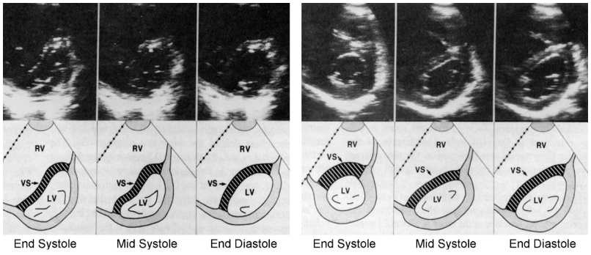
Right Ventricular Pressure vs. Volume Overload
Pressure Overload: Precapillary P-HTN
Volume Overload: Tricuspid regurgitation
Rudski et al. JASE. 2010.
Notes:
Rudski LG, Lai WW, Afilalo J, et al. Guidelines for the echocardiographic assessment of the right heart in adults: a report from the American Society of Echocardiography endorsed by the European Association of Echocardiography, a registered branch of the European Society of Cardiology, and the Canadian Society of Echocardiography. J Am Soc Echocardiogr. 2010;23(7):685-713.

Slide 34
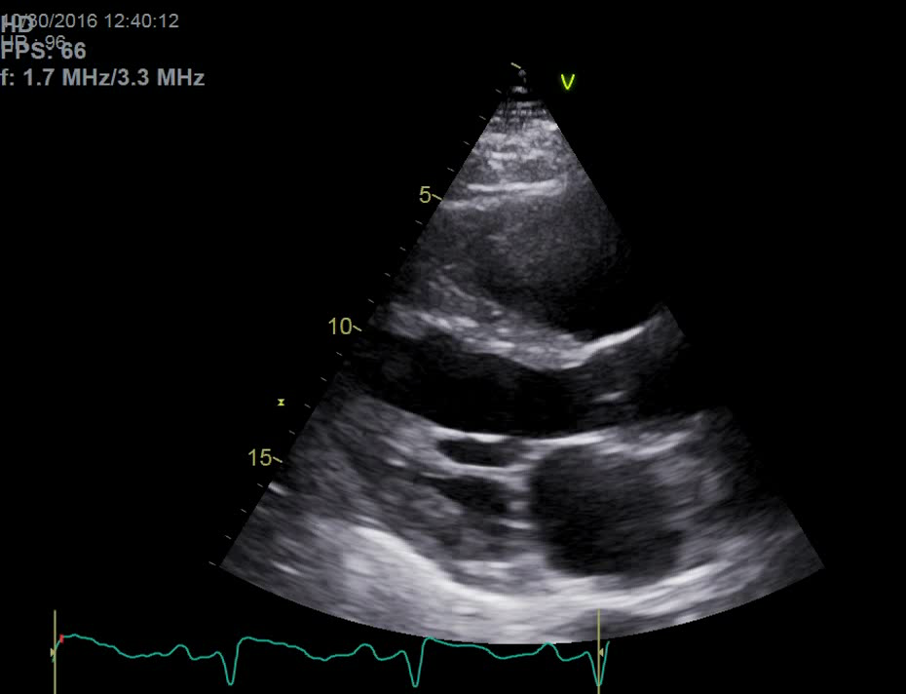
Case 5:
48 M with dyspnea, found to have elevated troponin-T to 6.84 ng/dL
Notes:
Nardone (2938998)
LV Clot

Slide 35
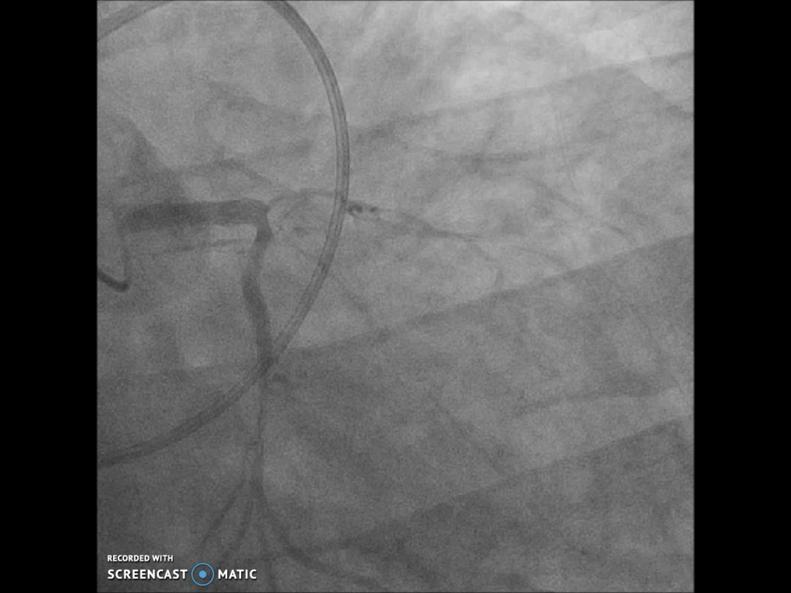
Case 5:
48 M with dyspnea, found to have elevated troponin-T to 6.84 ng/dL

Slide 36
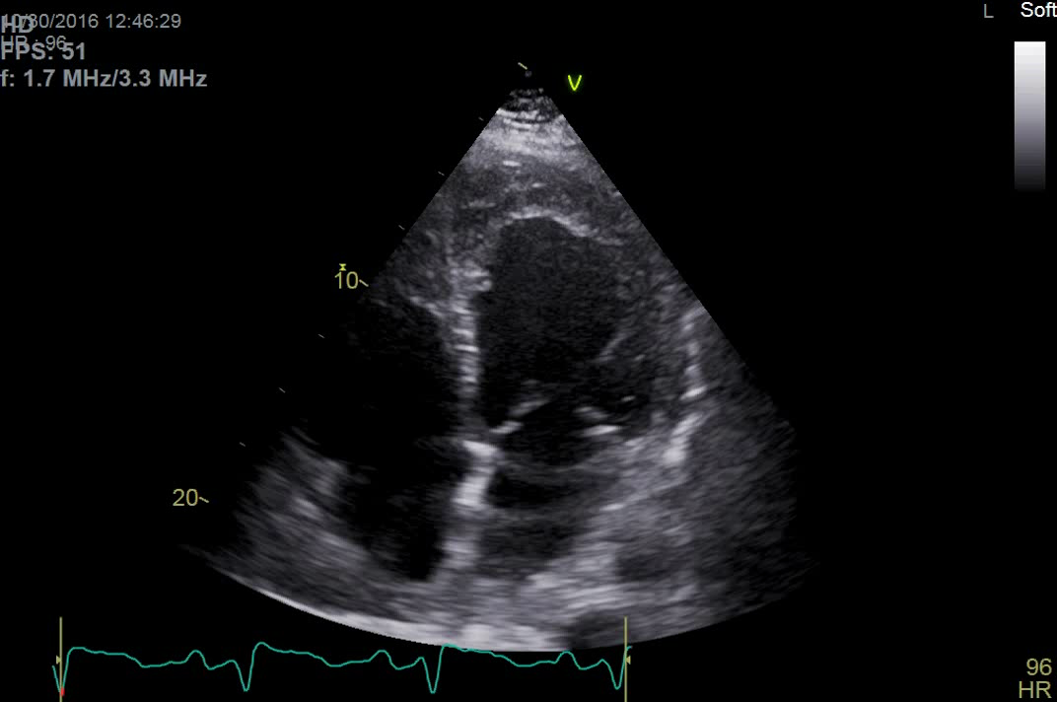
Case 5:
48 M with dyspnea, found to have elevated troponin-T to 6.84 ng/dL

Slide 37
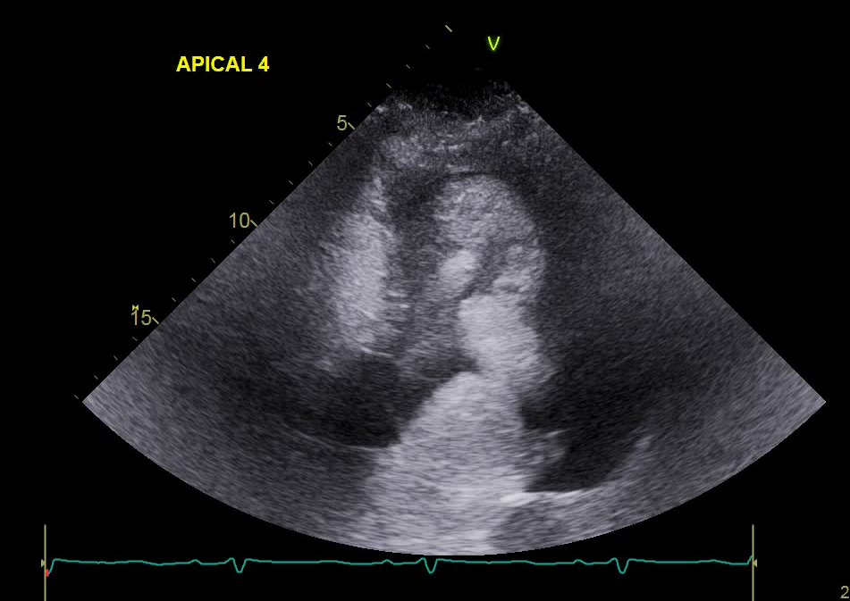
Case 4:
48 M with dyspnea, found to have elevated troponin-T to 6.84 ng/dL

Slide 38
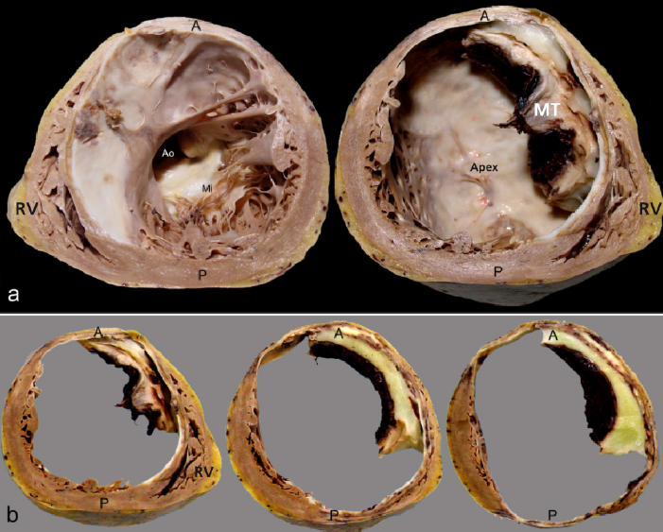
Mural Thrombus Complicating MI
Hironaka et al. Arq Bras Cardiol. 2009.
Notes:
Hironaka GK, Esper RB, Cesar LA, Dias CG, Mathias W, Castelli JB. Case 3/2009--a 75-year-old man with heart failure after myocardial infarction and ventricular aneurysm. Arq Bras Cardiol. 2009;93(1):64-73.

Slide 39
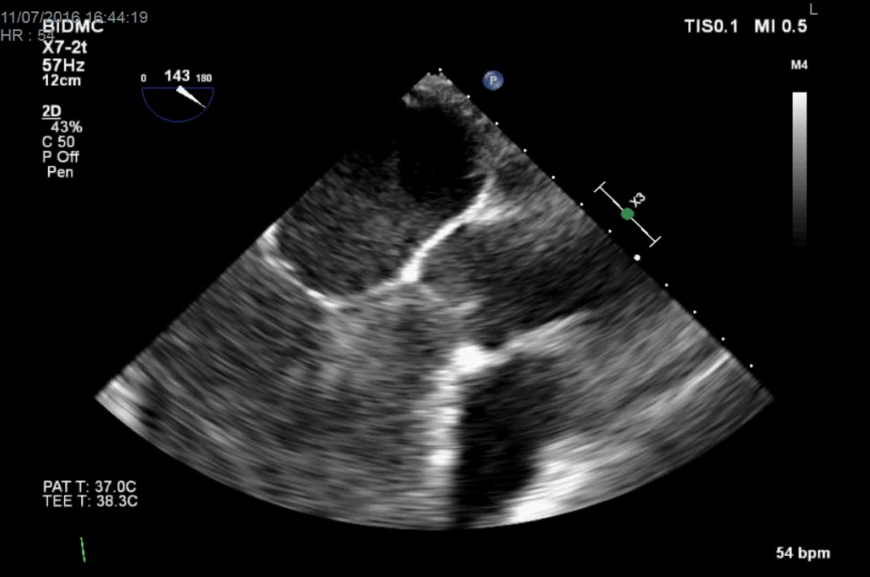
Case 4:
48 M with dyspnea, found to have elevated troponin-T to 6.84 ng/dL

Slide 40
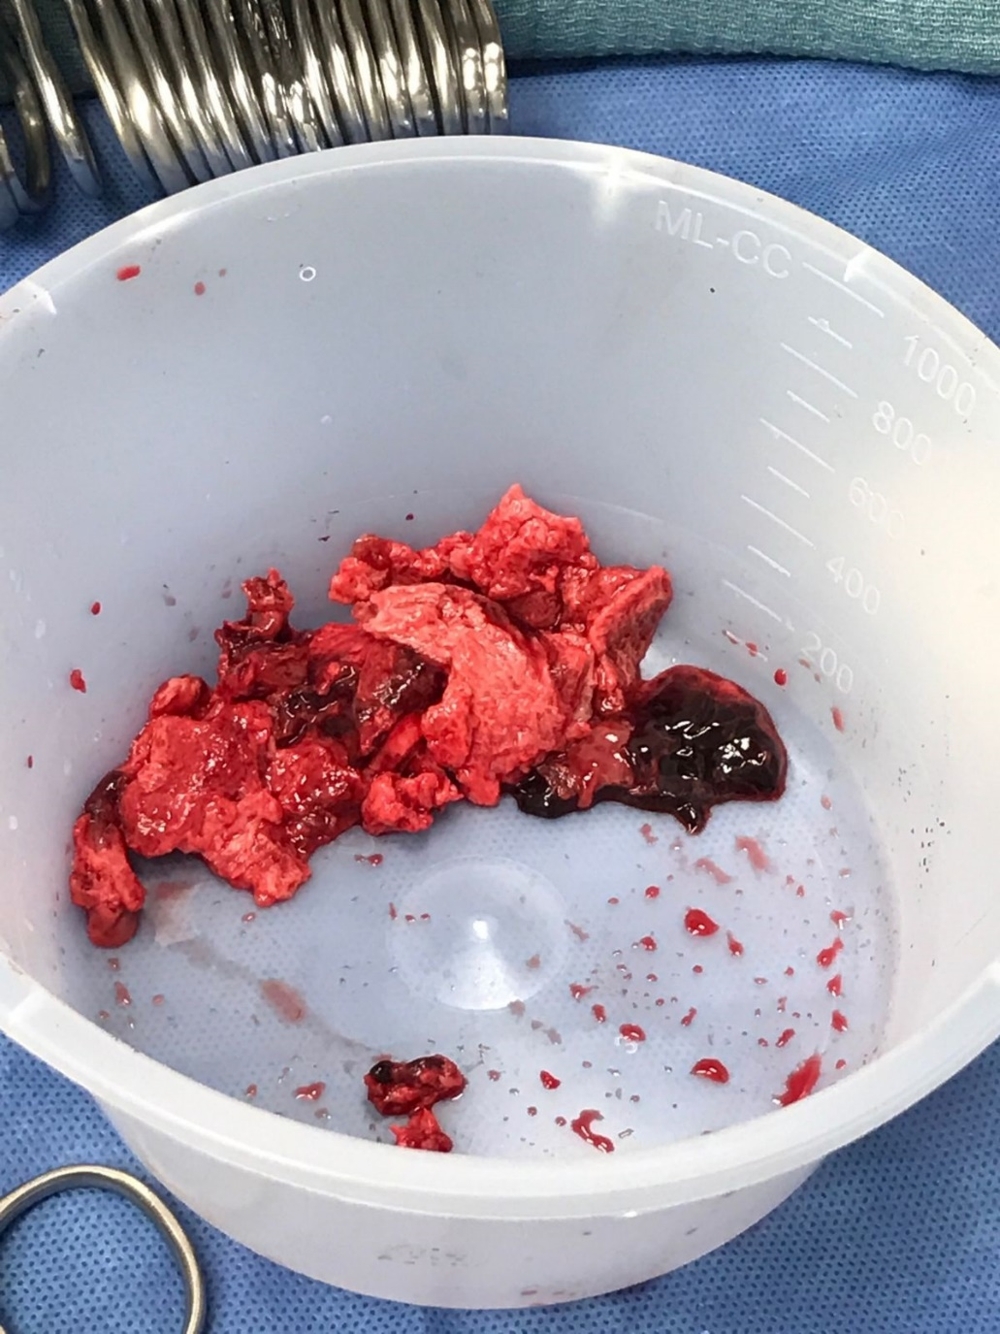

Slide 41
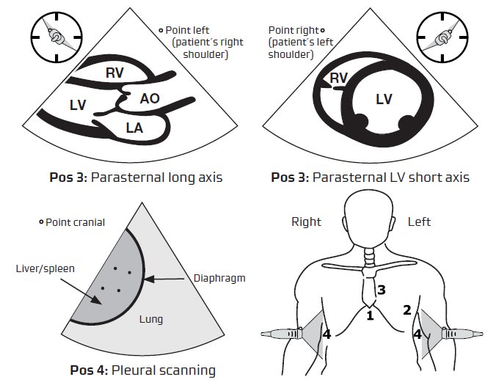
Focused Assessed Transthoracic Echo (FATE)

Slide 42
Additional Resources
Focused Assessed Transthoracic Echo (FATE): A great 2 page handout on echo. (http://usabcd.org/node/35)
Transthoracic Echocardiography Simulator with cases: http://pie.med.utoronto.ca/TTE/TTE_content/focus.html
MarkTuttleMD.com

