Slide 1




Cardiology Case 1
Mark Tuttle, MD
Sunday, September 18, 2016
Notes:
RV infarct, GI bleed

Slide 2
History of present illness
A 70 year old man with a history of peripheral vascular disease s/p femoral-popliteal bypass, right dominant femoral artery endarterectomy, CHF (EF 30-35%), history of severe GI bleeds presents from the OSH ED with fatigue, lightheadedness, nausea, and vomiting.
He had a large dinner, followed by a large non-bloody emesis, and a restless night in bed.
The following day he saw his PCP who found him to be hypotensive and he referred him to the OSH ED.

Slide 3
Review of systems
On review of systems, he denies recent dark-colored or bloody stools, although he says his stools are always dark due to iron pills.
He denies chest pain, palpitations, syncope, shortness of breath, fevers, chills, cough, or abdominal pain.

Slide 4
OSH ED Course
In the outside ED orthostatics were symptomatic:
  Lying: 112/48 (HR 79)
  Sitting: 85/73 (HR 80)
  Standing: 93/45 (HR 101).
His labs were notable for:
  TnI 57.3 (normal: 0.0-0.06, comparable to TnT 5.7)
  CK MB 308.9
  CK 2,189
  Cr 1.6 (baseline 1.0)
  Hct 31.1 (baseline 27)
  AST 177

Slide 5
OSH COURSE
His EKG reportedly showed ST depression in V5-V6.
He was given 2.5 L boluses of normal saline, which improved his symptoms.
He was also given 324mg of aspirin, pantoprazole (given GIB history) and transferred for possible cardiac catheterization.

Slide 6
Past Medical History
Peripheral vascular disease:
  Right superficial femoral artery PTA/stent (2009)
  R common femoral endarterectomy
Heart failure with reduced ejection fraction (LVEF 20-30%)
Transient ischemic attack
Hypertension
Dyslipidemia
Massive GI bleeds: Several hospitalizations requiring transfusions thought to be secondary to AVMs
Alcoholism: complicated by DTs in 2009, hemorrhagic duodenitis

Slide 7
Medications
Furosemide 20 mg
Lisinopril 10 mg
Carvedilol 25 mg
Pantoprazole 40 mg
Ferrous Sulfate 325 mg
Rosuvastatin 20 mg
Isosorbide Mononitrate 60 mg
Fluticasone-Salmeterol Diskus
Gabapentin 200 mg PO Daily

Slide 8
Social History
Occupation: He is a married, retired former carpenter.
Tobacco history: 60 pack years. Patient reports quitting but his wife reports he is still actively smoking.
EtOH: 6-8 beers/day quit in 2009; denies current use.
Illicit drugs: Never

Slide 9
Family History
No family history of early MI, arrhythmia, cardiomyopathies, or sudden cardiac death; otherwise non-contributory. His father had diabetes. He has 2 daughters ages 40 and 36 all alive and well.

Slide 10
Physical Exam
T 97.7 BP 112/48 HR 79 RR 18 SpO2100% RA
Sitting: 85/73 (HR 80), Standing: 93/45 (HR 101).
General: Elderly gentleman in NAD.
CV: Distant heart sounds but RRR. No murmurs. JVD 12 cm H2O at 30 degrees.
Lungs: Faint wheezes but otherwise clear to auscultation bilaterally. Breathing comfortably.
Abdomen: Soft, NT/ND.
Rectal: Guaiac testing performed and negative. No gross blood on exam.
Ext: He has notable scar on right medial lower extremity from prior stent placement.

Slide 11
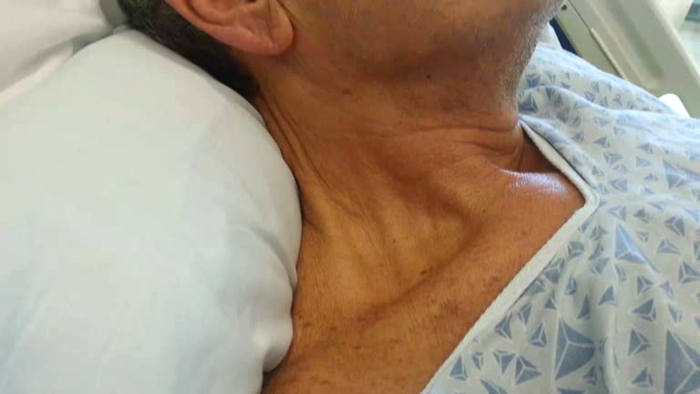

Slide 12
Initial Labs
Ca²⁺: 8.3
Mg²⁺: 2.0
PO₄³⁻: 2.6
8
143 | 92 | 26
3.5 | 25 | 0.9
5.5
227
145
24
Troponin-T: 6.45
D-Dimer: 2,117 (normal range: 0-500)

Slide 13
Causes of elevated troponin
Ischemic
  Acute coronary syndromes: STEMI, NSTEMI
  Non-ACS
    Coronary: Demand ischemia, hypertension, spasm, embolism, cocaine
    Non-coronary: Hypoxemia, global ischemia/anemia
Non-ischemic
  Cardiac: Heart failure, cardiomyopathy, myocarditis, trauma, infiltrative
  Systemic: Pulmonary embolism, toxicity (anthracyclines), renal failure, sepsis, subarachnoid hemorrhage
JACC. 2012.

Slide 14
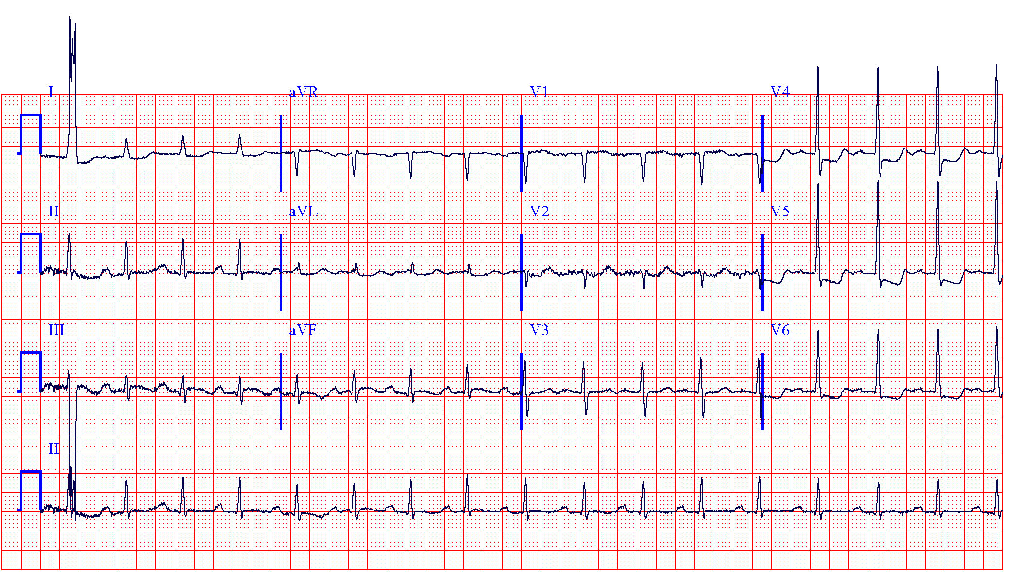

Slide 15
Should we cath him now?
Notes:
Amsterdam EA, Wenger NK, Brindis RG, et al. 2014 AHA/ACC Guideline for the Management of Patients with Non-ST-Elevation Acute Coronary Syndromes: a report of the American College of Cardiology/American Heart Association Task Force on Practice Guidelines. J Am Coll Cardiol. 2014;64(24):e139-228.

Slide 16
TIMI Score for UA/NSTEMI
Death, MI, Urgent revascularization @ 14 days
One point for:
Age ≥ 65
Risk factors ≥ 3
Stenosis > 50%
ECG changes (ST deviation)
Recurrent angina
Biomarkers ↑
Aspirin in last week
Cannon et al. JAMA. 2000.
Notes:
Cannon CP, Weintraub WS, Demopoulos LA, et al. Comparison of early invasive and conservative strategies in patients with unstable coronary syndromes treated with the glycoprotein IIb/IIIa inhibitor tirofiban. N Engl J Med. 2001;344(25):1879-87.

Slide 17
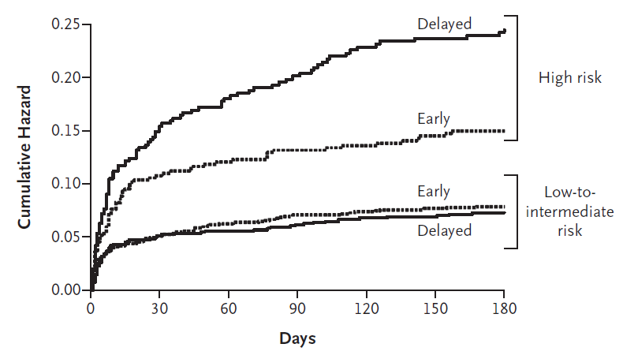
TIMACS Trial
Mehta et al. NEJM . 2009.
Notes:
Primary Endpoint: Composite risk of death, recurrent MI, or stroke at 6 months.
Rndomly assigned 3031 patients with acute coronary syndromes to undergo either routine early intervention (coronary angiography ≤24 hours after randomization) or delayed intervention (coronary angiography ≥36 hours after randomization)
Mehta SR, Granger CB, Boden WE, et al. Early versus delayed invasive intervention in acute coronary syndromes. N Engl J Med. 2009;360(21):2165-75.

Slide 19
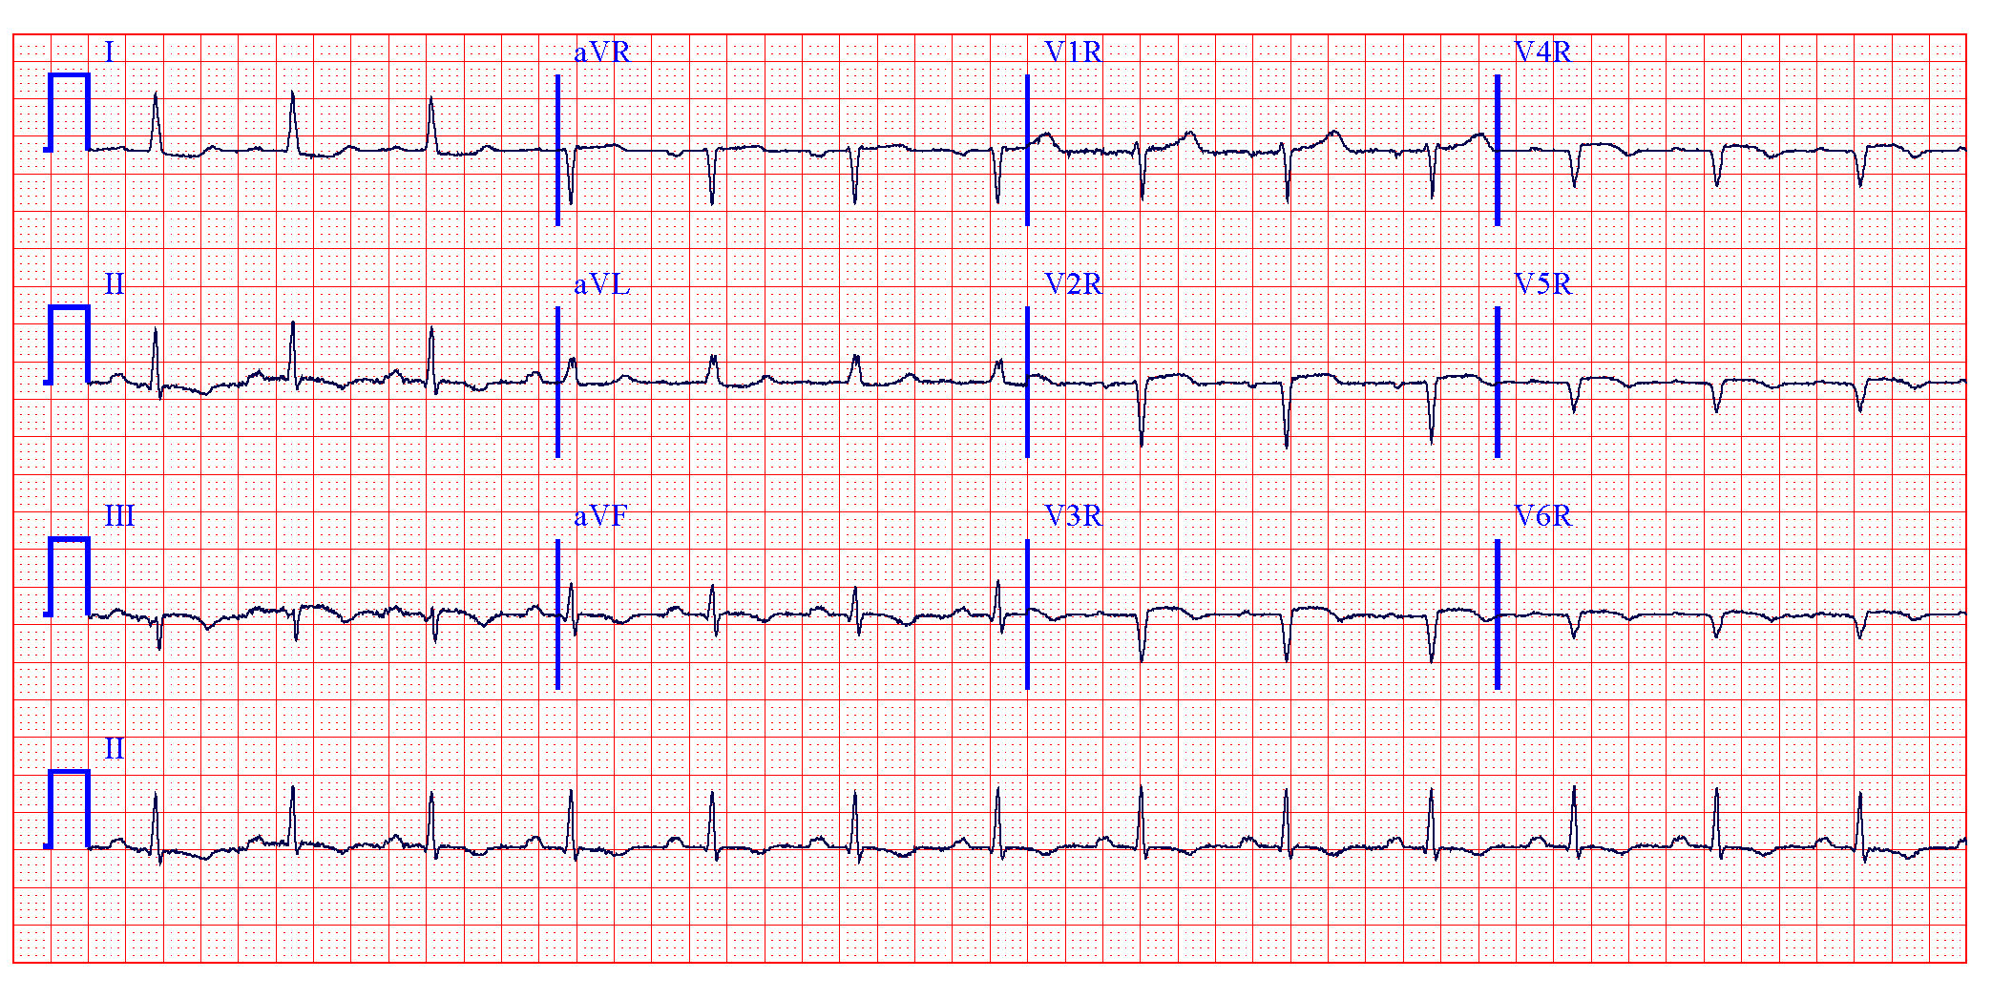
Right-sided precordial leads
AV delay. Non-diagnostic inferior ST segment elevation with ST segment depression in the lateral leads suggestive of an inferolateral myocardial infarction.
Notes:
AV delay. Non-diagnostic inferior ST segment elevation with ST segment depression in the lateral leads suggestive of an inferolateral myocardial infarction.

Slide 20
Definition of STEMI
ST segment elevation of ≥1 mm (0.1 mV) in contiguous chest leads or limb leads
EXCEPTION: ST segment elevation of ≥2 mm (0.2 mV) in men or ≥1.5 mm (0.15 mV) in women in leads V2–V3
Circulation. 2012.
Notes:
Thygesen K., Alpert J.S., Jaffe A.S., et al; Third universal definition of myocardial infarction. Circulation. 2012;126:2020-2035.

Slide 21
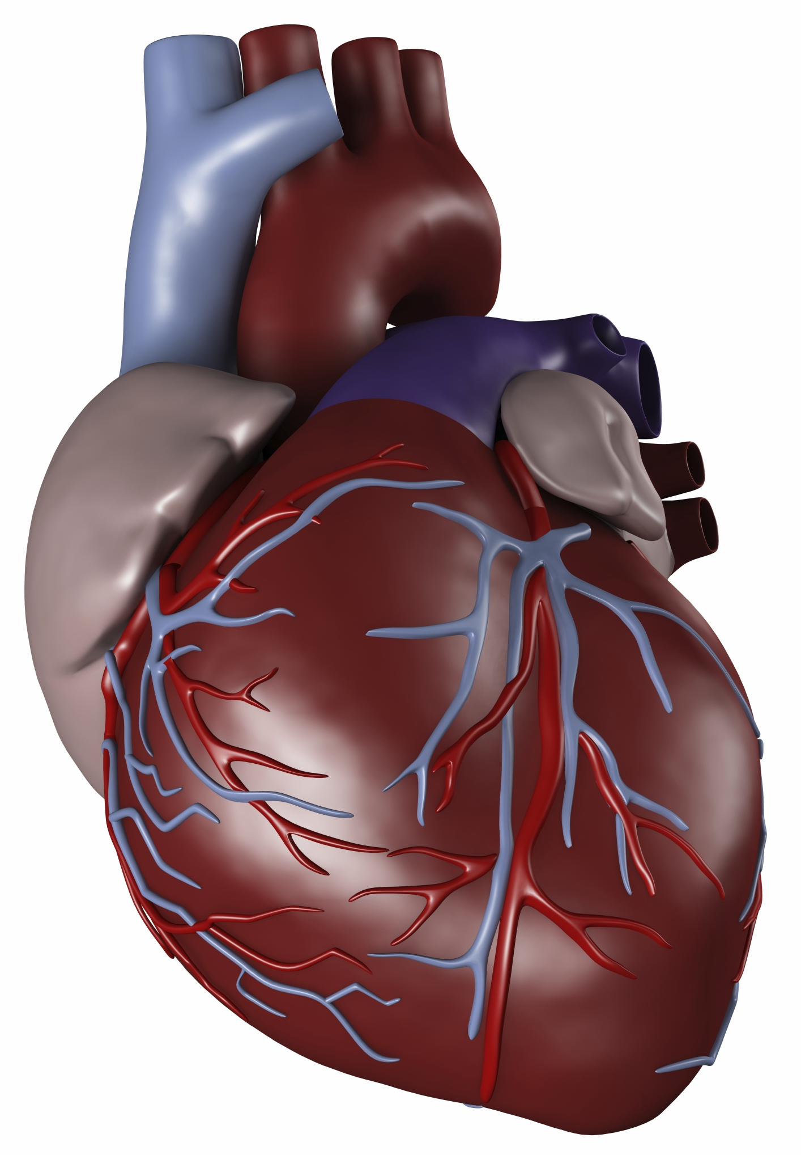
Infarct localization
ST elevation in II, III, aVF (inferior, 40-50% of MIs)
  II > III suggests LCx lesion
  III > II suggests RCA lesion
    V4R: ST elevation (proximal), isoelectric (distal)
ST elevation in V₁, V₂, V₃: LAD
  ST elevation > 2.5 mm in V₁: pLAD (12% Sn, 100% Sp)
  ST elevation in II, III, aVF: pLAD (66% Sn, 73% Sp)
aVR
aVL
I
III
II
aVF
Zimetbaum, Josephson. NEJM. 2003.

Slide 22
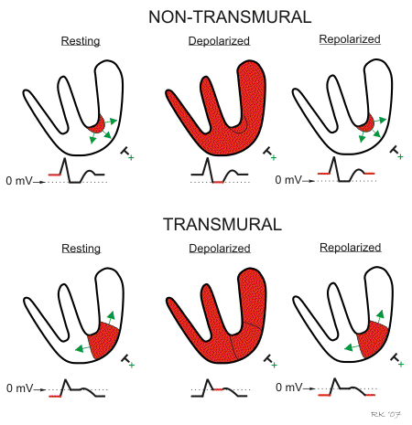
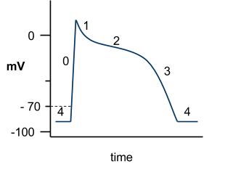
Mechanism of ST changes
Myocyte action potential
CVphysiology.com

Slide 23
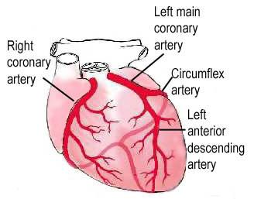
Coronary Anatomy

Slide 24
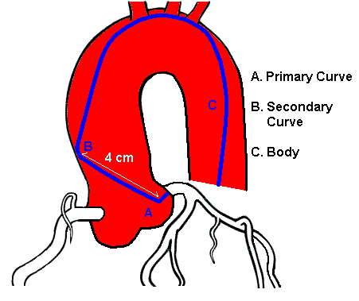
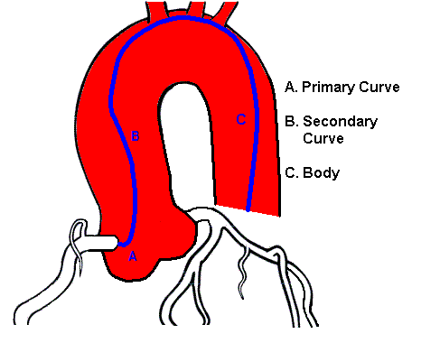
Angiography
Accessing left main coronary
artery (LMCA)
Accessing right coronary artery (RCA)

Slide 25
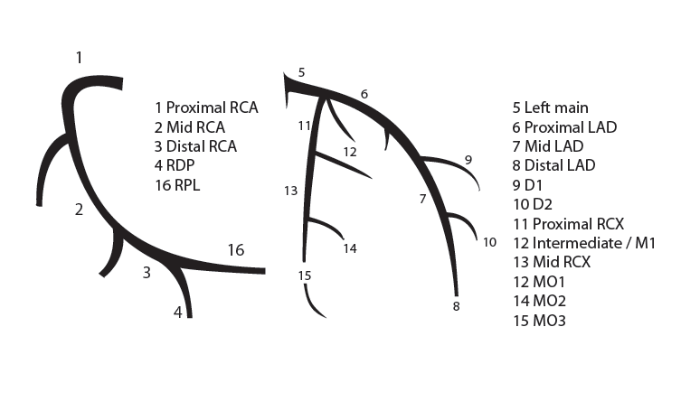
Coronary Anatomy
RCA
LMCA

Slide 26
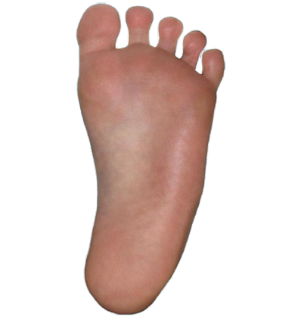
Angiographic projections
Anteroposterior (AP)

Slide 27
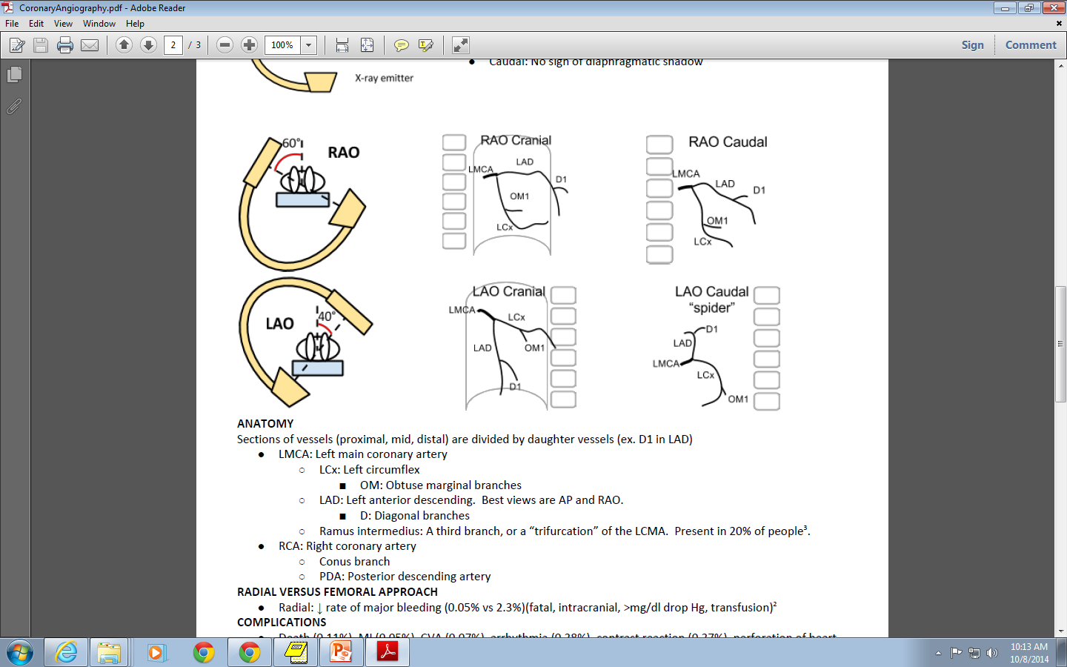
Angiographic projections
Left anterior oblique (LAO)
LMCA
LCx
LAD
OM1
D1

Slide 28
Angiographic projections
Left anterior oblique (LAO)
RCA
SA nodal
AM
PDA

Slide 29
What projection is this? Can you identify the vessels?
The spine is on the patient’s right side
Right anterior oblique (RAO)
LMCA
LAD
D1
LCx
OM1
The LCx is closer to the spine than the LAD
Notes:
LMCA = Left main coronary artery
LAD = Left anterior descending
D1 = First diagnoal branch
OM1 = First obtuse marginal branch

Slide 30
What projection is this? Can you identify the vessels?
Left anterior oblique (LAO)
LMCA
LCx
LAD
OM1
D1
Notes:
LMCA = Left main coronary artery
LAD = Left anterior descending
D1 = First diagnoal branch
OM1 = First obtuse marginal branch

Slide 31
What projection is this? Can you identify the vessels?
Left anterior oblique (LAO)
RCA
SA nodal
AM
PDA
Notes:
RCA = right coronary artery
AM = acute marginal
PDA = posterior descending artery

Slide 32
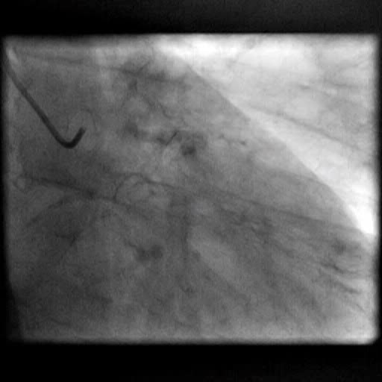
Right anterior oblique (RAO) of LMCA
LAD: long 70% mid, 50% major diagonal
LCX: 60% OM1

Slide 33
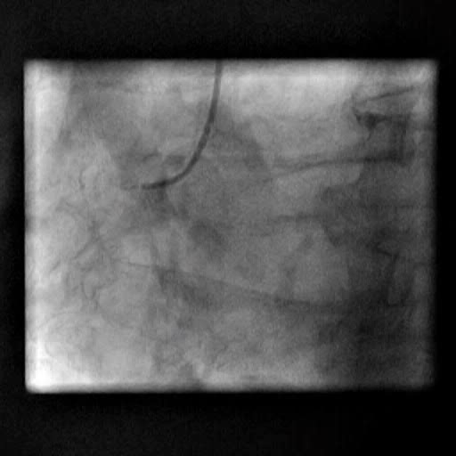
Left anterior oblique (LAO) of RCA
RCA: 100% proximal with L to R collaterals to distal RCA

Slide 34
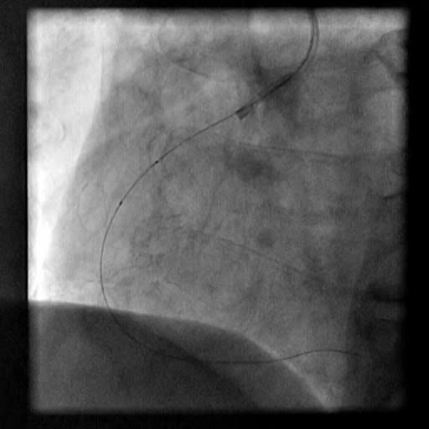
Left anterior oblique (LAO) of RCA

Slide 35
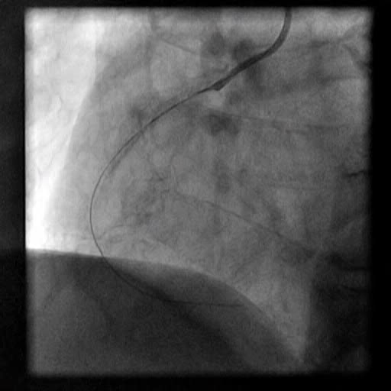
Left anterior oblique (LAO) of RCA

Slide 36
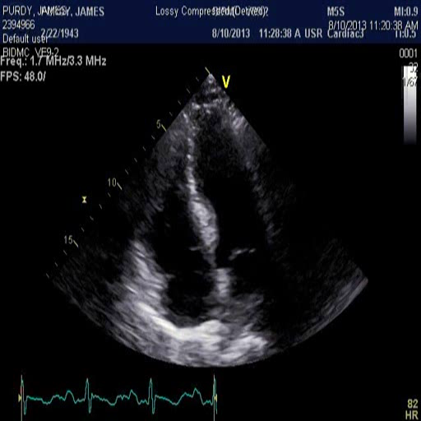
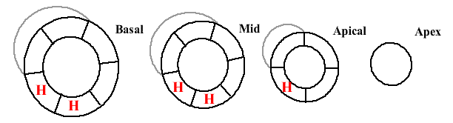
LVEF 40%
Infero-postero MI with RV involvement

Slide 37
Discharge
Started on clopidogrel, continued on aspirin
Patient feels great

Slide 38
Until…
Eight days after discharge, the patient notes two episodes of sub-sternal chest pain with associated SOB at home and his wife convinces him to come to the local ED.
Per his wife, he had been feeling progressively weaker since his discharge, but he was unwilling to seek attention until today.
The OSH ED is aware that he had a recent stent placed
T 98.4 HR 127 BP 149/53 RR 19 O2 100% on 2LNC
On exam, he is noted to be in moderate distress and pale, but with a normal heart and lung exam.

Slide 39
Post-MI complications
Re-infarction
Bleeding
Pseudoaneurysm
Ventricular septal defect (<1%)
Ventricular free wall rupture (0.2%)
Pericarditis
Mitral regurgitation
In-stent thrombosis

Slide 40
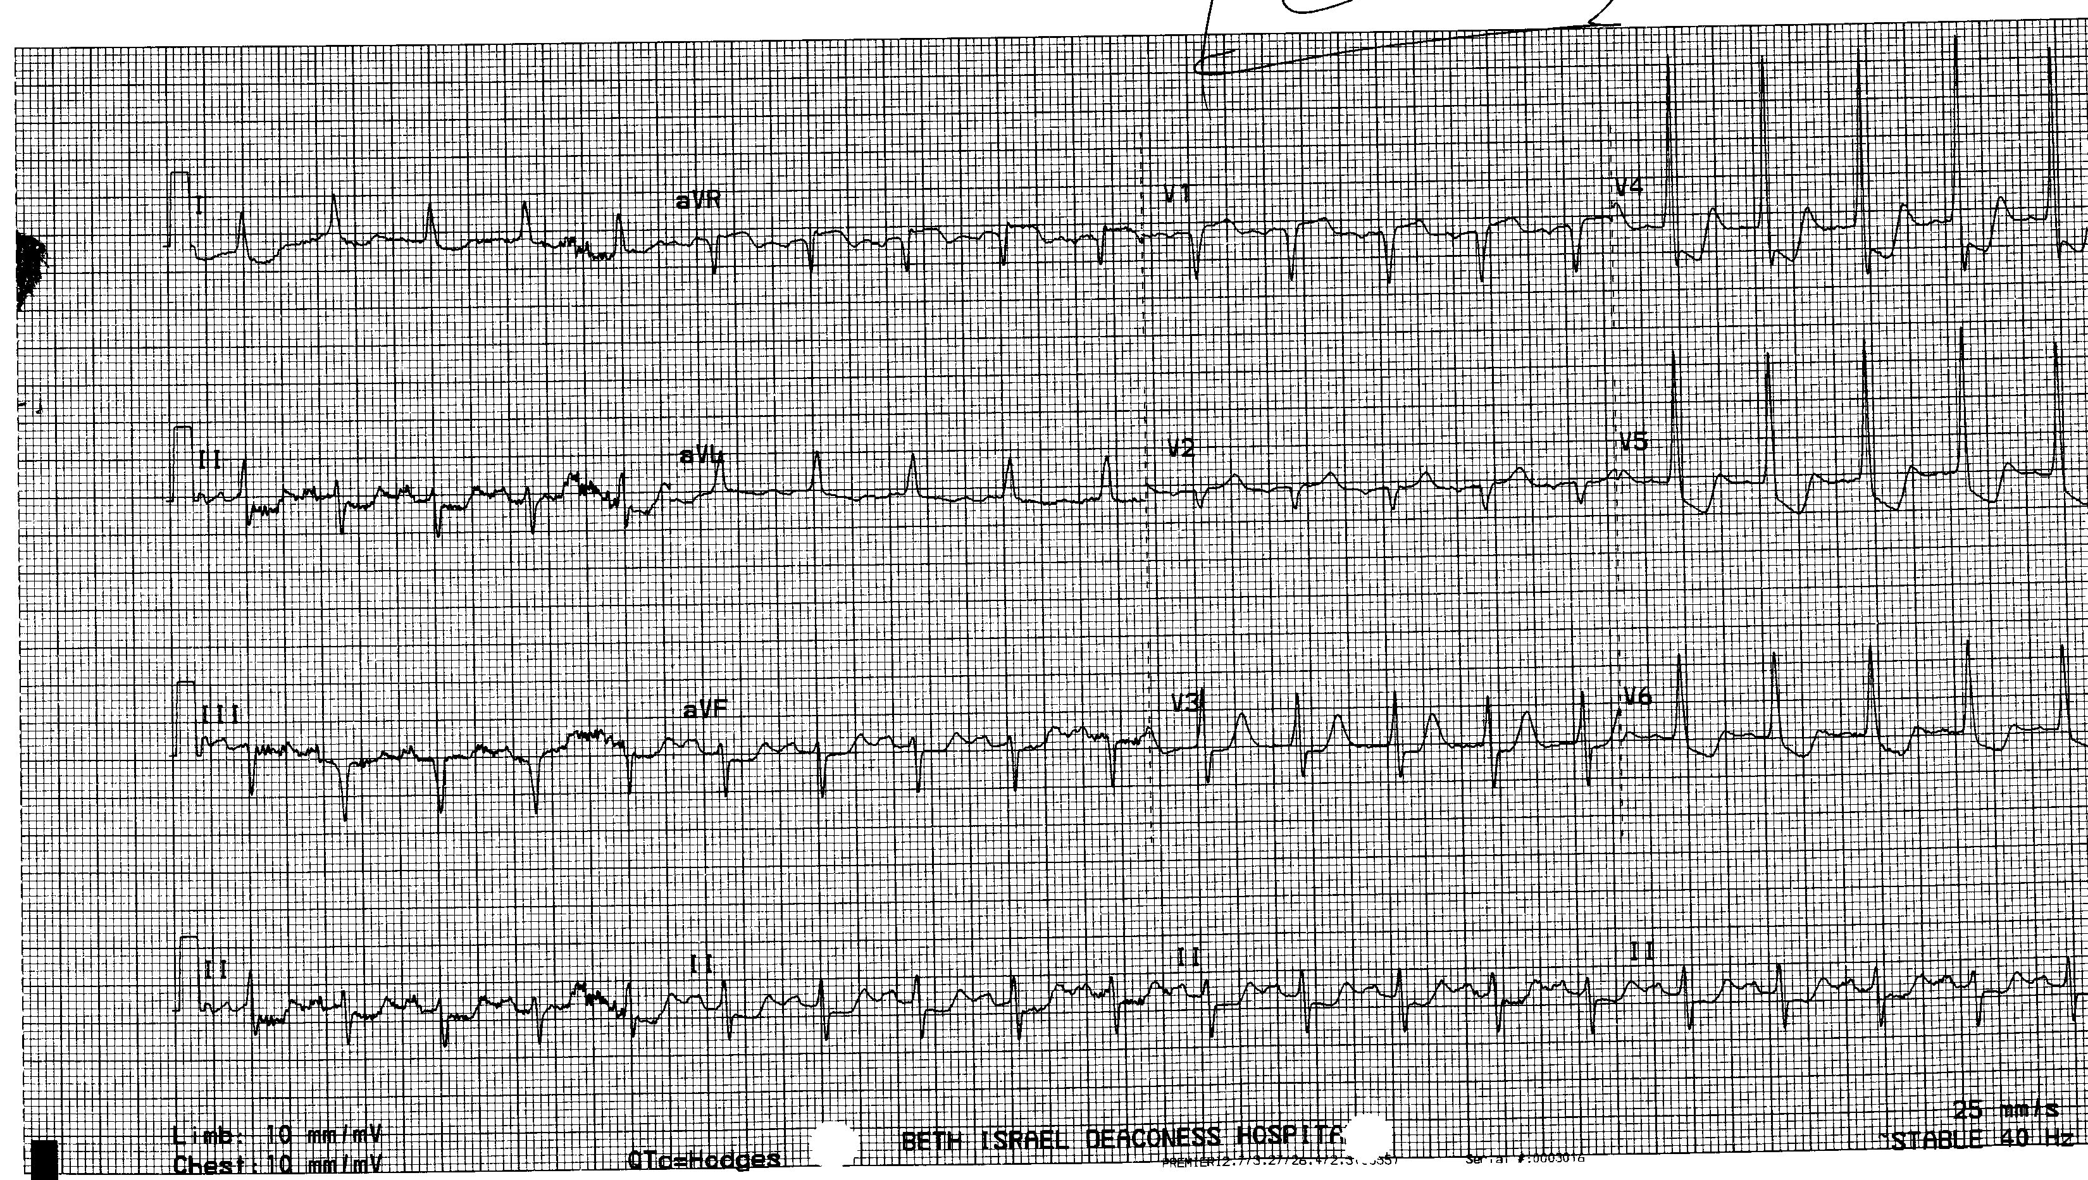

Slide 41
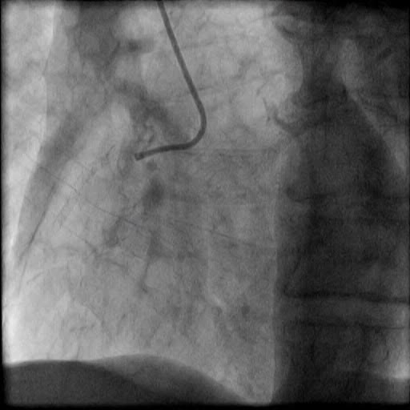

Slide 42
Labs
5
11
446
16
D-Dimer: 2,117 (normal range: 0-500)

Slide 43
Learning points
RV infarcts present with hypotension, jugular venous distension, and clear lungs
Elevated troponin is not always due to plaque rupture and occlusion (acute coronary syndrome)
When examining angiography, the side where the patient’s spine lies determines if it is RAO or LAO.
When engaging the LMCA, the LCx is on the side of the spine
Keep a broad differential and consider all available information, even when ST elevation is present

